Slide 1
Vehicular Speed Estimation using Received Signal Strength from Mobile Phones
Rutgers: Gayathri Chandrasekaran, Tam Vu, Marco Gruteser, Rich Martin,
ATT Labs: Alex Varshavsky
Stevens Institute: Jie Yang, Yingying Chen
Notes:
Need 25 slides in total including future work, etc.. – talk is for 25 minutes and 5 minutes of questions.

Slide 2
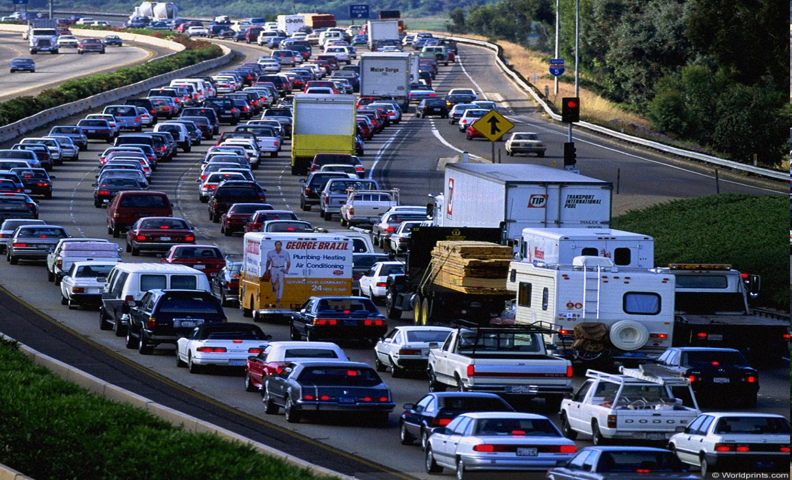
Why is Speed Estimation Interesting ?
Accurate, Real-Time traffic information is not readily available to drivers
Applications
Congestion Avoidance
Traffic Engineering
  Bottleneck detection
  Impact of construction work

Slide 3
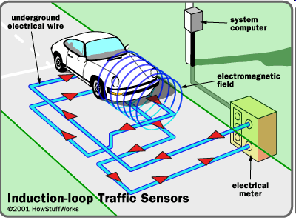
Speed Detection – Fixed Infrastructure(1)
Use of Loop Detectors (Sensors) embedded in the road segments -- Expensive

Slide 4

Speed Detection – Smartphones (2)
Use of GPS Enabled Probe Vehicles who transmit their location to a central server periodically
Cost & Privacy Issues
Significant Energy Consumption (GPS ~ 1000mj)
Virtual Triplines - NOKIA

Slide 5



Speed Detection – Cellular Phone Locations (3)
Coarse grained estimate – Red, yellow, green
Is it Really Real-Time ?
What are the Accuracy Limitations ?
Notes:
CDMA based localization

Slide 6
GOALS
GOAL 1 : Experimentally establish the accuracy limits for the existing GSM based techniques
Localization Based Speed Estimation
Handoff Based Speed Estimation
GOAL 2: Propose an algorithm that can improve the accuracy over the state of the art
Correlation Algorithm
Notes:
Goals:
Establish the Accuracy limits for each of the Above algorithms and compare their performance
Propose an algorithm that improves the accuracy of the state of the art technique.

Slide 7
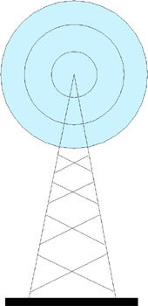
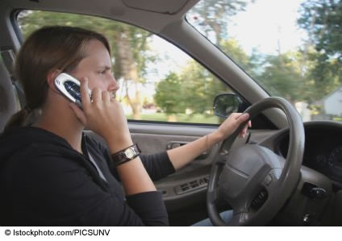
What is GSM Signal Strength ?
Cell Phone measures Received Signal Strength (RSS) from surrounding towers periodically and sends it back to the associated tower (Network Measurement Report)
This information is thus available to provider
RSS 1
RSS 2
RSS 3
Notes:
The Phone frequently makes RSS measurements from its surrounding cells and sends this information back to the Associated Tower to Enable Handoff Decisions.
Thus, This information is already available with the Cell Phone Provider.

Slide 8
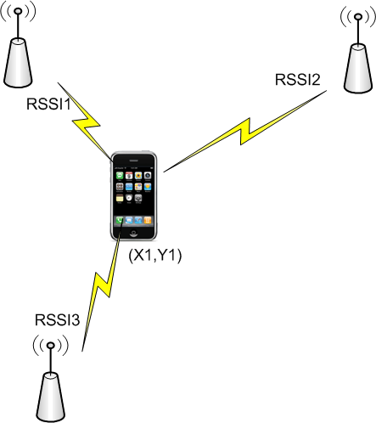
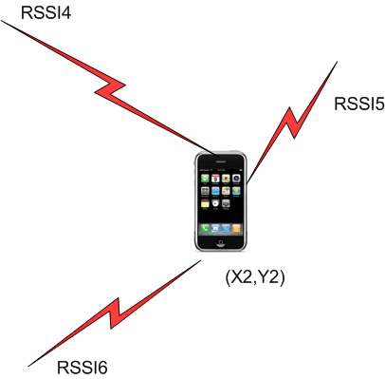
Localization Based Speed Detection
Triangulation
Fingerprinting
Bayesian Localization
Probabilistic-Localization
Median Localization Error ~= 90m
=> Low Speed Est. Accuracy !
Speed = (Euclidean Distance )/Time

Slide 9
Handoff Based Speed Detection
Assumption: Known Handoff Locations
Coverage Tower -1
Speed = (Distance between handoff)/(Time for handoffs)
Handoff Zone -1
Handoff Zone -2
Handoff Zone -3
A
B
Coverage Tower -2
Coverage Tower -3
Infrequent Speed Estimations
=> Lower Speed Prediction Accuracy.

Slide 10
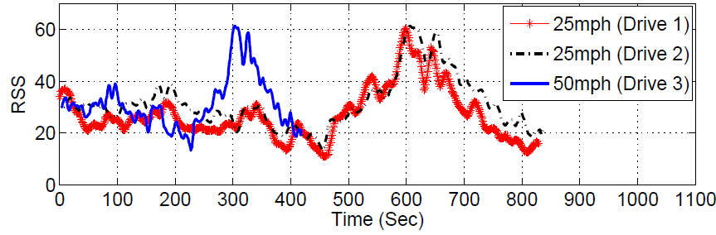
Our Proposal - Correlation Algorithm
Observation: Similar RSS profile on any given road
Compression (or Expansion) ~ Speed

Slide 11
Correlation Algorithm
Inputs:
  RSS-profile from a Mobile Phone moving with an “known Speed”
  RSS-profile from a Mobile Phone moving with an “Unknown Speed”
Need To Estimate:
  The “Unknown Speed” of the Mobile Phone
Technique:
  Generate several “virtual speed traces” from known speed trace
  Estimate Correlation Co-Efficient between “Unknown trace” and all “Virtual Traces”
  The speed corresponding to the Virtual trace that yields highest correlation co-efficient would be the Unknown speed.

Slide 12
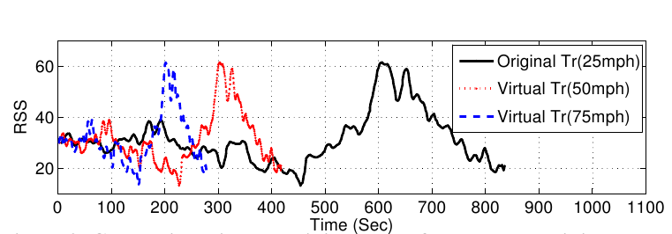
Correlation Algorithm –“Virtual” Traces
Generate Virtual traces for Speeds [1-80mph]
Sub-Sample to generate high speed virtual traces
Interpolate to generate low speed virtual traces

Slide 13
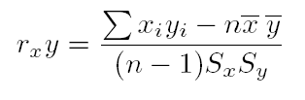
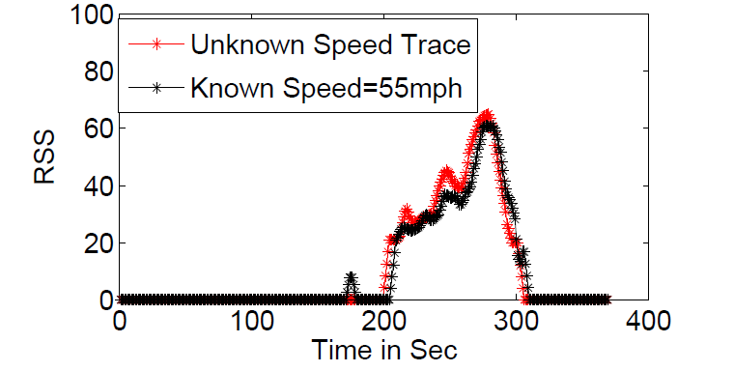
Correlation Algorithm
Similarity Metric: Pearson’s Correlation Co-Efficient
  Ranges between [-1, +1]
  0 => No Correlation
  +1 => Strong Positive Correlation
Correlation Co-eff = 0.994

Slide 14
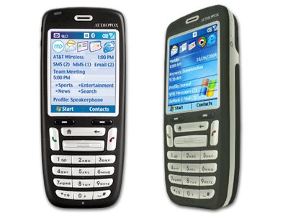
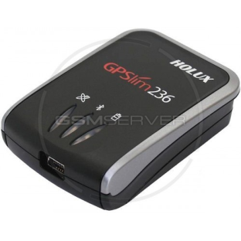
Experiment Set-Up
A GSM Phone
Bluetooth GPS Device (Holux GPSlim)
Software to Collect and record GSM/GPS
Constant Speed Experiment
  9 constant-speed drives thrice at 25mph, 40 mph, 55 mph
  7 Miles Drive
Highway Experiment (Varying Speeds)
  38 traces on a Highway.
  ~20 Miles of Intersecting route (I-287)
Arterial Road Experiment (Varying Speeds)
  19 drives on roads with traffic lights
  10 miles stretch

Slide 15
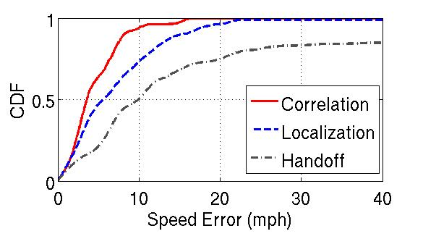
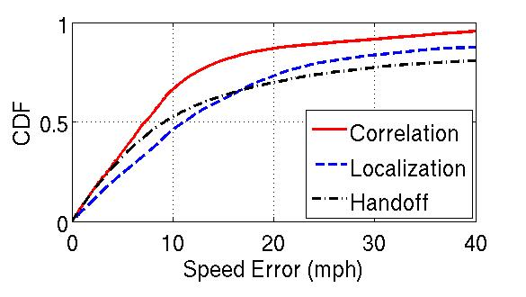
Accuracy of Speed Estimation (1)
Constant Speed Trace
Correlation: 4mph
Localization: 6mph
Handoff: 10mph
Correlation Algorithm outperforms the Rest
Highway Trace
Correlation: 7mph
Localization: 12mph
Handoff : 10mph

Slide 16
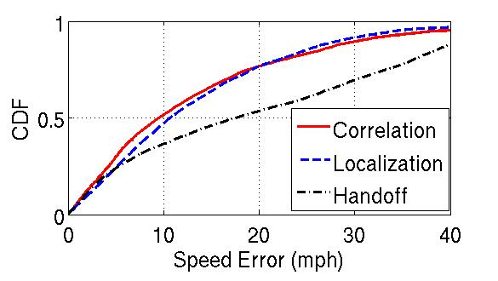
Accuracy of Speed Estimation (2)
Arterial Roads
Correlation: 9mph
Localization: 10mph
Handoff: 18mph
Highly Varying Speeds
Correlation ~ Localization > Handoff

Slide 17
Conclusion & Future Work
Experimentally evaluated the existing GSM-RSS based speed prediction algorithms
  Handoff , Localization
Proposed correlation algorithm that can predict speeds with higher accuracy
  Energy advantage compared to GPS
  No Bootstrapping issues
  No explicit user participation (Less privacy concerns)
Tradeoff between driving conditions vs duration of matching vs accuracy.
Predict instantaneous speeds instead of avg. speed
  Impressive results showing we can track highly variable vehicular speeds with < 5mph error.
  Can work in indoor & outdoor environments

Slide 18

Thanks!

Slide 21
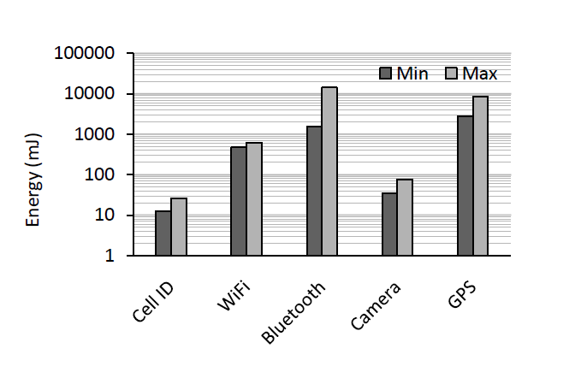
Energy Accuracy Tradeoff
Kaisen Lin, et.al “ Energy Accuracy Aware Localization for Mobile Phones” MobiSys 2010

Slide 22
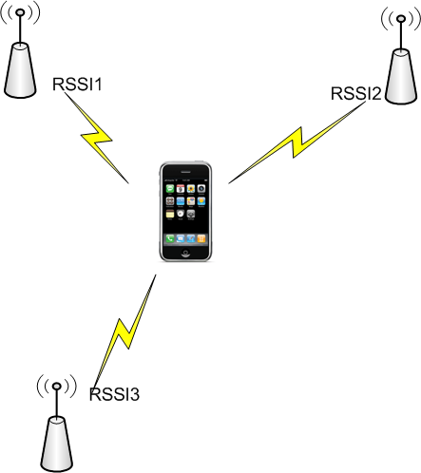
Localization
Triangulation
Fingerprinting
Bayesian Localization
Probabilistic-Localization
(X1,Y1)‏
RSS – Received Signal Strength
Notes:
22

Slide 23
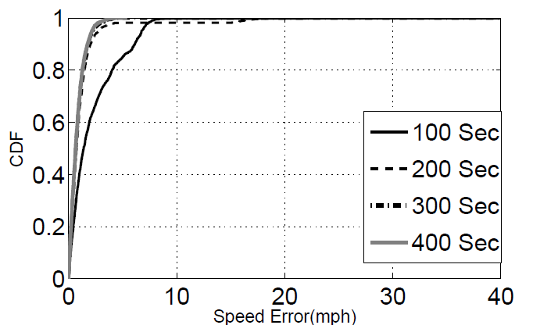
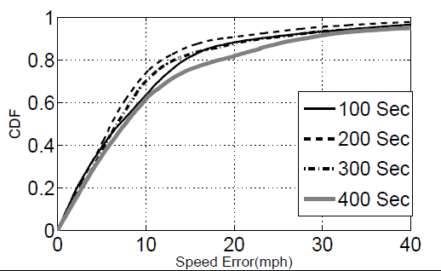
Impact of Matching Duration on Accuracy
Constant Speed Traces
Accuracy Improves with Time
Optimal time for correlation depends on the trace.
We choose 100 sec
Variable Speed Traces
Accuracy drops beyond 200 second interval

