Slide 1


Ask, Don’t Search:
A Social Help Engine for
Online Social Network Mobile Users
Tam Vu, Akash Baid
WINLAB, Rutgers University
http://www.winlab.rutgers.edu/~tamvu
May 21, 2012

Slide 2
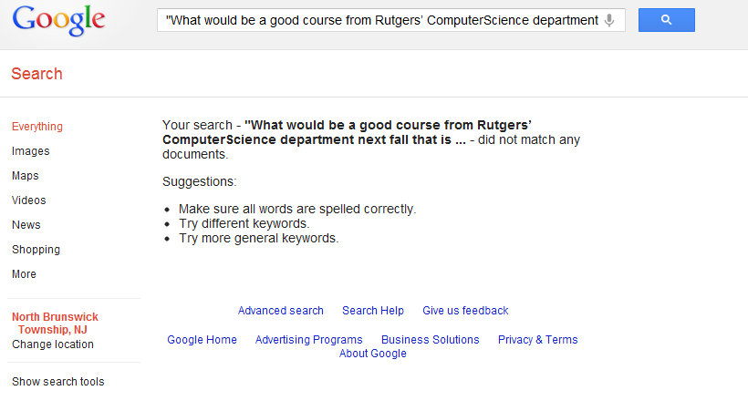
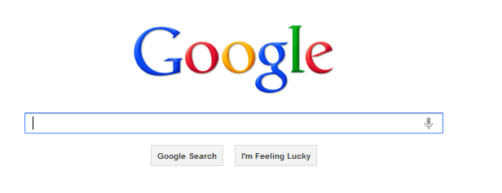
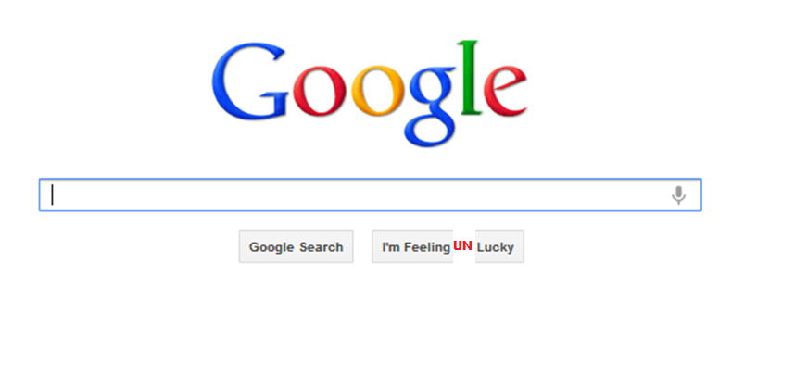
Don’t search !!!
What would be a good course from Rutgers’ Computer Science department next fall that is aligned with my research interests in machine learning and computer networks?

Slide 3
Why not... ?
Question can’t be expressed in the way that today’s search engines can understand
Search engines rely on content already exists somewhere on the Internet
No quality assurance, accountability and follow-up questioning
Go ask friends and colleagues that have desired expertise
Too expensive to query all people you know to ask for the answer

Slide 4




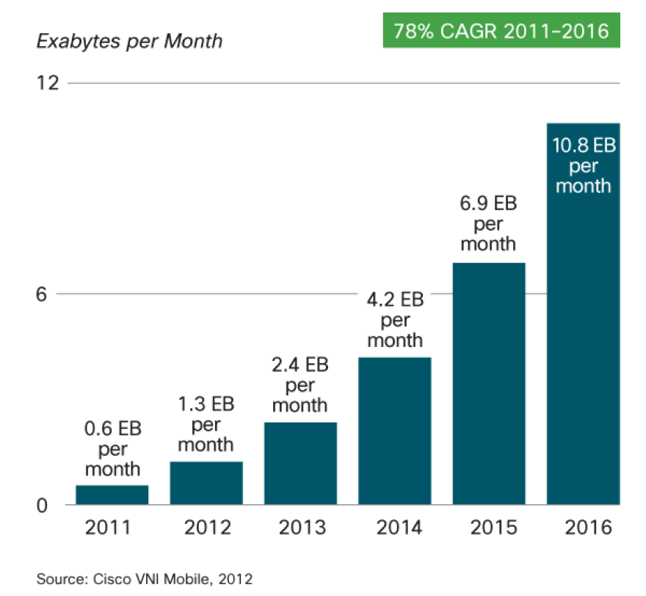
To whom my question should be routed to seek for the answer ?
Connections between users in online social networks can serve as links along which the question could be routed
From social networks, a rich set of information can be inferred:
  User’s social relationship
  Expertise
From mobile devices’ sensor
  E.g. Location-related info
Notes:
Location related info could be:
+ Speed
+ Traffic condition

Slide 5
Related works
Aardvark system - state-ofthe-art social search engine – acquired by Google
  To match questions from a user to other users based on their area of expertise
  Require explicit list of users skill set
  Doesn’t consider user’s latent social relationships
Our Odin Help Engine
  A question routing engine
  Mining latent social relationships among users
  Leverage sensing data from mobile devices
Notes:
Odin is a name of a greek god that knows everything

Slide 6
Odin Help Engine
Mining social network profiles, joint activities between users and their photo/post tagging behavior to create a strength-weighted relationship graph (WRG)

Slide 7
Odin Help Engine
2. Crawling and indexing all the available resources on social networks to extract expertise information and creating a baseline indexed database (BiDB)

Slide 8
Odin Help Engine
3. Converting sensor data and associated metadata to text in order to make it indexable and combining it with BiDB to create the indexed database (iDB)

Slide 9
Odin Help Engine
4. Identifying and routing the query to the most suited responder by ranking users based on their relationship with the asker as well as their expertise

Slide 10
How does it work ?
User registration
  Odin collects social contacts
  Specify type of sensing info will be provided to Odin
    Access control:
    e.g. Only close friend group could see my location.
  Ready to ask/answer questions

Slide 11
How does it work ?
Asking question
  Through Odin UI or third party plug-in e.g. Thunderbird plugin, Facebook app, Iphone App
  Classify question privacy level
Odin will:
  Verify and analyze the question by the Query Analyzer
  Route to Ranking Engine to find candidate responders:
    Most likely to answer
    With highest level of confidence
  Forward the question to the highest candidate for answering
  Repeat above steps for follow-up questions

Slide 12
Intimacy inference for WRG
Friendship connectivity from social network
  is not sufficient
  Binary
Apply latent variable model proposed by Xiang et al. [WWW 2010] to infer the latent relationships
Notes:
More detail can be found in [www 10] and the paper

Slide 13
Expertise data base construction
Device signal harvesting
  Raw sensor reading with timestamps are collected
  Odin combines these raw data with additional application-specific database (ASD) to add semantics to the data before indexing
  E.g. <lat,lon> => Street address using Google reverse geo-coding service
Social crawling
  Blog posts extraction
  Online social network profile
  Online tagging and comments
  Satisfaction feedbacks

Slide 14
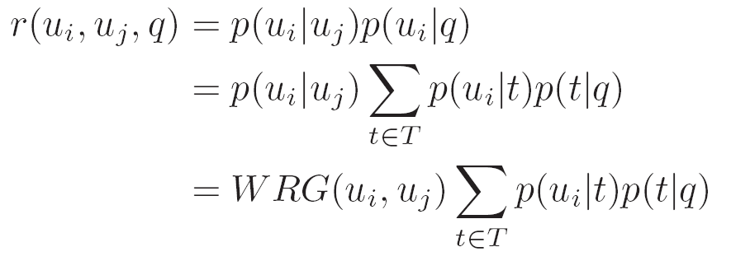
Ranking algorithm
Expertise + Latent relationship
  Adopt algorithm proposed by Horowithz et al. [WWW’2010] with the enhancement of connection strength
Scoring function for question q for the user pair (i,j) is computed offline

Slide 15
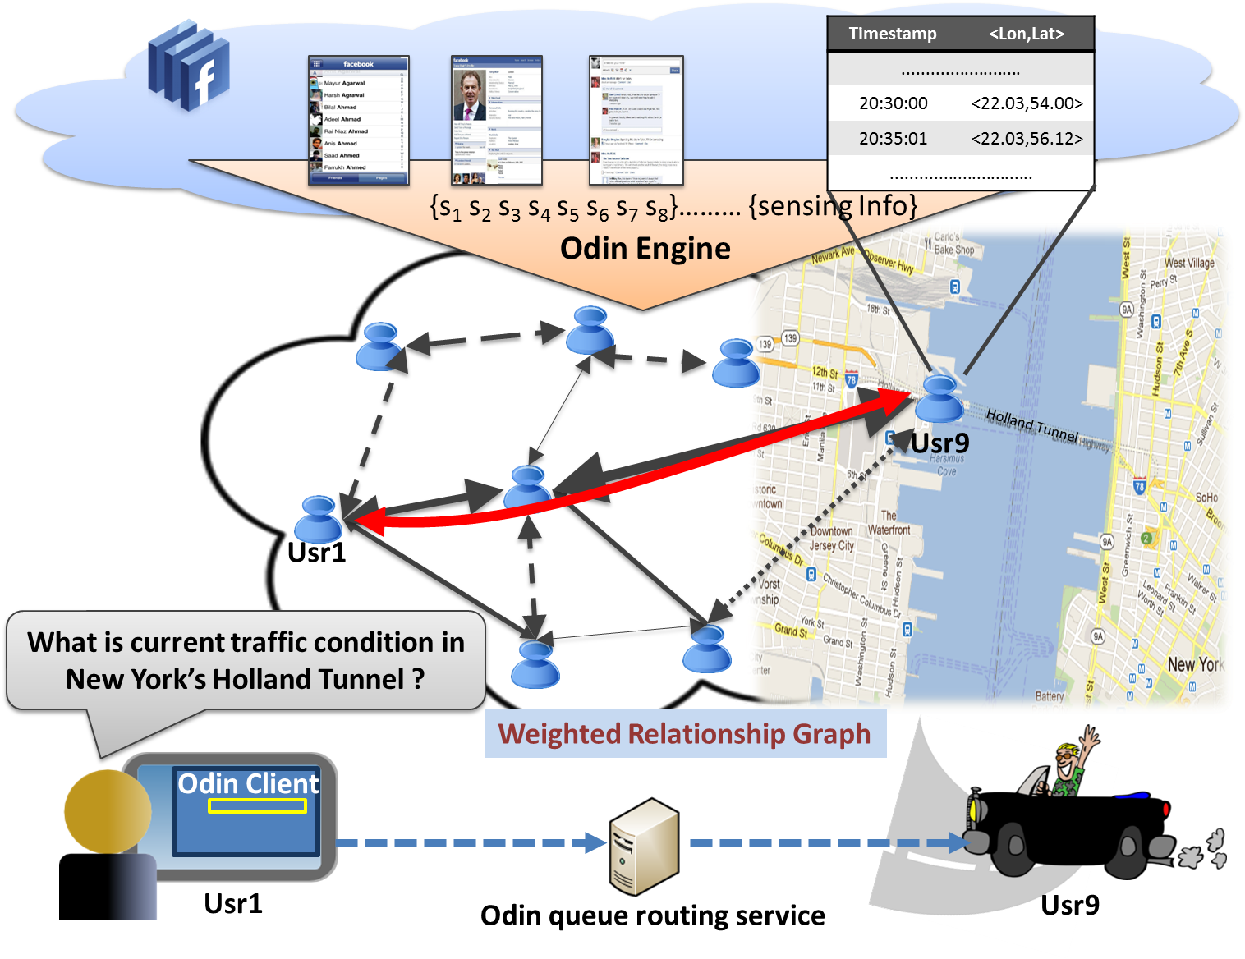
Use case for location based queries

Slide 16
Conclusion & Future Works
We presented the architecture of Odin, a social search engine that
  Infers social relationships between users to form a strength-weighted relationship graph
  Infers expertise from user profiles
  Ranks candidate responders by a pagerank-like algorithm taking both relationship strength and user expertise into account
Future works
  Intelligent sampling and data compression for sensing information
  Signal fusion from multiple sensors and from different sets of social network data
  Incentive mechanisms and business model to encourage participation

Slide 17
Thanks!
Questions? http://www.winlab.rutgers.edu/~tamvu

