Slide 1
Phantom:
Physical Layer Cooperation for
Location Privacy Protection
Presenter: Tam Vu¹
Joint work with
Sangho Oh¹, Marco Gruteser¹, Suman Banerjee²
¹WINLAB, Rutgers University
²Department of Computer Sciences, University of Wisconsin

Slide 2






Motivation
Adversary Localizing and
Tracking System
s₁
s₂
s₃
Notes:
+ Our work is motivated by the popular of mobile devices now a day.
+ Many of these transmitters are virtually always on—they send messages for push email, handoffs, or sensor status updates even without any explicit user action
+ Trilateration => localize using physical signal
+ Existing techniques

Slide 3
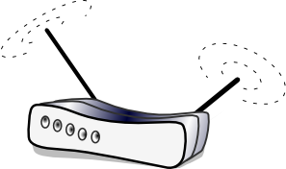
Adversary Localization System
Localization algorithm: Radio fingerprinting technique
  Compare the measured signal vector, r={r₁,r₂,r₃}, with training data measured at each reference point, u(x,y)
  Select the best matching location for the target user’s location
_{AP}
s₁
s₂
1
2
…
x
…
Eve
(Adversary
Localization
System)
. | . | . | .
. | . | . | .
. | . | . | .
. | . | . | .
1
v₂
u(1,1)
u(2,1)
2
u(1,2)
…
u_{A}
y
Alice
…
s₃
Notes:
We try to check the feasibility of the system indoor localization systems and physical layer experiments, so we have selected one of the most popular and precise localization techniques based on RSS measurements.

Slide 4
Existing solutions
Transmission power variation
Transmission frequency variation
∆P
Adversary Localizing and
Tracking System
s₁
∆P
∆P
s₂
s₃
Notes:
+ Our work is motivated by the popular of mobile devices now a day.
+ Many of these transmitters are virtually always on—they send messages for push email, handoffs, or sensor status updates even without any explicit user action
+ Trilateration => localize using physical signal
+ Existing techniques

Slide 5
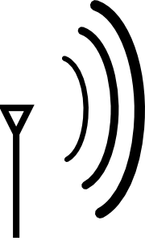
Existing solutions
Transmission power variation
Transmission frequency variation
Directional antennal
Adversary Localizing and
Tracking System
s₁
s₂
s₃
Can we create the same effects without a cumbersome directional antennal ?
Notes:
+ Our work is motivated by the popular of mobile devices now a day.
+ Many of these transmitters are virtually always on—they send messages for push email, handoffs, or sensor status updates even without any explicit user action
+ Trilateration => localize using physical signal
+ Existing techniques

Slide 6


Phantom : Ghosts Creation
Cloning = With the help of collaborators, transmitters create fake locations with same identity as that of the ones being protected
  Two synchronized signals from Alice and Bob are combined at adversary sensors
  Received signal vector , r={r₁,r₂,r₃}, is different from the signal vector from Alice and Bob
Challenges
  Collaborating partners must transmit the exact same bits using the same transmission parameters (e.g. frequency, power, time...)
    Synchronization
    Dummy packet creation
_{Alice}
_{AP}
Pw₁
Eve
Pr=Pw₁+Pw₂
Pw₂
Not Alice
_{Bob}
_{(Cooperator)}
Notes:
Cloning is a technique that protects the location privacy of wireless users by creating a number of fake locations with the same identity with the user
The fake locations which are also called as ghost locations are created by cooperative transmission with other nodes.
In picture, Alice is transmitting her signal to communication with other node AP,
But adversary Eve can localize her location by measuring her RSS or TOA from a number of her sensors.
So Bob is helping Alice to create ghosts by spoofing the adversary sensors through synchronized transmissions with Alice.
If the two signal from Alice and Bob are properly synchronized, they the RSS or TOA values that adversary measure will be different from the signal from Alice, which is indicating another ghost location that is not Alice
If we can make the packets cooperatively transmitted have the same ID with Alice’s packet, then the probably that Eve points the right location of Alice can be significantly reduced.
In this part, we are going to discuss the technical issues, and the performance of Phantom technique, overhead required to create ghost locations, and also discuss about strong adversary models that we can think of.

Slide 7


Coordination and dummy packet creation
Backend coordinator
  Registration, authentication, association, coordination, shared key (k_{ab}) distribution
  Avoid peer-to-peer coordination
    Explicit coordination may risk the location privacy of nodes
Ghost
BC
Cooperation for
Cloning
IP
k_{ab}
Dummy packet
for A’s ghost
Source
Address
Message
Payload
A
(Transmitter)
B
(Cooperator)
Alice
…
A
01101…
A
10101…
Beacon from AP
τ_{i}
Bob
A
10101…

Slide 8
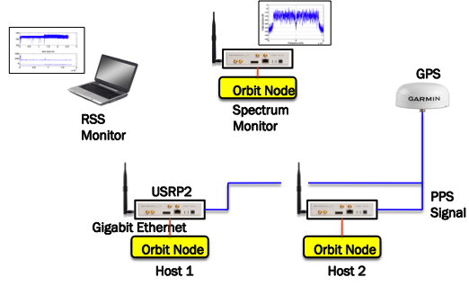
Phantom Experiments
Demonstrate creating clones of nodes by cooperative transmission
  Use software defined radios (GNU Radios)
    Transmit 802.11g packets
  Show the RSS change in adversary sensors due to cooperative transmission
Notes:
Our first experiment is to find the technical feasibility in packet synchronization which is critical in implementing Phantom
We used GNU software radios, because radio devices does not support the control of time and frequency control to the level that we need.
We used two GNU Radios for two cooperative transmitters, and used another one for signal processing for calibration
We used a laptop with standard WiFi network card to verify the reception of dummy packets.
We created standard 802.11g packets and let two GNU radios transmit that packets at the same time,
Then measure how RSS values change in the receiver node equipped with a Wi-Fi card

Slide 9
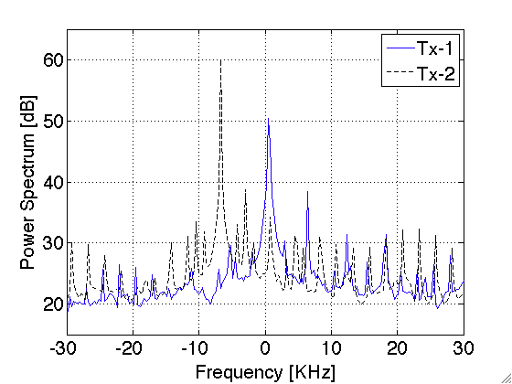
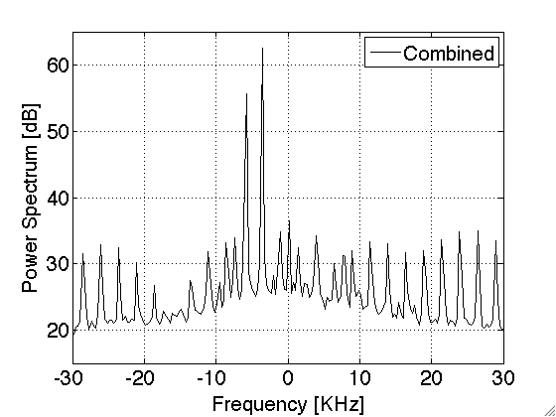
Frequency Synchronization
Frequency synchronization
  Manual configuration
  Reduce ICI between the two signals
Before
Manual
calibration
After
Notes:
New: If two frequency are different, they are going to interfere each other.
With in 1% of the sub carrer
Old:
===========
To see whether we can synchronize the transmission so that adversary can’t see.
This is the first result for radio calibration on frequency and time synchronization
- Frequency offset is radiomatric signature that is caused by the difference in oscillator in radio modules
Using monitor node, we find the center frequency of two radios and adjust their difference so that they can be aligned with the frequency difference allowed for OFDM demodulation
If the frequency is not synchronized, two signals severely interfere each other, prevents the adversary receivers properly demodulate dummy packets.
So it is important to synchronize the center frequency within 1% of sub-carrier intervals in OFDM radios, which is about 3Khz
The figure shows before calibration, two radios showed about 10Khz difference, which is quite large compared to the sub-carrier interval, but after some manual adjustments, two frequencies can be properly synchronized within 3Khz interval.
Frequency synchronization can be achieved either by tunable hardwares of very precise oscilators. Acutally ultra precision oscillators that support ~pps level precision is already available small additional cost, so we think frequency synchronization is not such a big deal in implementing Phantom
Time synchronization is more difficult to achieve since it requires a reference signal to synchronize the timers in each node.
The level of time synchronization required is about a microsecond for Wi-Fi radios, since two OFDM signals should arrive within the size of cyclic prefix of OFDM symbol, otherwise, they are going to interfere each other.
So we assume the nodes in Phatom has a external source for time synchronization, using GPS signals in outdoors, or beacons of AP or psudo satellite signals in indoors.
In our experiment, we used GPS modules to synchronize two radios. Although we used only one GPS module and split the singnal into two radios due to the restriction in indoor experiment environments, we verified that the timing offset of comodity GPS moduels is very small within 500nsec level.
So we make the first stage time synchronization using GPS PPS signal, however, we need second stage time synchronization due to the offset in oscillators in current GNU raidos.
Even the offet in oscillators are as small as tens of pps, the time offset continuously grow during the synchronization interval of one second
So we neede to further calibrate two radios for this experiments

Slide 10
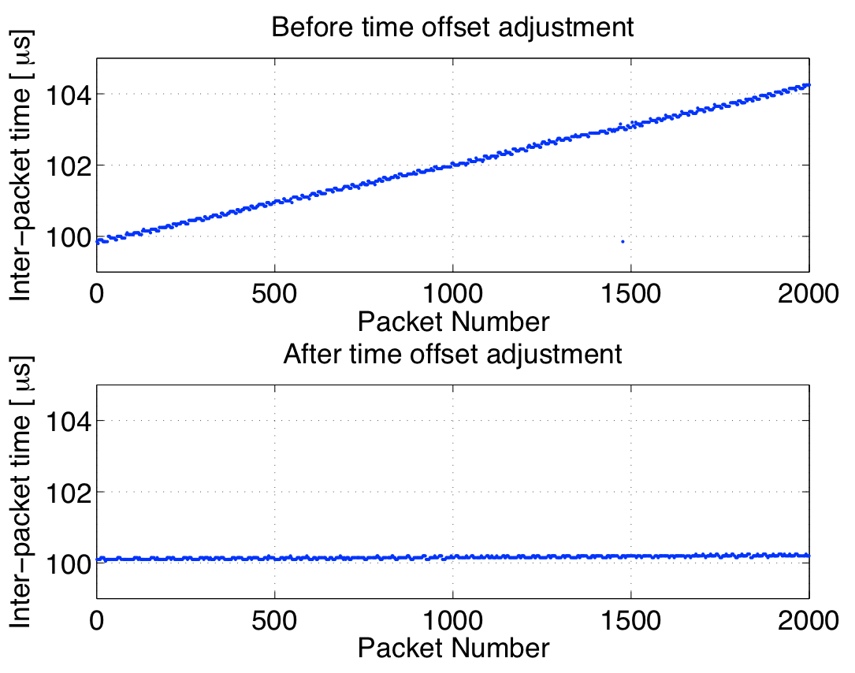
Time Synchronization
Time synchronization
  Coarse:
    Use GPS in outdoors: ~500nsec cheap GPS modules
    Indoors: Use beacon from AP
  Fine time offset (τ_{off} ) adjustment
    Caused by imperfect local oscillator
    Measured by correlating the received signal with preamble (known signal pattern)
Fine Time offset adjustment
Before
After
Notes:
+ Now frequency is synchronized. We can synchronized using GPS to the accuracy of 500ns
+ Time Drifting because of the ossilator.
The time offset is growing up to 4us over 2second period – inter packet arrival time
GPS PPS - pulse per second => sync every 1 second
==============
We have put additional baseband samples => give base band sample to GNU radio
20 million (20Mhz) => GNU radio running

Slide 11
Cloning Experiments: Results (2)
After time/frequency synchronization
  Pass the integrity check of the adversary
  Measured RSS is the sum of two received signal power
Notes:
This result show:
Increase and decrease the offset to see how the Receiver demodulate.
=> shows the improvement in PRR and RSS as synchronization
==============
These are the result for time synchronization
The left figure shows the time offset between two radios between one second synchronization interval
Two radios synchronize their time every second according to PPS clock, however the small difference in their local oscillators produce non trivial offset which is upto 4 usec, which should not be ignored.
We test this by transmitting 2000packet continuously and find their timing offset grows as shown in the top figure in the left side.
We solve this problem by making one of the radios transmit a little bit extended symbols than other radios, which means adding some additional baseband samples to the radio that has a fast running oscillator.
The right figure is the result of time and frequency synchronization
We shift the time offset of one of the radio and measure the packet reception rate and RSS using regular WiFi radio.
The result shows the level of time synchronization required is about +- one micro second, which is quite surprising considering the size of cyclic prefix of 802.11 symbols is only 0.8 microsecond
And the below curve shows change of RSS due to cooperative transmission
We can find the RSS measurement has actually been increased due to the cooperation of two nodes

Slide 12
ORBIT Experiment:
Location privacy protection performance measure
Experiment setup: ORBIT
  Transmitter and cooperator
    2 GNU Radios
  Adversary
    Nodes in ORBIT Grid
Cooperation power control
  Change the location of the clone
  Power configuration
    Tx-1 power = k [dBm]
    Tx-2 power = 20-k [dBm]
Notes:
Now we have applied the result to ORBIT grid localization system.
We did the experiment on controlled environment to exclude the artifacts from noises and unexpected shadowing effects.
We built RSS map on 400 reference points using radio fingerprinting technique
Then use two GNU radios in ORBIT location at (3,8) and (8,3), and make them two transmit same packet at the same time.
The we assume adversary sensors use a number of sensors nodes to measure the received signal to localize the transmitters.
- The right figure shows the location that the adversary RSS based localization algorithm points when they received dummy packets.
Depending on the power configuration of two nodes, the ghost location moves around the grid.
-

Slide 13
Conclusion
Phantom enables users to dynamically create confusion about their location by creating additional ghost transmission from different locations with the same identity
We implemented a proof of concept using software defined radios as transmitters and explored issues related to frequency and time synchronization of such transmitters.
We demonstrated the feasibility of inducing localization errors through cooperative transmissions.

