Slide 1
Tracking Fine-grain Vehicular Speed Variations by Warping Mobile Phone Signal Strengths
Presented by Tam Vu
Gayathri Chandrasekaran*, Tam Vu*, Alexander Varshavsky†,
Marco Gruteser*, Richard P. Martin*, Jie Yang‡, Yingying Chen‡
*WINLAB, Rutgers University †AT&T Labs
‡Stevens Institute of Technology

Slide 2
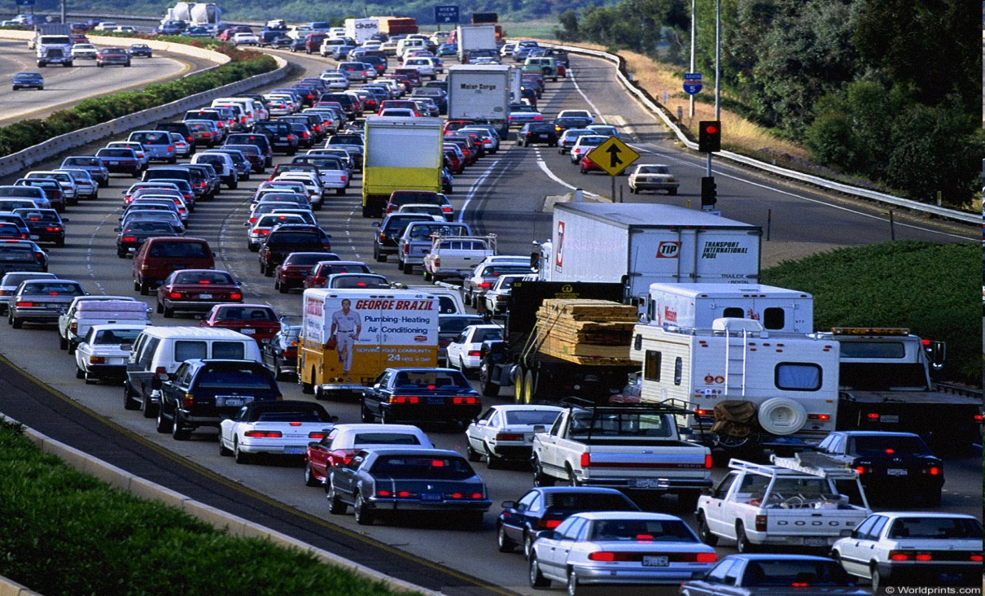
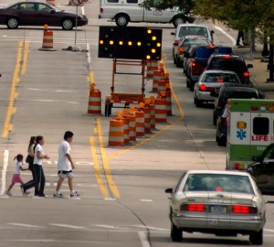
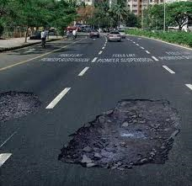
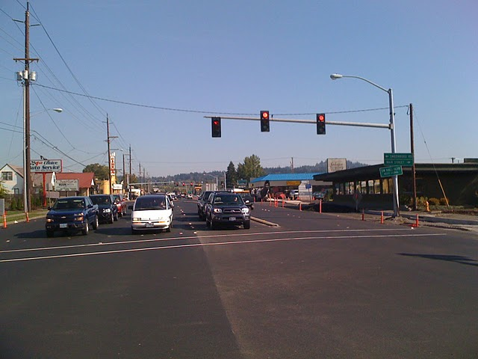
Motivating Applications for Speed Tracking
Congestion Avoidance
Traffic Engineering Applications
Notes:
Getting stuck in a traffic is nothing new to us ! Given that commuting to work is an everyday event, congestion avoidance would be the top most priority for all of us.
Fine-grain speed variation traces could improve pinpointing the congestion segment of a road, especially in arterial road.
It can also reveal whether traffic pattern on a particular road segment is slow but smoothly flowing through or in stop and go fashion.
These factors have significant effect on gasoline consumption and accident rate, hence it would be important to be monitored on the large scale.

Slide 3
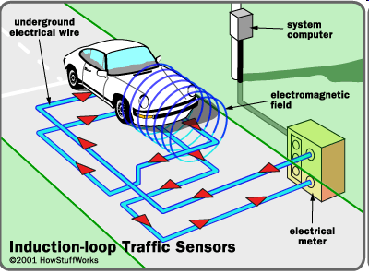



State of the Art for Vehicular Speed Estimation
Loop Detectors
Using Locations of Mobile phones estimated by triangulation.
  Can have lower accuracy (We will evaluate this)
Using Mobile phone’s Handoff Information
Probe Vehicles fitted with GPS enabled Smart-Phones
  Require additional hardware
  Battery Drain ( 2 orders of magnitude higher )
A Combination of the above techniques
  VTrack ( Sensys 2009) : Infrequent sampling of GPS + Wi-Fi localization + cellular phone triangulation
Average Speed Estimators
Trades off accuracy for energy !
Requires voluntary user participation
Notes:
These information is avaialble through these method but isn’t sufficient because….
Transition:
We propose a new method for optaining more fine-grain at large scale

Slide 4
Our Objectives
High/comparable accuracy to state of the art
Consume less energy
No voluntary user participation

Slide 5
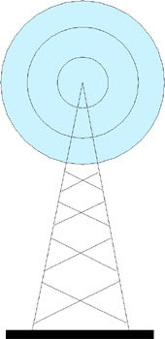
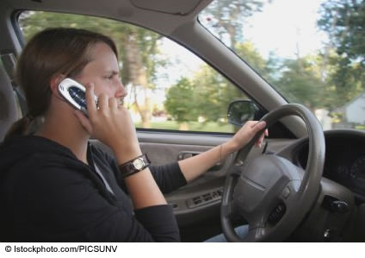
Why use GSM Signal Strength ?
Phone periodically sends Network Measurement Report
RSS 1
RSS 2
RSS 3
NMR
Associated Tower

Slide 6
Problem Statement
Assumption: Availability of GSM RSS profile of a phone
moving with known speeds for a given road (Training data).
How to derive the speed of another mobile phone that moves
on the same road from the RSS profile of that phone (Testing data)?
Notes:
Observation: the largescale path loss and shadow fading components of signal strength
readings (signal profile) obtained from the mobile phone on any
given road segment appears similar over multiple trips along the
same road segment except for distortions along the time axis
due to speed variations.

Slide 7
Observation Behind Our Approach
40mph
80mph
20mph
RSS
Time (sec)
Large scale path loss and shadow fading component of RSS traces
on a given road segment appear similar over multiple trips
except for distortion along time axis due to speed variation
Stretch or compression is uniform ~ speed
Notes:
As vehicle moving through the same place with different speed, cell phone towers see the same RSS profile being stretched or compressed form.

Slide 8
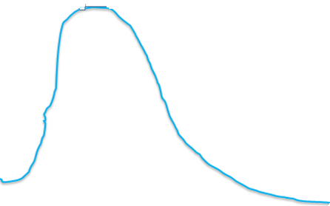
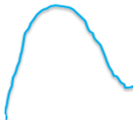
More Realistic Scenario
40mph
20mph
40mph
RSS
Time (sec)
Stretch/Compression can vary over the length of the trace
Relative stretch/compression can give speed of one trace wrt other

Slide 9
Detailed Problem Description
Given
  Training RSS trace ( Known Speed)
  Testing RSS trace (Unknown Speed)
How do we compress or stretch the testing RSS trace to match
the training RSS trace?

Slide 10
Time Warping Algorithm
Given two time-series (training and testing), time warping algorithm performs an optimal alignment of the two traces.
Training
Testing
Optimal alignment: Minimal cumulative difference between
the absolute values of RSS of aligned points

Slide 11
How do we accomplish optimal alignment ?
Training
 |  |  |  | D_{ij}
Classic Dynamic-
Programming Algorithm
DDTW – Derivative Dynamic
Time Warping
Testing
Distance Matrix
D_{ij} = (RSS′_{i} – RSS′_{j})²
M × N
Notes:
If a peak is mapped with a peak and a dip with a dip, the corresponding pairs of Dij are very low. In contrast if a Peak is mapped to a dip, their RSS values are very different which could lead to high Dij. So, the goal is now to pick the Dij that would minimize the overall cost and ensure a complete mapping between the training and testing traces.

Slide 12
Derivative Dynamic Time Warping
Training
Cost Matrix
C_{ij} = D_{ij} +
Min(C_{(i-1)j},C_{(i-1)(j-1)}, C_{i(j-1)})
Local Constraint
Stronger Local Constraint
A point in training can be
mapped to atmost two
consecutive points in testing
or vice-versa
Testing
Goal : Min C_{MN}
M × N
Notes:
To this end, we introduce a cost matrix which is an estimate of the cumulative cost to reach a specific I,j from 1,1.
The cumulative formulation depends on the local constraints.
The most unrestrictive local constraint is what we have showed here.
You could reach i,j from one of its three neighbours… This is unrestrictive because

Slide 13
Derivative Dynamic Time Warping
Training
Boundary Condition:
(1 1), (M N)
Global Constraints
E_{MAX}= Max(M/N,N/M)
Type-1
Slope=1/E_{MAX}
Warping Path
Slope=1/E_{MAX}
Type-2
Testing
S(testing) = 2 * S(training)
Type-3
S(testing) = S(training)
S(testing) = S(training)/2
Slope=E_{MAX}
M × N
Notes:
To guarantee the meaning full warping path, we use global contraints to limit which region in which the warping path can be as shown.
Also, it wil guarantee the path will always be going from (1,1) to (MxN)
The result of the algorithm is the warping path that define the matching pattern between training trace and testing trace.
From the warping path, we infer testing speed as follows:
If one point on training is matched to 1 point in testing, the testing speed at that point is equal to the speed of training.
If one point of training is matched to 2 points of testing, then the testing speed is half of the training speed
If one point of testing is matched with 2 point in training then, the testing speed is twice faster than the training speed

Slide 14
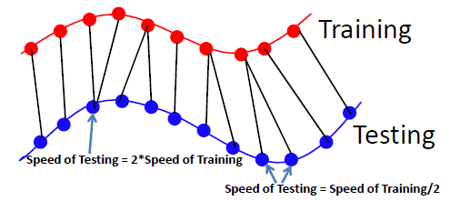
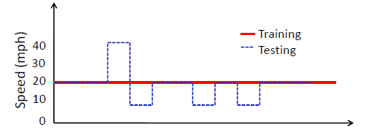
Deriving Speed from Warping Path
Estimated Speed = Multiples of Training
Mis-match due to noise or small scale fading
Running estimated speeds through a Smoothing Window
=> Highly Oscillating.

Slide 15
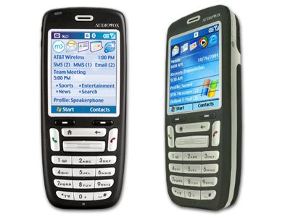

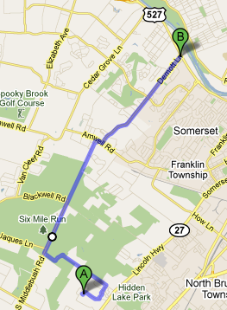
Experiment Set-up
A GSM Phone
Bluetooth GPS Device (Holux GPSlim)
  To Collect the Ground-Truth
Software to Collect and record GSM/GPS
Arterial Road Experiment (Highly Varying Speeds)
  19 drives on roads with traffic lights (~8 miles)
  6 hours of driving trace.
Notes:
+ we collected two sets of data. The first set of data was collected outdoors using GSM enabled HTC Typhoon phones running the Intel-POLS [2] software. The software records the time, cell tower description (Cell ID, MNC, MCC, LAC, IMEI), and the received signal strength from the 7 strongest cells once every second.

Slide 16
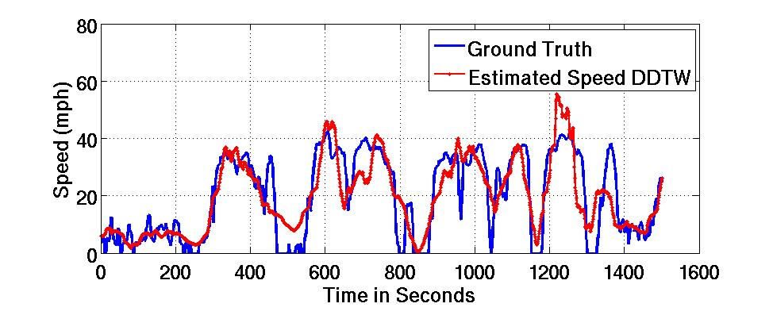
Speed Estimation Accuracy - DDTW
Correlation Co-Efficient = 0.8262
Effective at tracking speed variation !

Slide 17
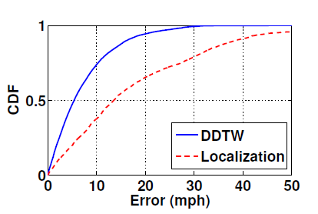
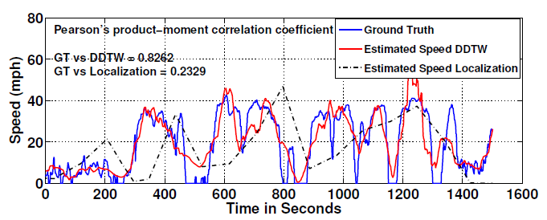
DDTW vs Localization ?
Median Error
DDTW: 5mph
Localization: 12mph
Notes:
+ The figure shows that the speed estimated by DDTW matches the actual speed very well whereas the localization algorithm performs poorly

Slide 18
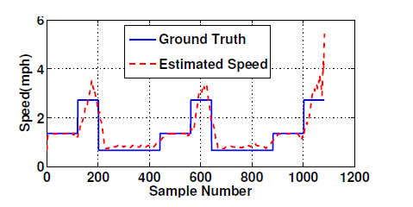
Detecting Walking Speeds Indoors (Wi-Fi)
 | Receiver 1 | Receiver 2 | Receiver 3
Median Speed Estimation Error | 0.1527mph | 0.1388mph | 0.1527mph
Note: Just one receiver seems sufficient !
Notes:
The second set of data was collected indoors on a 802.11b Wi-Fi network. We collected 9 traces in which the experimenter
placed a laptop equipped with 802.11b WG511T Wi-Fi card in a cart and moved along a corridor measuring 228 ft in length thrice at three different speeds ( 1ft/sec, 2ft/sec, 4ft/sec) while sending out packets at the rate of 2 pkts/sec. Three receivers were placed along the corridor: one closer
to the beginning of the corridor, one in the middle and one closer to the end of the corridor.

Slide 19
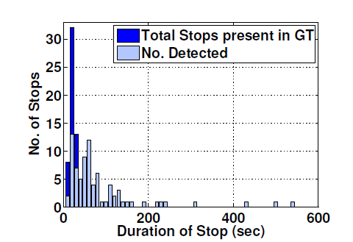
Effectiveness of DDTW at detecting Slowdowns
Slowdown: When and How long did it last ?
Detects slowdowns > 30sec
DDTW : Effective at detecting slowdowns > 30 seconds
  Due to Smoothing (50 seconds)
Localization could detect all slowdowns > 100sec

Slide 20
Conclusion
We presented a time warping algorithm that can estimate vehicular speeds with 5mph median accuracy using GSM signal strength
We extended our framework to identify bottlenecks (slowdowns). DDTW was effective at detecting all slowdowns that lasted longer than 30 seconds
Demonstrated the generality of the approach by extending the framework indoors on Wi-Fi networks.

Slide 21

Questions ?

Slide 22
Thank you

Slide 23
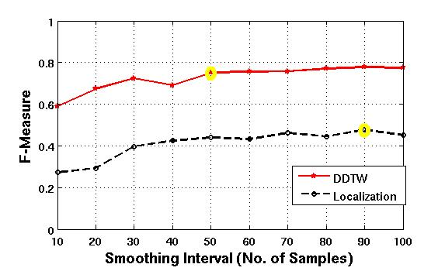
Metrics to Evaluate Slowdown Prediction
Precision = TP/(TP + FP)
Recall = TP/(TP + FN)
2 * precision * recall
F-Measure = -------------------------
(Precision + Recall)
DDTW (50 samples)
Precision = 68%
Recall = 84%
Localization
Precision = 38%
Recall = 63%

Slide 24
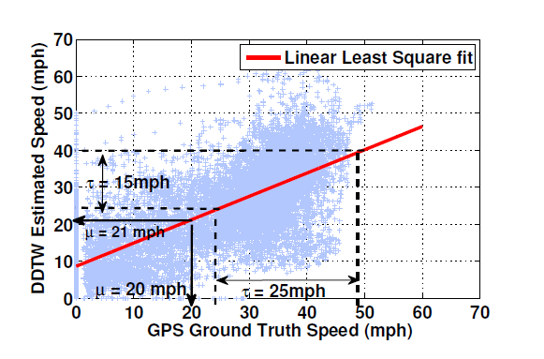
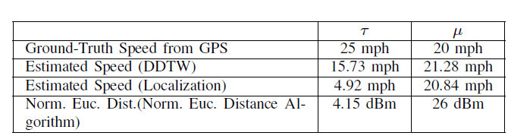
Backup Slides

Slide 25
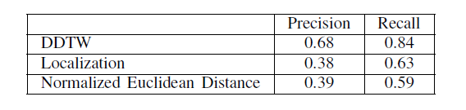
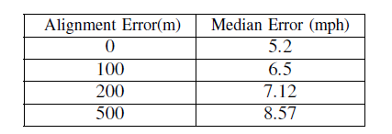
Other Results

Slide 26
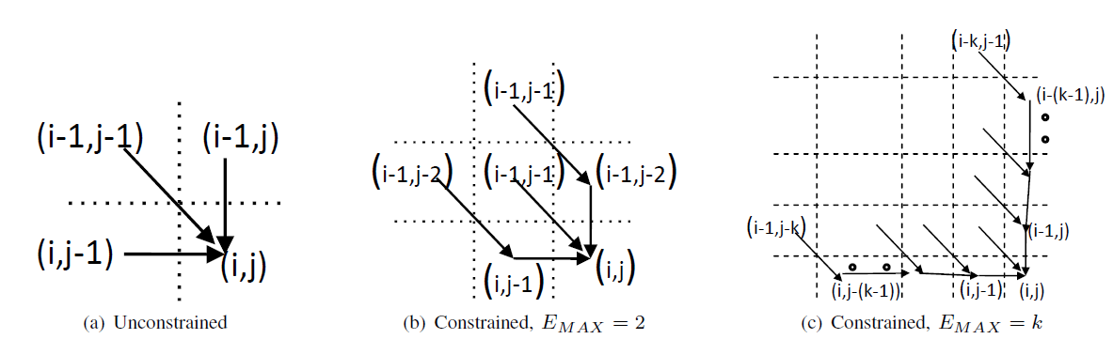
DDTW: Cost Function

Slide 27
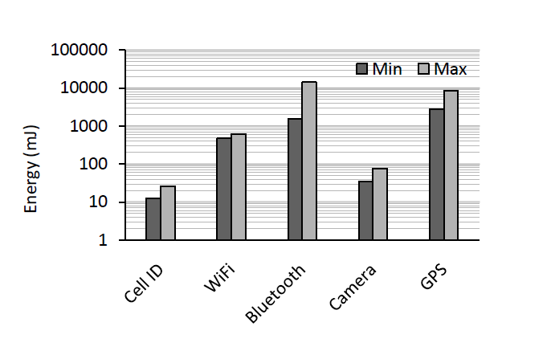
Energy Tradeoffs for Different Technologies
Kaisen Lin, et.al “ Energy Accuracy Aware Localization for Mobile Phones” MobiSys 2010

