Slide 1
DMAP : Global Name Resolution Services Through Direct Mapping
Tam Vu
WINLAB, Rutgers University
http://www.winlab.rutgers.edu/~tamvu/
(Joint work with Akash Baid, Yanyong Zhang, Thu D. Nguyen,
Junichiro Fukuyama, Richard P. Martin, Dipankar Raychaudhuri)

Slide 2
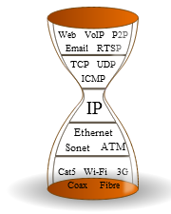
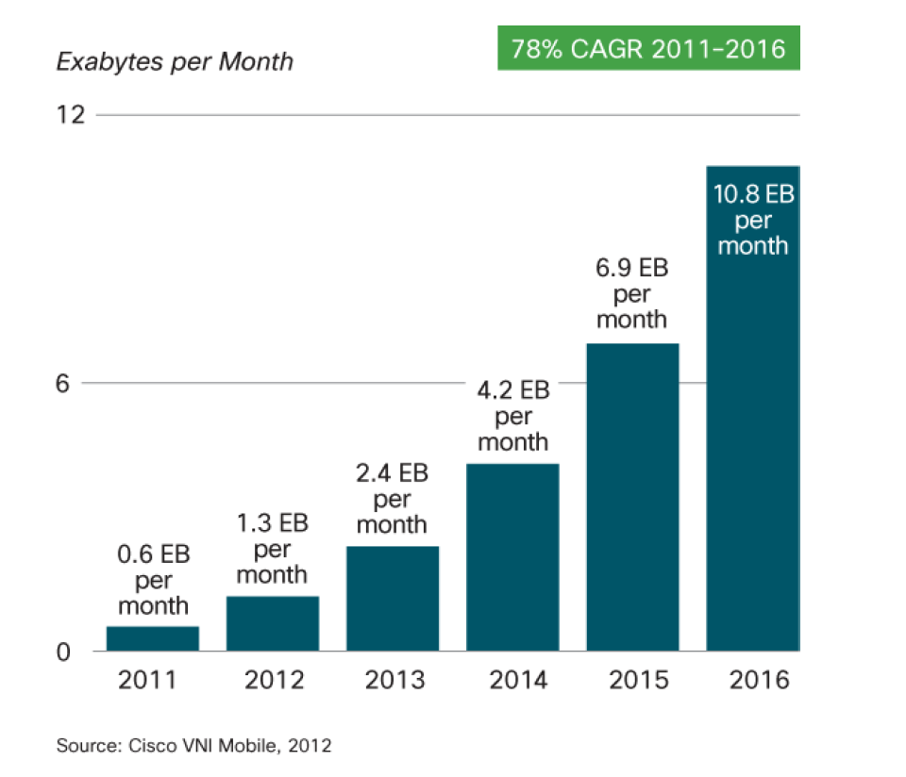
Today’s Internet
IP address is used as both:
  Routing Locator - how a device is attached to the network
  Identifier – “who” the device is
Results in a lot of problems:
    Mobility
    Site/device/network multi-Homing
    Scalability
    Security
    Addressing
    ...
Notes:
The 30 years old design with IP proven to be a key factor to the success of Today’s Internet.
Mobility: Connection tears down if Locator changes
Scalabilty: Huge routing tables due to granular subnets and traffic engineering
Security: IPs not authenticated at all
Addressing: Not content or user, but Host at Location is addressed
Cisco forecast 10.8 Exabytes per Month of Mobile data traffic by 2016.

Slide 3
Locator – Identifier Split
ID
IP
Loc
Common idea is the separation of
Identifier from Routing Locator
  Locator is for routing
  Identifier is for naming
The approach advocated by industry and research communities (e.g. AIP, HIP, LISP, MILSA, MobilityFirst, etc..)
Notes:
An approach advocated by industry and research communities. (e.g. I3, HIP, LISP, MILSA, MobilifiFirst, etc..)

Slide 4
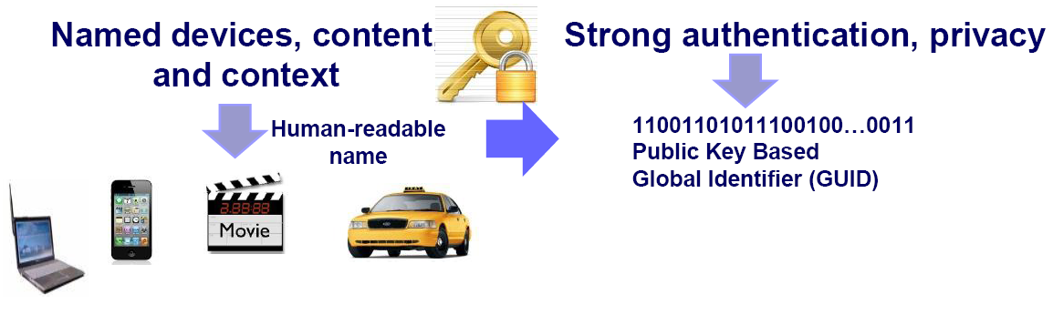
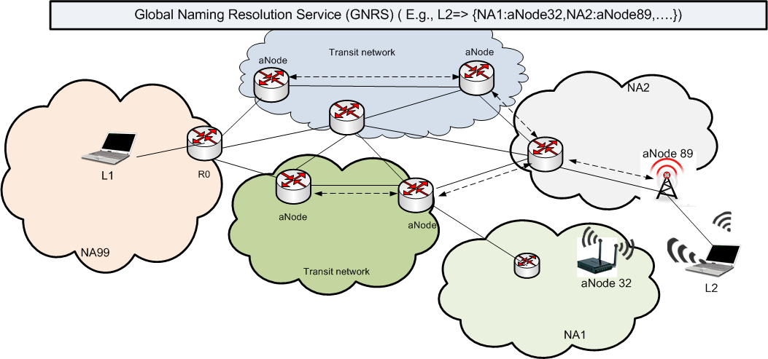

Example: MobilityFirst
Distributed Global Naming
Resolution Service
GUID query
GUID | NA
LapA | NA10,NA12
PhoneX | NA20 => NA21
VideoB | NA20,NA99
returns NA(s)
L2 addr?
NA2:aNode32
NA1:aNode89

Slide 5
Naming Service Design Goals
Mobility is directly handled using
dynamic identifier to locator mapping
Low mapping look up latency ( ~ 100ms)
Fast mobility support requires that
the mappings be updated at a time-scale
smaller than the inter-query time
Low staleness
Support heterogeneous networked objects including devices, sensors, context, content, etc..
Flat Identifier support
Flat identifiers would lead to
substantially more number of identifier to locator entries
Storage Scalability ( ~10 billion of mappings)
As the heart of the whole network architecture, RS must be robust
Decentralized, cooperating resolvers
Notes:
DNS is an example of high staleness win

Slide 6



Existing Scalable Naming Systems
 | Lookup Latency | Staleness | Support Flat ID | State overhead
DNS | Low | High |  | Low
LISP-TREE | High | Normal |  | Low
LISP-DHT | Low | Normal |  | High
DHT-MAP | Normal | Low |  | High
SILMS | High | Low |  | High
??? | Low | Low |  | Low
Notes:
LISP-TREE is slow since it recursively go through or iteratively query servers.
Staleness is relatively high due to heavily caching
DHT-MAP: is normal look up latency since it going through multiple neighbor – USING CAN
Six/one: address is hierarchical
SILMS: High overhead due to separate management/policies servers && it is overlay

Slide 7
Outline
Motivation
Related work
DMap (Direct Mapping)
  Minimize latency through in-network single-hop hashing
  Leveraging reachability information of underlying routing infrastructure
Evaluation
Conclusion

Slide 8
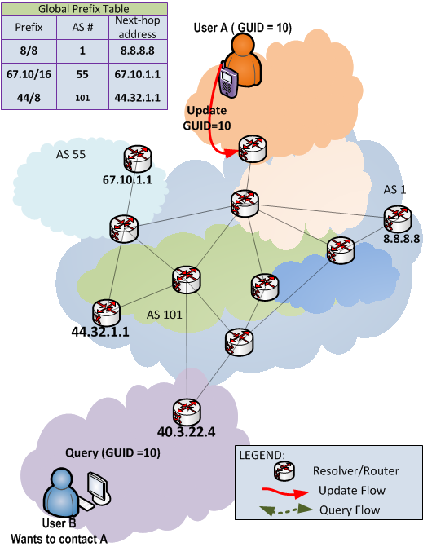
Direct Mapping (DMap)
GUID
(00101100……10011001)
Consistent hash
Consistent hash
Consistent hash
K
IP_{x}
IP_{x}
IP_{x}
IP_{x} = (44.32.1.153)
Global Prefix Table
{e.g. BGP)
IP to AS# lookup
Prefix | AS# | Nexhop
... | ... | ...
IP to AS# lookup
IP to AS# lookup
K
Storage AS#
Storage AS#
Storage AS#
K replicas
Mapping Update

Slide 9
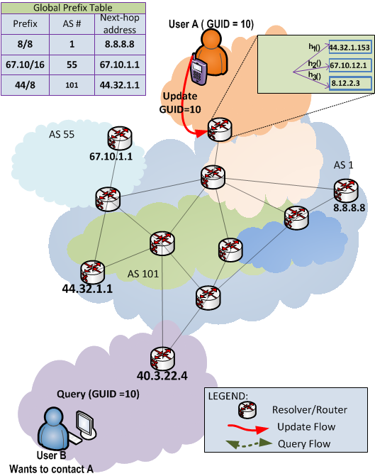
Direct Mapping (DMap)
GUID
(00101100……10011001)
Consistent hash
Consistent hash
Consistent hash
K
IP_{x}
IP_{x}
IP_{x}
IP_{x} = (44.32.1.153)
Global Prefix Table
{e.g. BGP)
IP to AS# lookup
Prefix | AS# | Nexhop
... | ... | ...
IP to AS# lookup
IP to AS# lookup
K
Storage AS#
Storage AS#
Storage AS#
K replicas
Mapping Update

Slide 10
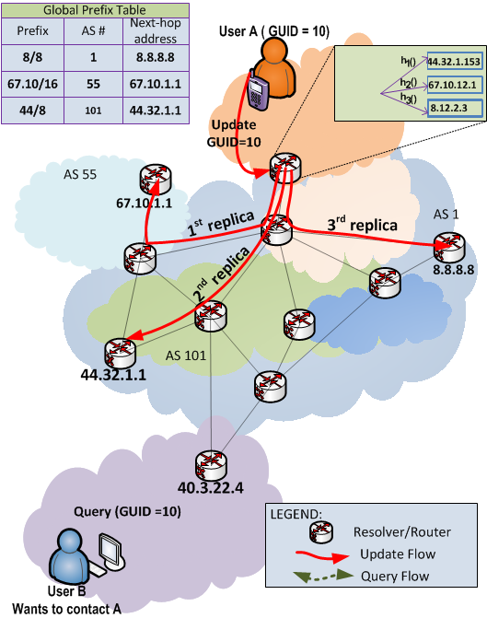
Direct Mapping (DMap)
GUID
(00101100……10011001)
Consistent hash
Consistent hash
Consistent hash
K
IP_{x}
IP_{x}
IP_{x}
IP_{x} = (44.32.1.153)
Global Prefix Table
{e.g. BGP)
IP to AS# lookup
Prefix | AS# | Nexhop
... | ... | ...
IP to AS# lookup
IP to AS# lookup
K
Storage AS#
Storage AS#
Storage AS#
K replicas
Mapping Update

Slide 11
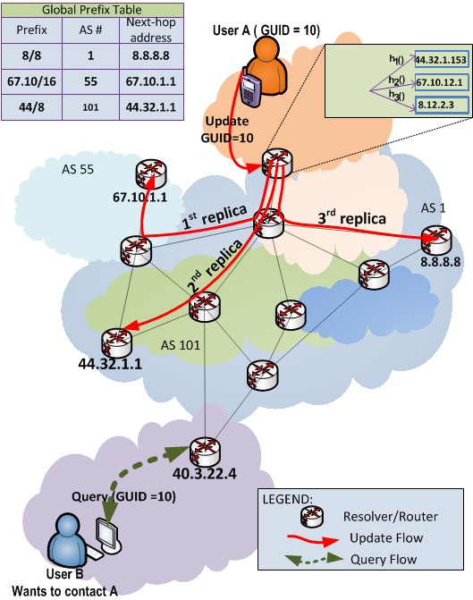
Direct Mapping (DMap)
GUID
(00101100……10011001)
Consistent hash
Consistent hash
Consistent hash
K
IP_{x}
IP_{x}
IP_{x}
IP_{x} = (44.32.1.153)
Global Prefix Table
{e.g. BGP)
IP to AS# lookup
Prefix | AS# | Nexhop
... | ... | ...
IP to AS# lookup
IP to AS# lookup
K
Retrieve Mapping from the closest AS
Mapping Lookup

Slide 12
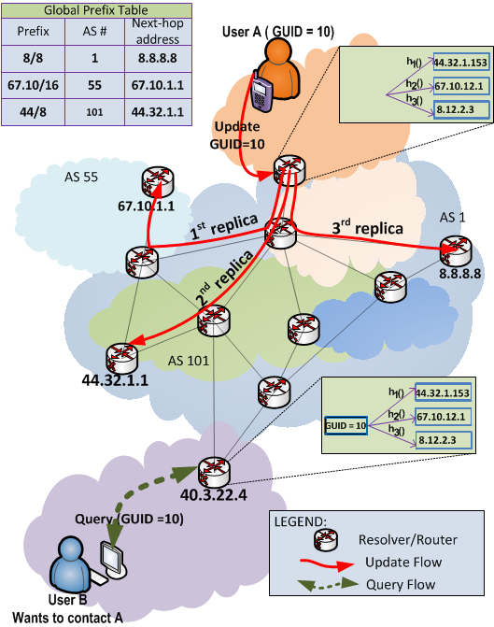
Direct Mapping (DMap)
GUID
(00101100……10011001)
Consistent hash
Consistent hash
Consistent hash
K
IP_{x}
IP_{x}
IP_{x}
IP_{x} = (44.32.1.153)
Global Prefix Table
{e.g. BGP)
IP to AS# lookup
Prefix | AS# | Nexhop
... | ... | ...
IP to AS# lookup
IP to AS# lookup
K
Retrieve Mapping from the closest AS
Mapping Lookup

Slide 13
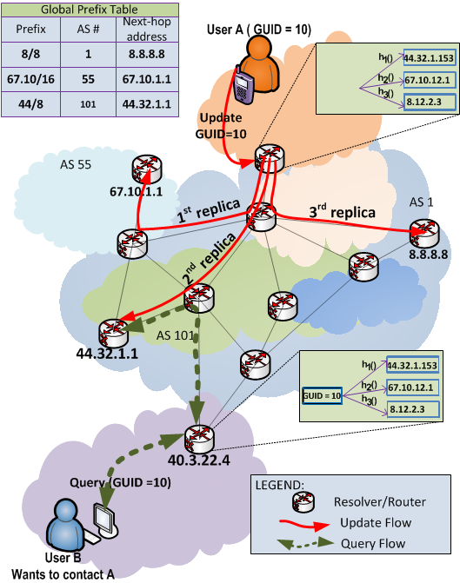
Direct Mapping (DMap)
GUID
(00101100……10011001)
Consistent hash
Consistent hash
Consistent hash
K
IP_{x}
IP_{x}
IP_{x}
IP_{x} = (44.32.1.153)
Global Prefix Table
{e.g. BGP)
IP to AS# lookup
Prefix | AS# | Nexhop
... | ... | ...
IP to AS# lookup
IP to AS# lookup
K
Retrieve the mapping from the closest AS
Mapping Lookup

Slide 14
Direct Mapping (DMap)
Minimize latency through in-network single-hop hashing
Leveraging reachability information of underlying routing infrastructure
 | Lookup Latency | Staleness | Support Flat ID | State overhead
DMAP
Low
Low
~Zero
Notes:
1. By design, DMAp support Support Flat ID which intern enable all type of name overloading for SECURITY and Migration
2. How LOW will be shown in the evaluation

Slide 15
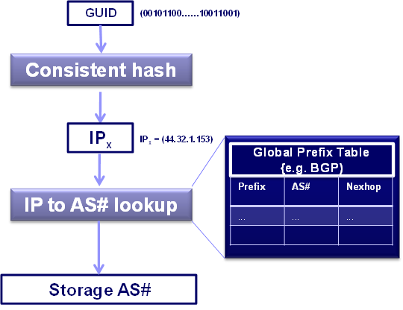
Challenges
What if the hashed IP_{x} doesn’t belong to any ASs ?
  IP hole problem
Mappings could be stored in random ASs ?
  Limited locality
Infrastructure dynamism (Routers and ASs)
  Mapping entries inconsistency

Slide 16
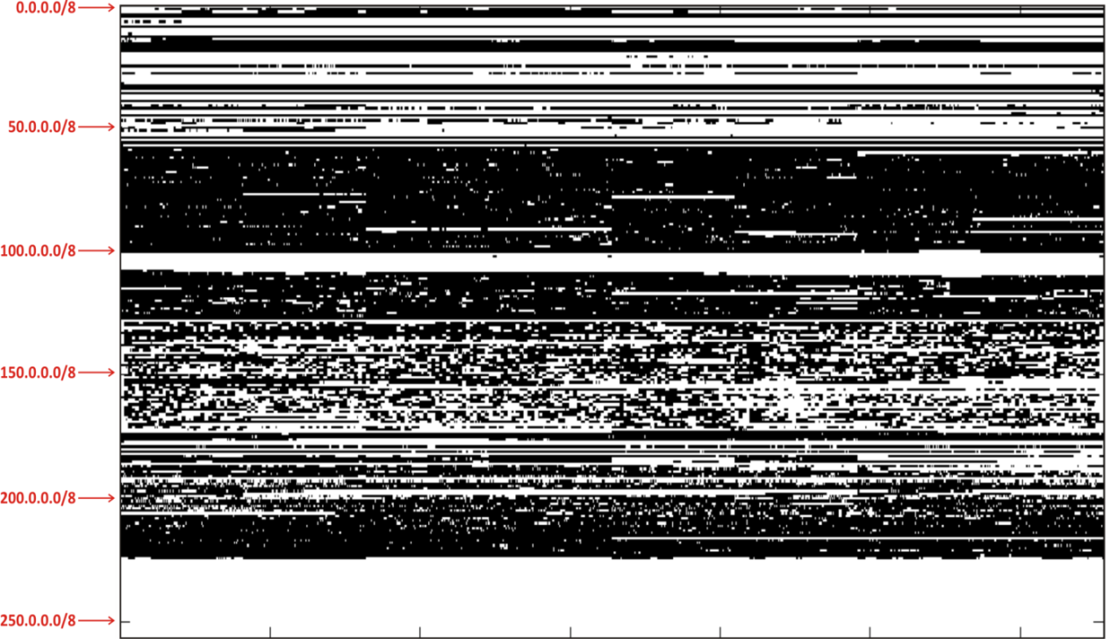
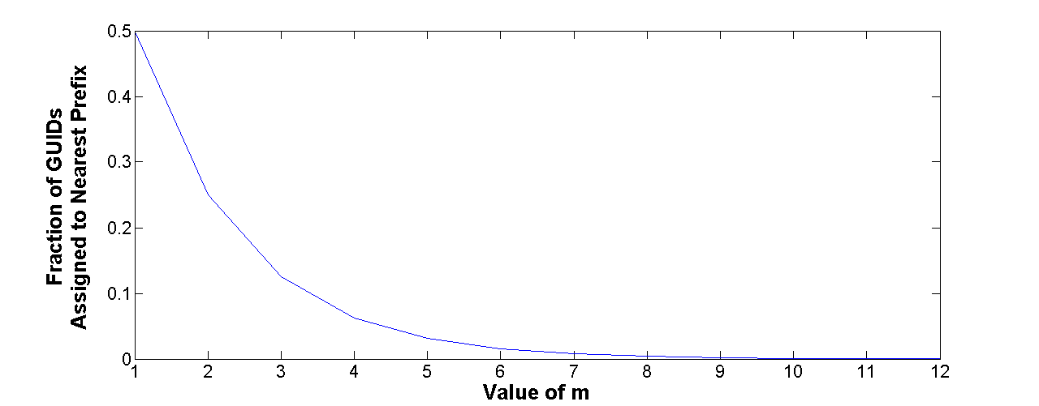
Fixing IP Holes for IPv4
Fixing IP Holes:
  If hash of GUID falls in the IP hole, rehash that IP m times to get out of the hole
  Lookup follows the same process to find GUID
Map of IP (/8) address space (white = unassigned addresses)
Value at m=10 is 0.0009

Slide 17
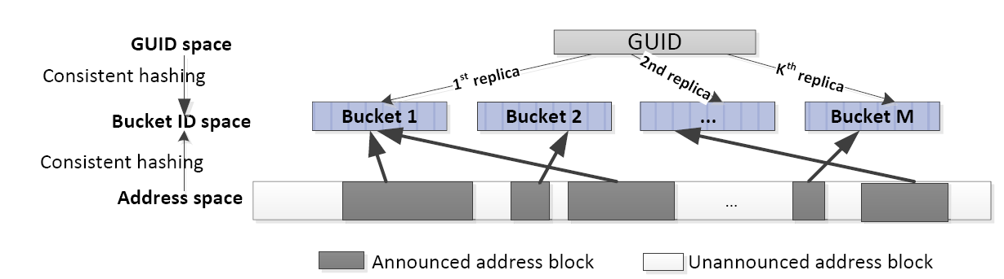
Fixing IP Holes for Larger
Network Addressing Schemes
In a general network addressing scheme, we can have more holes than used segments (e.g., IPv6)
Used address segments are hashed into N buckets
  a two-level index: (bucket ID: segment ID)
Mapping GUID to NA
  H₁(GUID) → bucket ID
  H₂(GUID) → segment ID within a bucket

Slide 18


Capturing Locality
Spatial locality:
  GUIDs will be more often accessed by local nodes (within the same AS)
Solution: Keep a local replica of the mapping
  A lookup can involve simultaneous local lookup and global lookup
  Updates are issued to both Local NRS ( LNRS) and Global NRS (GNRS)
Local replica
GUID | AS#
10 | 1
AS 1
GUID 10
AS 5
K=1
AS 200
K=3
AS 101
GUID | AS#
10 | 1
GUID | AS#
10 | 1
K=2
GUID | AS#
10 | 1

Slide 19
Inconsistent Mapping Entries
GUID | NA
C | H
GNRS
GUID
Publishing
2. GNRS
lookup
H
3. GNRS
Reply: H
C
H’

Slide 20
Inconsistent Mapping Entries
GUID | NA
C | H
GNRS
GUID
Publishing
2. GNRS
lookup
H
3. GNRS
Reply: H
GUID
Update
4. connect
5. miss
H’
6. Keep checking
GNRS until H’

Slide 21
Inconsistent Mapping Entries
GUID | NA
C
GNRS
H’
GUID
Publishing
2. GNRS
lookup
H
3. GNRS
Reply: H
GUID
Update
4. connect
5. miss
7. connect
H’
reply
6. Keep checking
GNRS until H’

Slide 22
Prototype and evaluation
Internet-scale simulation
  A custom built simulation at today’s Internet scale
    With 26,000 Autonomous Systems
    Real-world traffic and latency from DIMES repository
  Lookup and update latency ?
  Storage Fairness ?
Emulation of GNRS on the Orbit Testbed
  In memory Berkeley DB on each node
  Topology according to the Jellyfish model
  Each Orbit node representing multiple Ass
Qualitative reasoning using Jellyfish model
  Effects of number of replica on look up latency ?

Slide 23
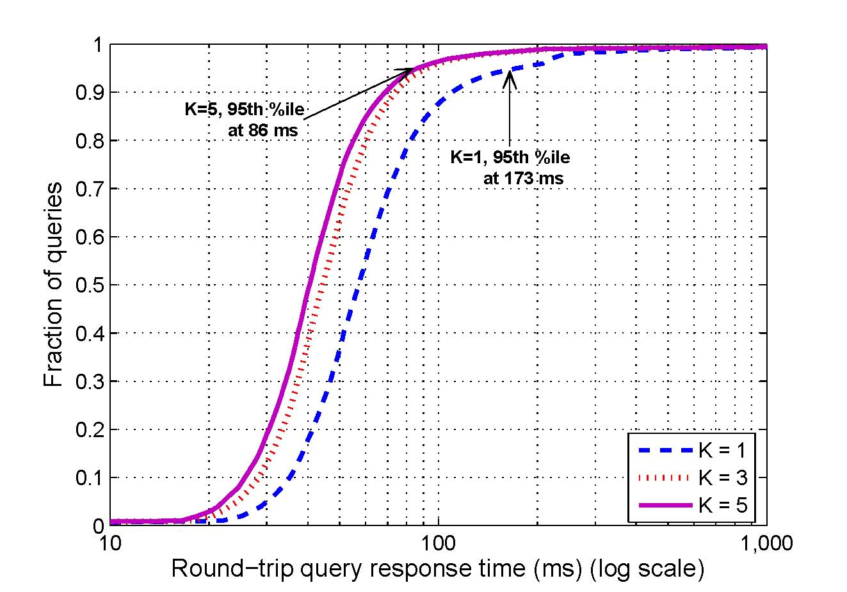
Simulation Results – Query Latencies

Slide 24
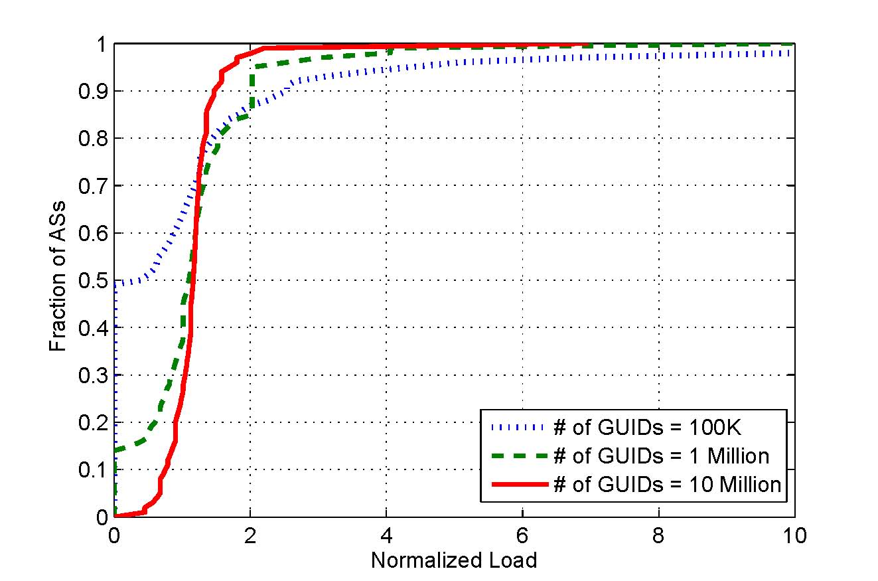
Simulation Results – Load Distribution

Slide 25
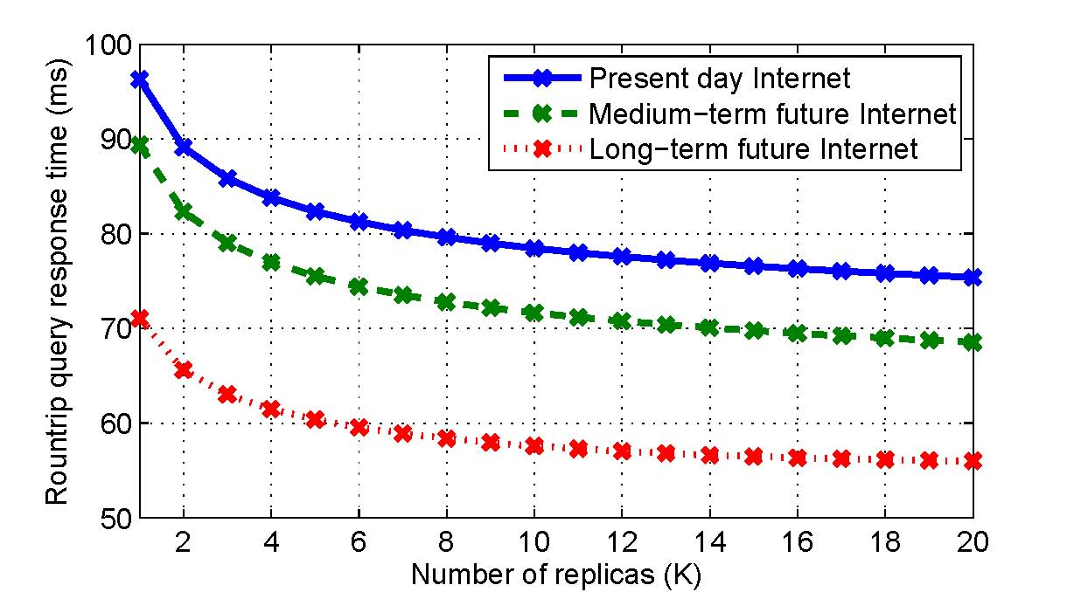
Tomorrow’s Internet
A Jellyfish model
  Captures each AS’s distance to the core
Tomorrow’s Internet
  More and larger ASs
  More direct paths between ASs and the core

Slide 26
Conclusion
We presented the concept, design and evaluation of a highly scalable, distributed cooperative mapping system, called Dmap
We shown that leveraging reachability information of underlying routing layer would help eliminating the need of maintaining states
 | Lookup Latency | Staleness | Support Flat ID | State overhead
DNS | Low | High |  | Low
LISP-TREE | High | Normal |  | Low
LISP-DHT | Low | Normal |  | High
DHT-MAP | Normal | Low |  | High
SILMS | High | Low |  | High
DMap | Low | Low |  | Low
~Zero

Slide 27

Thank you !!!
MobilityFirst
http://www.winlab.rutgers.edu/~tamvu/
Image courtesy of Jonathan Zittrain

