Slide 1
Edge Assisted Real-time Object Detection for Mobile Augmented Reality
Luyang Liu, Hongyu Li, Marco Gruteser
WINLAB, Rutgers University
05/10/2019

Slide 2
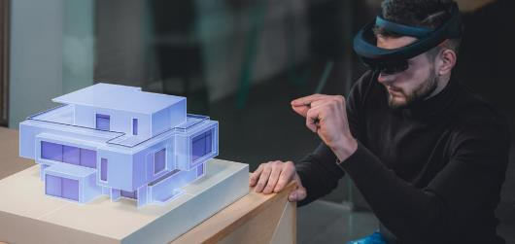

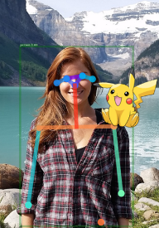
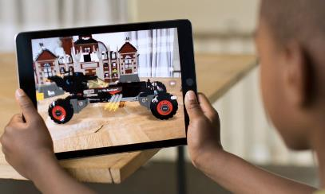


Mobile Augmented Reality
Good understanding of the 3D geometry of the surrounding.
Lack the ability to detect and classify complex objects in the real world.
Notes:
Arkit Arcore.

Slide 3
Impossible to run high quality object detection model on mobile phone at high frame rate
Model | SoC | RAM | MobileNet (224×224) (ms) | ResNet (512x512) (ms)
Huawei P20 Pro | HiSilicon Kirin 970 | 6GB | 144 | 2634
OnePlus 6 | Snapdragon 845/DSP | 8GB | 24 | 1365
Samsung Galaxy S9+ | Exynos 9810 Octa | 6GB | 148 | 1572
Google Pixel 2 | Snapdragon 835 | 4GB | 143 | 1953
http://ai-benchmark.com/ranking
Notes:
heat dissipation issues

Slide 4


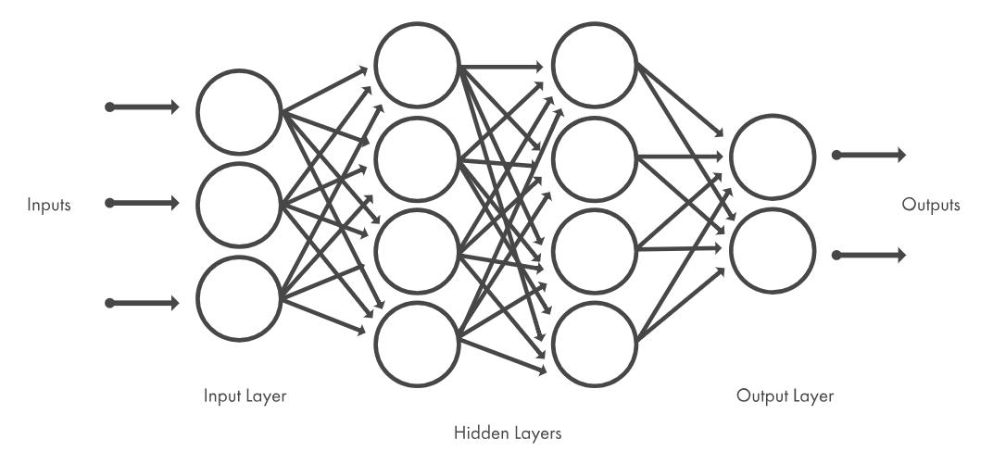



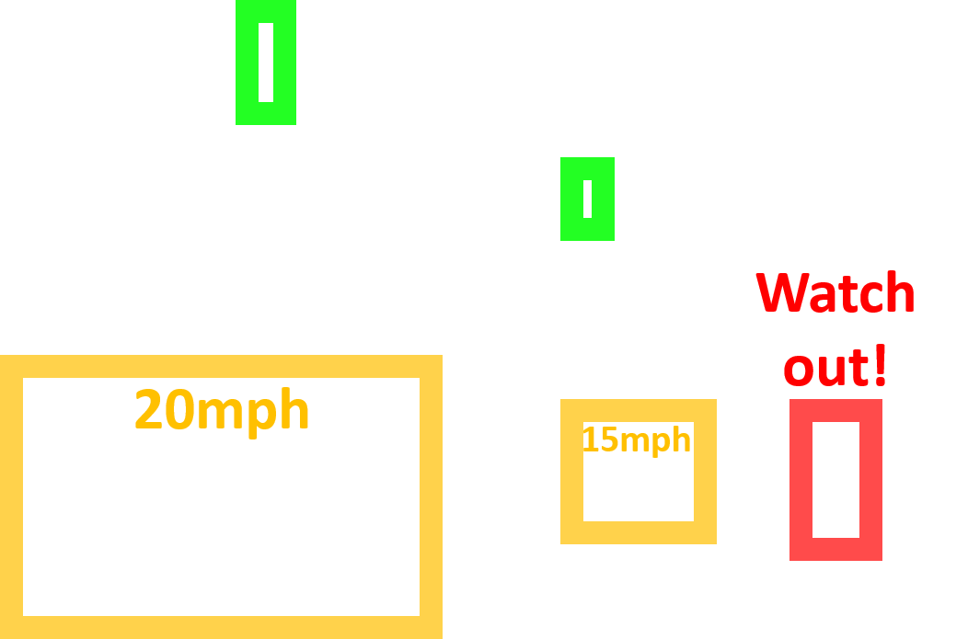
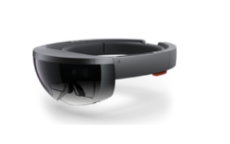
Opportunity: Offload Vision Tasks to Edge Cloud
Edge Cloud
Challenge: Long latency (around 80ms)
significantly decreases detection accuracy.
T₁
T₂
T₃
T₄
AR Headset
Frame Uploading
Object Detection
Rendering

Slide 5
Our Contribution
Low latency offloading techniques:
  Dynamic RoI Encoding.
  Parallel Streaming and Inference.
  Model quantization
  Latency: 80ms -> 15ms.
On-device fast object tracking technique:
  Motion Vector based Object Tracking.
  Latency: 15ms -> 2.24ms.
Adaptive Offloading technique.
We achieve 60fps high quality object detection on mobile devices on 1280x720 resolution video fames.

Slide 6



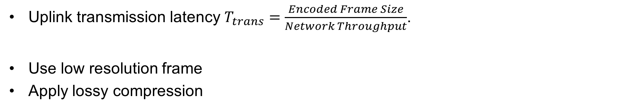
Dynamic RoI Encoding
Uplink transmission latency $T_{trans}=\frac{Encoded Frame Size}{Network Throughput}$.
Use low resolution frame
Apply lossy compression
=> Decrease detection accuracy.
Original Frame
Low Resolution Frame
Lossy Frame

Slide 7
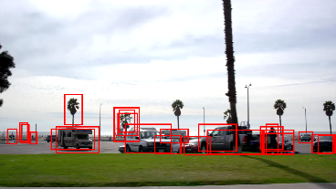
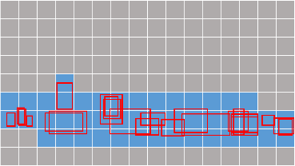
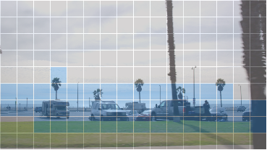
Dynamic RoI Encoding
RoI – Regions of Interest
Detect RoIs on the last offloaded frame.
Mark macroblocks that overlap with RoIs.
Change encoding quality on the current frame.

Slide 8



Parallel Streaming and Inference
…01010110101010101…
…10101011011010101…
Encoding
Transmission
Decoding
Inference

Slide 9

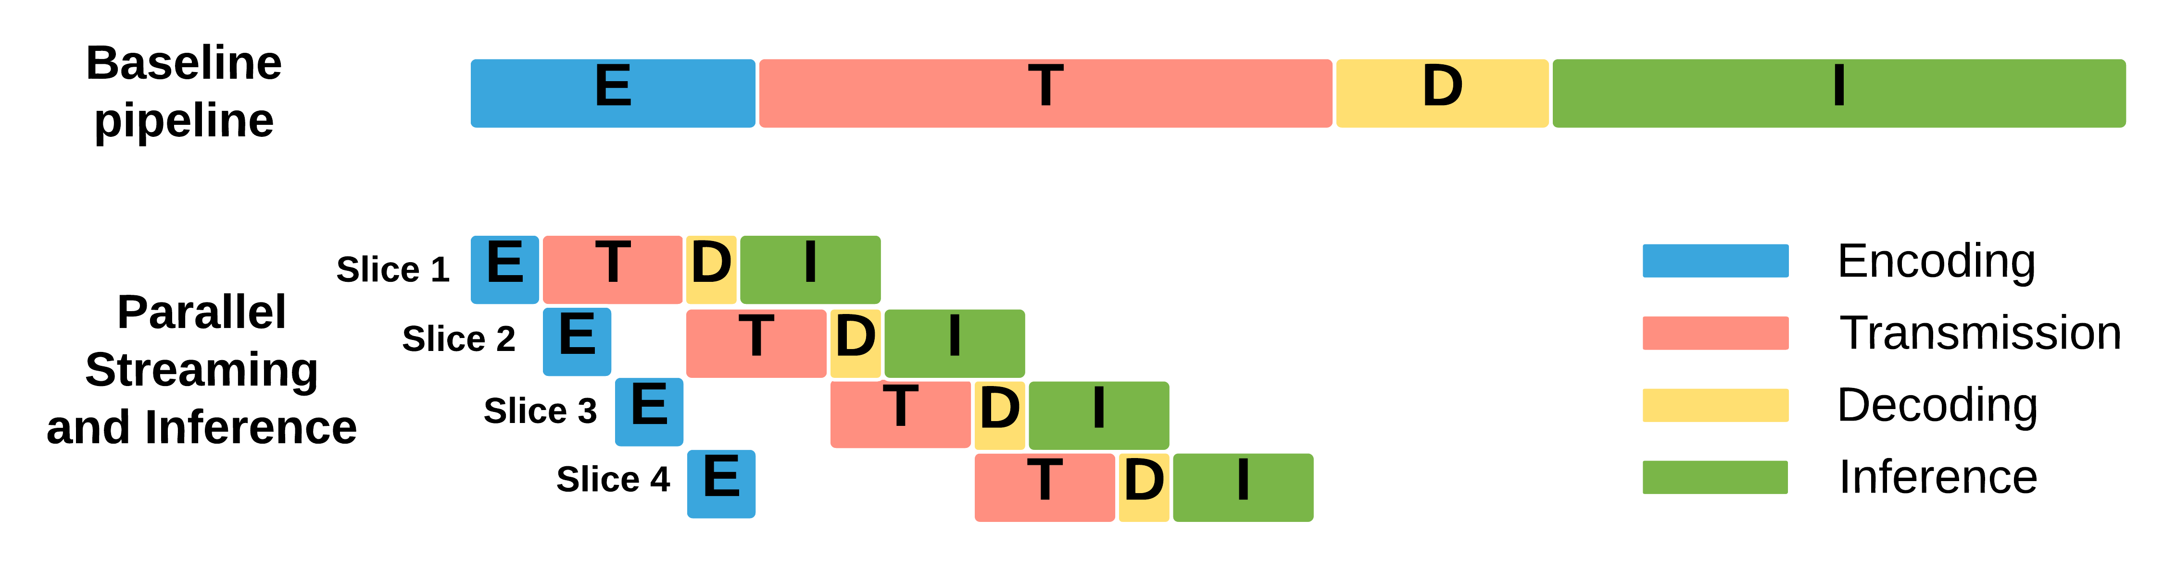
Parallel Streaming and Inference
Encoding
Transmission
Decoding
Inference
Encoding
Transmission
Decoding
Inference
Encoding
Transmission
Decoding
Inference
Encoding
Transmission
Decoding
Inference
Latency Reduction

Slide 10


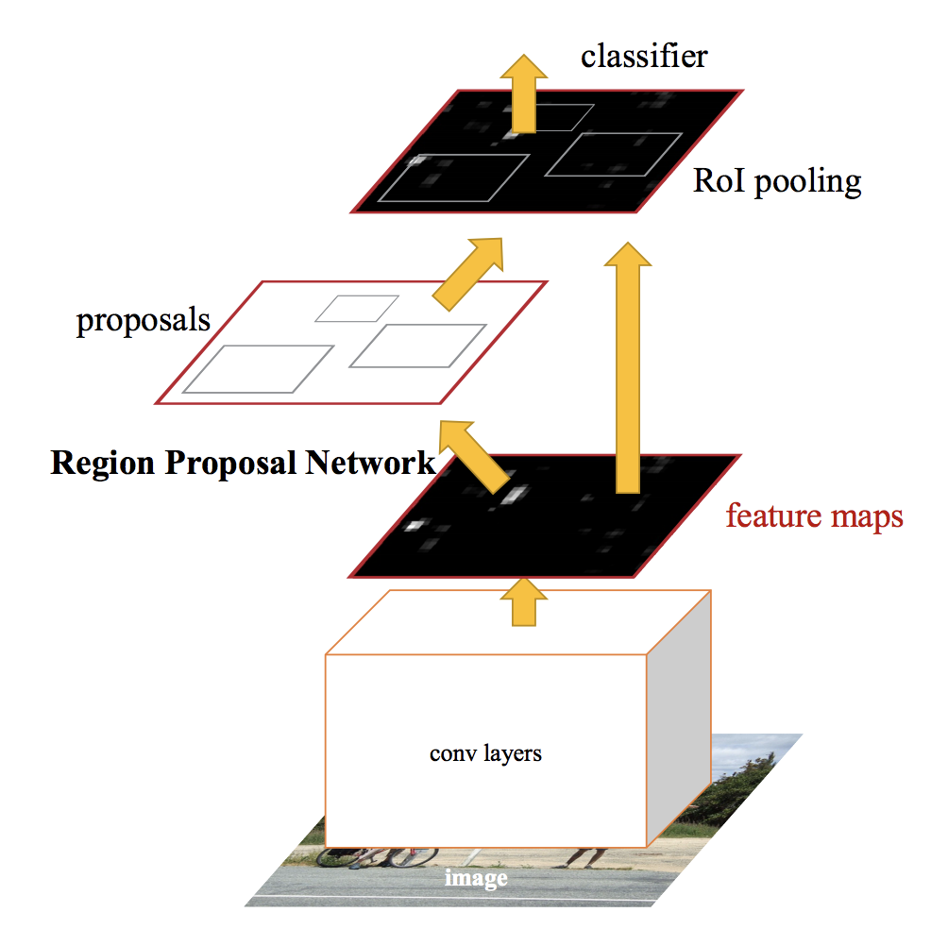

Dependency Aware Inference
Depth of Convolutional Neural Network
Faster RCNN Object Detection Model
Slice 1
Slice 2
Slice 3
Slice 4

Slide 11
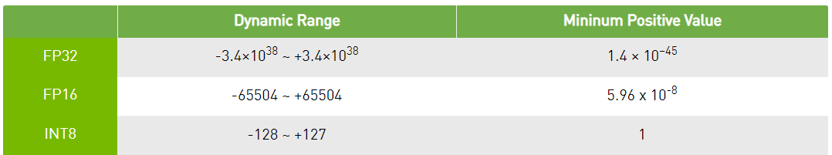
TensorRT INT8 Inference
Dynamic range and minimum precision.
Improve inference latency significantly.

Slide 12
Our Contribution
Low latency offloading techniques:
  Dynamic RoI Encoding.
  Parallel Streaming and Inference.
  Model quantization
  Latency: 80ms -> 15ms.
On-device fast object tracking technique:
  Motion Vector based Object Tracking.
  Latency: 15ms -> 2.24ms.
Adaptive Offloading technique.

Slide 13

Motion Vector based Object Tracking
Traditional Approach: SIFT and Optical flow…
Our solution: Use the motion vector embedded in the video frame.
Offloaded Frame
I
P
P
...
P
P
I
P
...
Current Frame
Motion Vectors

Slide 14
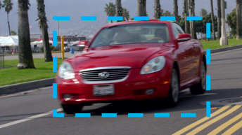
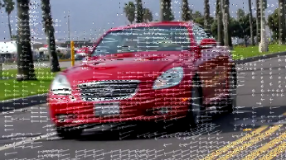
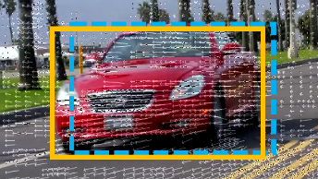
Motion Vector based Object Tracking
Cached detection result of the last offloaded frame.
Motion vectors extracted from the current encoded frame.
Shift the bounding box based on the motion vectors.

Slide 15

Adaptive Offloading
Case 1
Don’t Offload
Last Offloaded Frame
Current Frame
Case 2
Offload
Last Offloaded Frame
Current Frame

Slide 16

Our System
Offloading Pipeline
Motion Vector based Object Tracking
Cached Detection Result
Rendering Pipeline

Slide 17
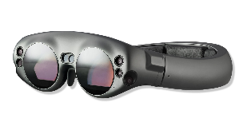
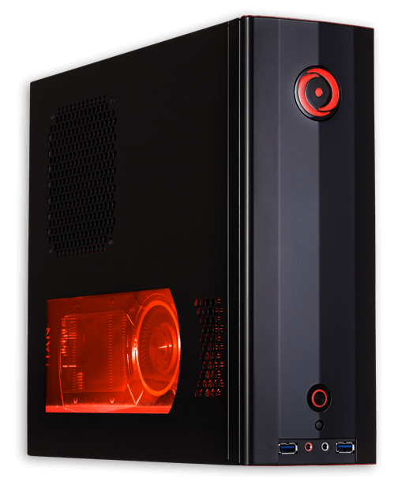
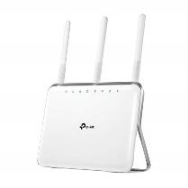
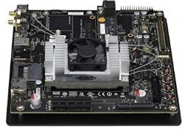
Experiment Setup
Client
Server
WiFi 2.4GHz
WiFi 5GHz
TP-Link AC1900
Nvidia Jetson TX2
Magic Leap One
Desktop PC with Nvidia Titan Xp GPU

Slide 18




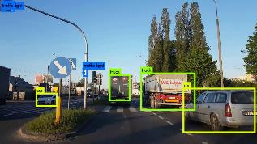
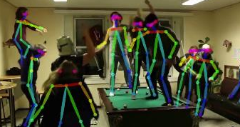
Experiment Setup
Ten videos in the Xiph video dataset.
Two object detection tasks.
Object Detection
Human Keypoint Detection

Slide 19
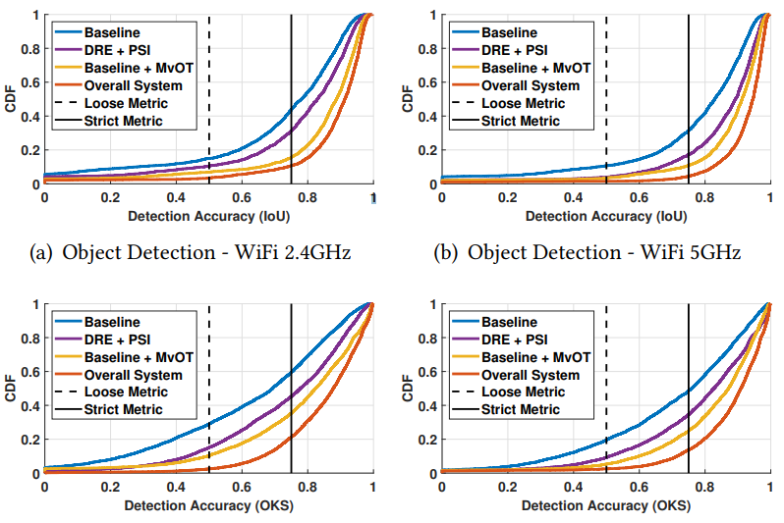
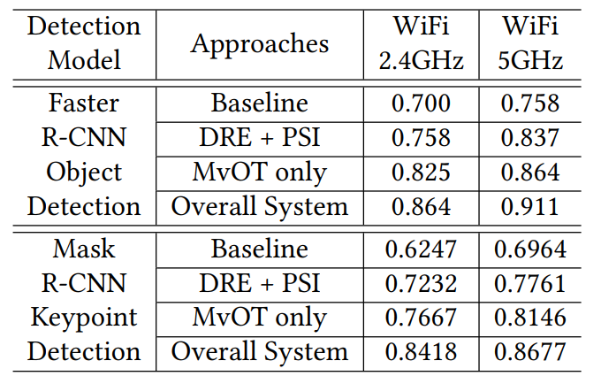
Evaluation Result
Mean Detection Accuracy (IoU/OKS) of two models with two WiFi connections.
CDF of detection accuracy (IoU/OKS) for object detection and keypoint detection task.

Slide 20
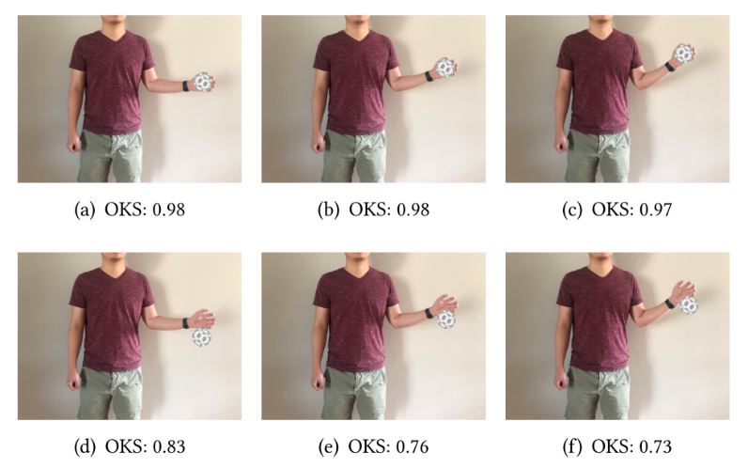
Evaluation Result
Baseline
Our System

Slide 21
Conclusion
Contribution:
  We design a system that enables high accuracy object detection for AR/MR systems running at 60fps.
  Low latency offloading techniques.
  On-device fast object tracking.
Future works:
  Improve network robustness.
  Improve camera capture and screen display latency.
  Better server-client collaboration.

Slide 22
Thank you!
Luyang Liu
luyang@winlab.rutgers.edu
http://www.winlab.rutgers.edu/~luyang/

Slide 23
Backup Slides

Slide 24



Opportunity: Offload Vision Tasks to Edge Cloud
Edge Cloud
Uplink
Transmission
Sensing
Processing
AR Device
Object Detection
Downlink
Transmission

