Slide 1
SCPL: Indoor Device-Free Multi-Subject Counting and Localization Using Radio Signal Strength
Rutgers University
Chenren Xu
Joint work with
Bernhard Firner, Robert S. Moore, Yanyong Zhang
Wade Trappe, Richard Howard, Feixiong Zhang, Ning An

Slide 2
Device-free Localization

Slide 3
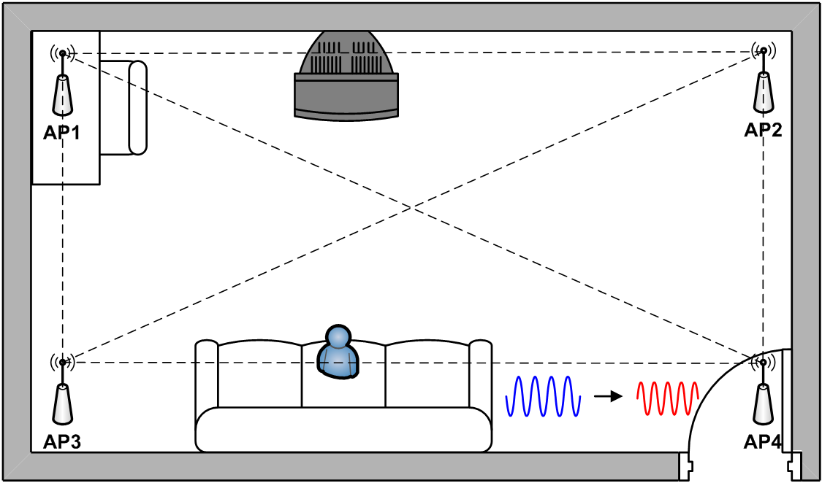
Device-free Localization

Slide 4
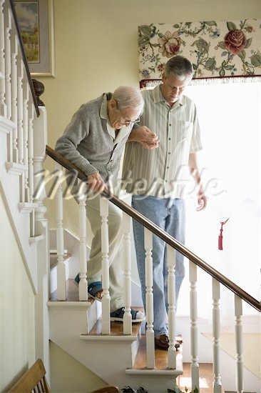
Why Device-free Localization?
Monitor indoor human mobility
Elder/health care

Slide 5
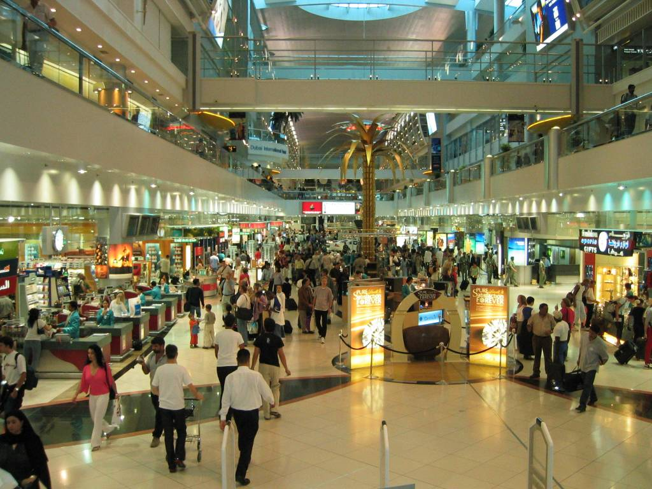
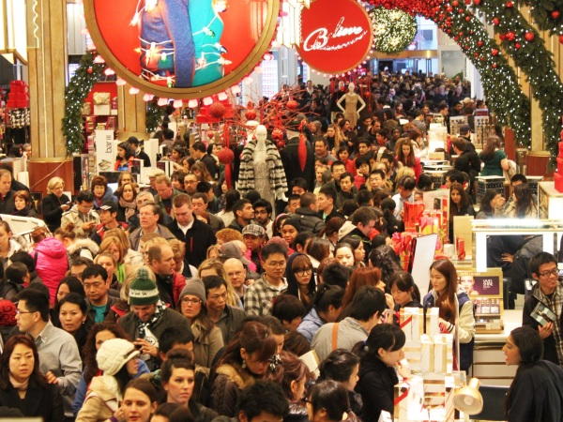
Why Device-free Localization?
Monitor indoor human mobility
Traffic flow statistics

Slide 6
Why Device-free Localization?
Monitor indoor human mobility
Health/elder care, safety
Detect traffic flow
Provides privacy protection
No identification
Use existing wireless infrastructure

Slide 7
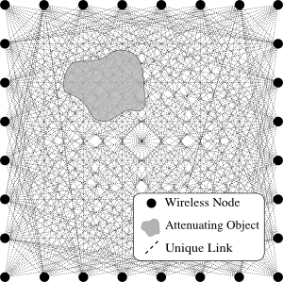
Previous Work
Single subject localization
Geometry-based approach (i.e. RTI)

Slide 8
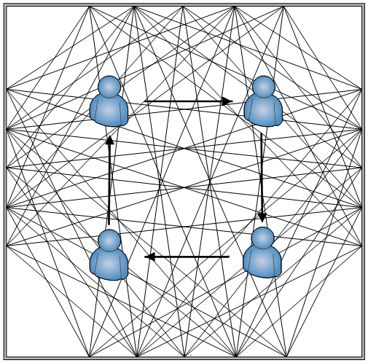
Previous Work
Single subject localization
Fingerprinting-based approach

Slide 9
Previous Work
Single subject localization
Fingerprinting-based approach
Require fewer nodes
More robust to multipath

Slide 10
Fingerprinting N Subjects?
Multiple subjects localization
Needs to take calibration data from N people for localizing N people

Slide 11
Fingerprinting N Subjects
…
9 trials in total for 1 person

Slide 12
Fingerprinting N Subjects
…

Slide 13
Fingerprinting N Subjects
…
…

Slide 14
Fingerprinting N Subjects
…
…
…
36 trials in total for 2 people!

Slide 15
Fingerprinting N Subjects
 | 1 person
9 cells | 9
9 × 1 min = 9 min

Slide 16
Fingerprinting N Subjects
 | 1 person | 2 people
9 cells | 9 | 36
36 cells | 36 | 630
630 × 1 min = 10.5 hr

Slide 17
Fingerprinting N Subjects
 | 1 person | 2 people | 3 people
9 cells | 9 | 36 | 84
36 cells | 36 | 630 | 7140
100 cells | 100 | 4950 | 161700
161700 × 1 min = 112 days
The calibration effort is prohibitive !

Slide 18
SCPL
Input:
Collecting calibration data only from 1 subject
Observed RSS change caused by N subjects
Output:
count and localize N subjects.
Main insight:
If N is known, localization will be straightforward.

Slide 19
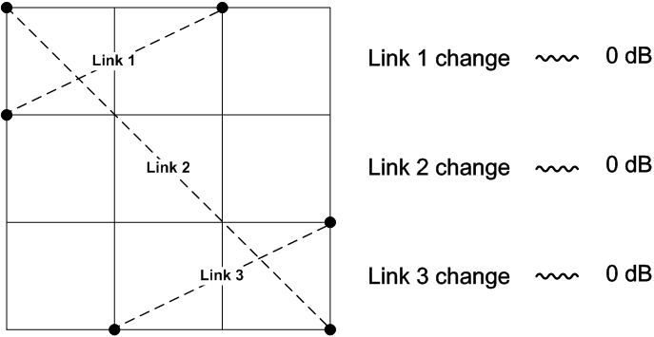
No Subjects

Slide 20
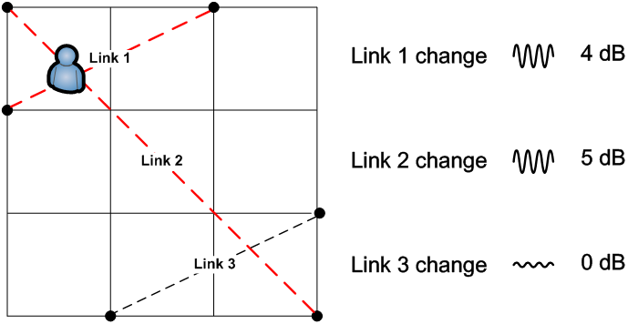
One Subject

Slide 21
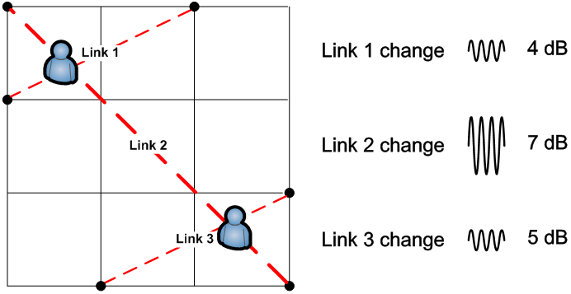
Two Subjects

Slide 22
Measurement
 | N = 0 | N = 1 | N = 2
Link 1 | 0 | 4 | 4
Link 2 | 0 | 5 | 7
Link 3 | 0 | 0 | 5
Total (∆N) | 0 | 9 | 16
∆N N?
∆N / ∆1 = N?

Slide 23
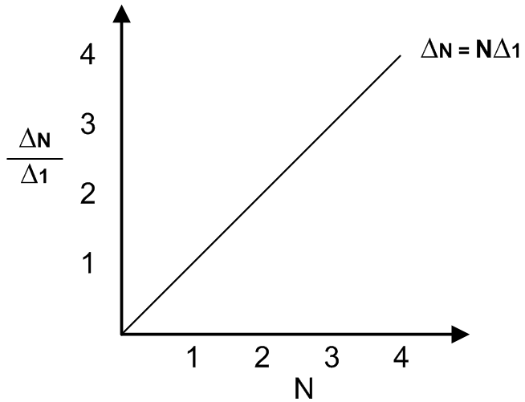
Linear relationship

Slide 24
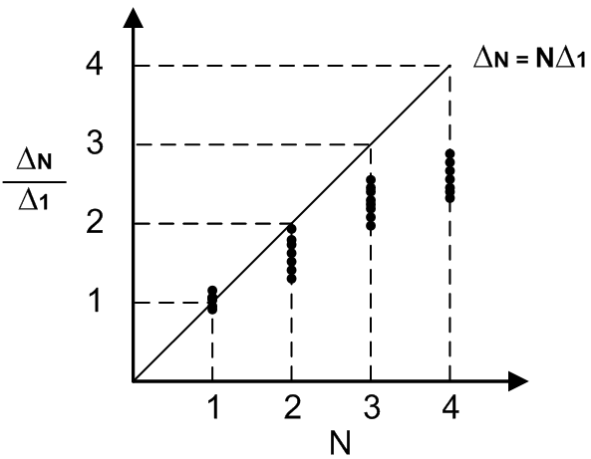
Measurement
1.6
Nonlinear problem!
∆N / ∆1 < N

Slide 25
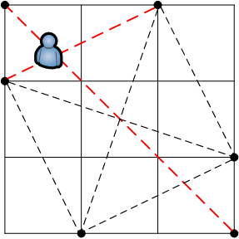
Closer Look at RSS change
4 dB
5 dB

Slide 26
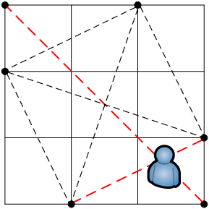
Closer Look at RSS change
6 dB
5 dB

Slide 27
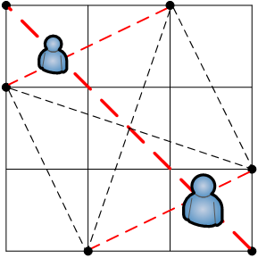
Closer Look at RSS change
4 dB
4 dB
+
6 dB
=
7 dB
?
5 dB
5 dB
5 dB
4 dB + 0 dB = 4 dB √
5 dB + 6 dB = 11 dB ≠ 7 dB X
0 dB + 5 dB = 5 dB √

Slide 28
Closer Look at RSS change
+
6 dB
≠
7 dB
!
5 dB
5 dB + 6 dB ≠ 7 dB X
Shared links observe nonlinear fading effect from multiple people

Slide 29
SCPL Part I
Sequential Counting (SC)

Slide 30
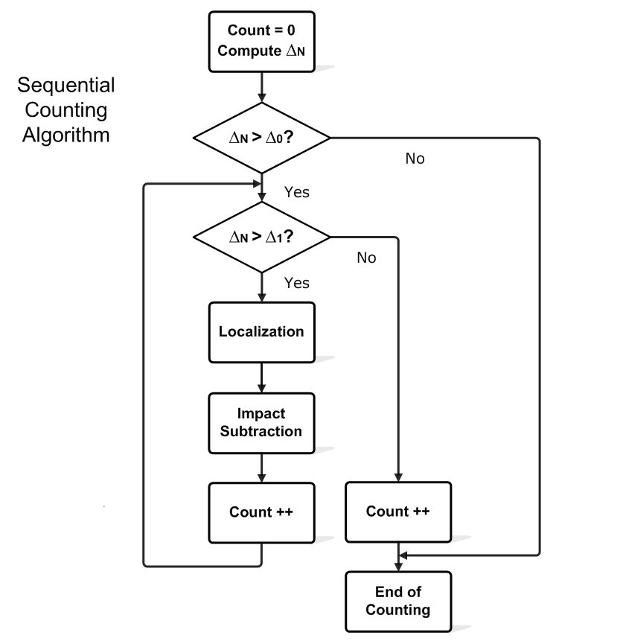
Counting algorithm
Detection

Slide 31
Phase 1: Detection
4 dB
∆N = 4 + 7 + 5 = 16 dB
∆N > ∆1
More than one person!
7 dB
5 dB
Measurement in 1st round

Slide 32
Phase 2: Localization
4 dB
PC-DfP:
7 dB
Find this guy
5 dB
Measurement in 1st round
C. Xu, B. Firner, Y. Zhang, R. Howard, J. Li, and X. Lin. Improving rf-based device-free passive localization in cluttered indoor environments through probabilistic classification methods. In Proceedings of the 11th international conference on Information Processing in Sensor Networks, IPSN ’12

Slide 33
Phase 3: Subtraction
6 dB
5 dB
Calibration
data

Slide 34
Phase 3: Subtraction
4 dB
4 dB
-
=
7 dB
6 dB
1 dB
5 dB
5 dB
Measurement in 1st round
Calibration
data
Measurement
In 2nd round
Subject count ++
Go to the next iteration…

Slide 35
Phase 3: Subtraction
4 dB
4 dB
-
=
7 dB
6 dB
1 dB
5 dB
5 dB
Measurement in 1st round
Calibration
data
Measurement
In 2nd round
Subject count ++
Go to the next iteration…
Hold on …

Slide 36
Phase 3: Subtraction
4 dB
1 dB
Measurement
In 2nd round

Slide 37
Phase 3: Subtraction
4 dB
4 dB
1 dB
5 dB
Measurement
In 2nd round
Calibration
data

Slide 38
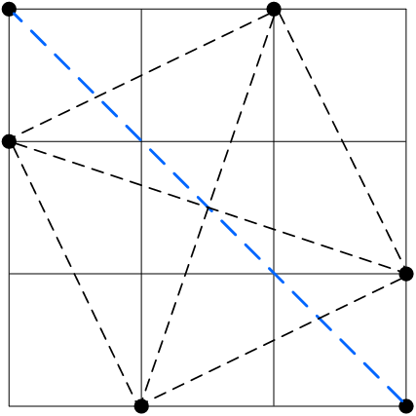
Phase 3: Subtraction
4 dB
4 dB
-
=
1 dB
5 dB
-4 dB
Measurement
In 2nd round
Calibration
data
We over-subtracted its impact
on shared link!

Slide 39
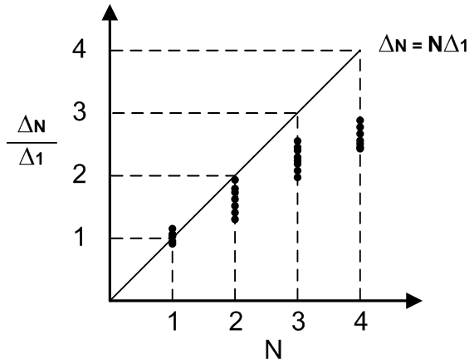
Measurement

Slide 40
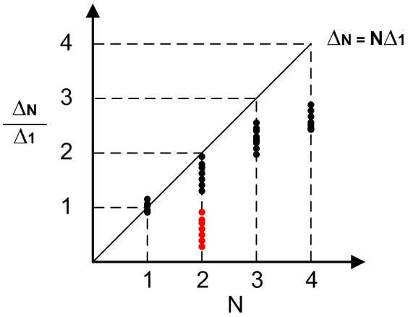
Measurement
1st round

Slide 41
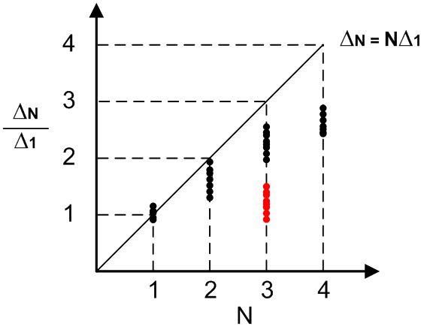
Measurement
1st round

Slide 42
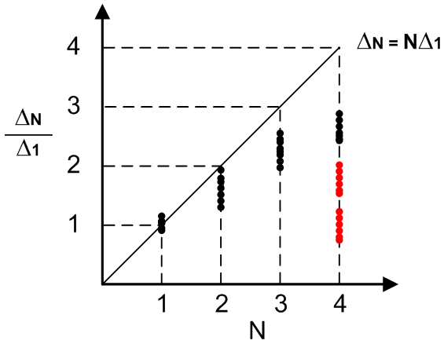
Measurement
1st round
2st round

Slide 43
Phase 3: Subtraction
4 dB
4 dB
-
=
7 dB
6 dB
1 dB
5 dB
5 dB
Measurement in 1st round
Calibration
data
Measurement
In 2nd round
We need to multiply a coefficient β ϵ [0, 1]
when subtracting each link

Slide 44
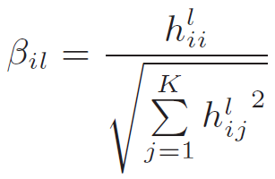
Location-Link Correlation
To mitigate the error caused by this over-subtraction problem, we propose to multiply a location-link correlation coefficient before successive subtracting:

Slide 45
Phase 3: Subtraction
4 dB
4 dB
-
=
4.6 dB
7 dB
6 × 0.4 dB
5 dB
5 × 0.8 dB
1 dB
Measurement in 1st round
Calibration
data
Measurement
in 2nd round
Subject count ++
Go to the next iteration…

Slide 46
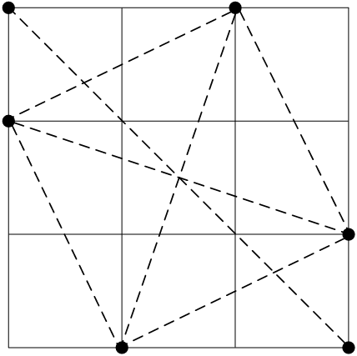
Phase 3: Subtraction
4 dB
4 × 0.8 dB
1 dB
4.6 dB
-
6 × 0.6 dB
=
1 dB
1 dB
1 dB
Measurement
in 2nd round
Calibration
data
Measurement
in 3rd round
We are done !

Slide 47
SCPL Part II
Parallel Localization (PL)

Slide 48
Localization
Cell-based localization
Allows use of context information
Reduce calibration overhead
Classification problem formulation
C. Xu, B. Firner, Y. Zhang, R. Howard, J. Li, and X. Lin. Improving rf-based device-free passive localization in cluttered indoor environments through probabilistic classification methods. In Proceedings of the 11th international conference on Information Processing in Sensor Networks, IPSN ’12

Slide 49
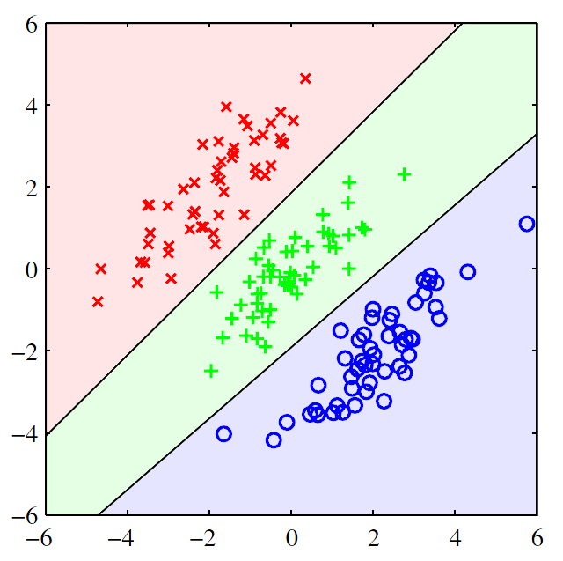
Linear Discriminant Analysis
RSS measurements with person’s presence in each cell is treated as a class/state k
Each class k is Multivariate Gaussian with common covariance
Linear discriminant function:
Link 2 RSS (dBm)
k = 1
k = 2
k = 3
Link 1 RSS (dBm)
C. Xu, B. Firner, Y. Zhang, R. Howard, J. Li, and X. Lin. Improving rf-based device-free passive localization in cluttered indoor environments through probabilistic classification methods. In Proceedings of the 11th international conference on Information Processing in Sensor Networks, IPSN ’12

Slide 50
Localization
Cell-based localization
Trajectory-assisted localization
Improve accuracy by using human mobility constraints

Slide 51
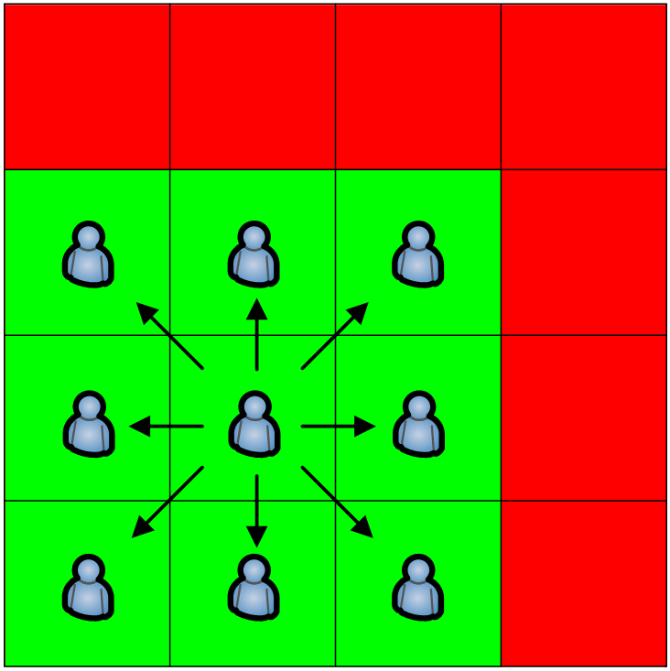
Human Mobility Constraints
You are free to go anywhere with limited step size inside a ring in free space

Slide 52
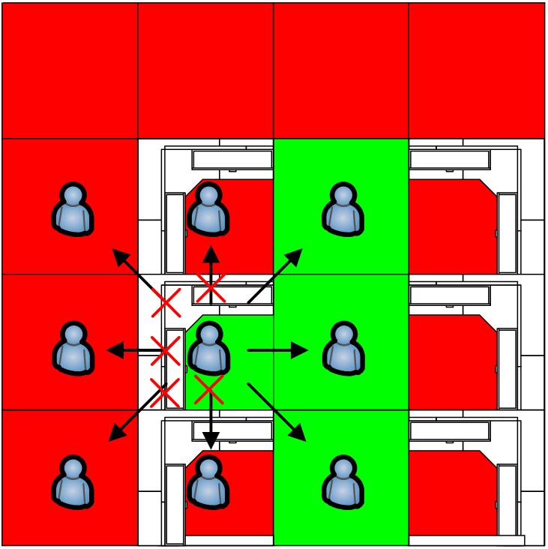
Human Mobility Constraints
In a building, your next step is constrained by cubicles, walls, etc.

Slide 53
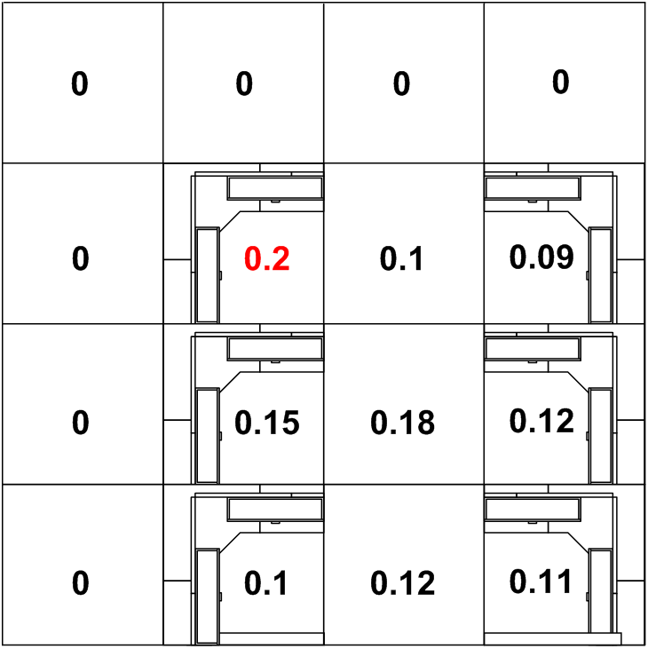
Phase 1: Data Likelihood Map

Slide 54
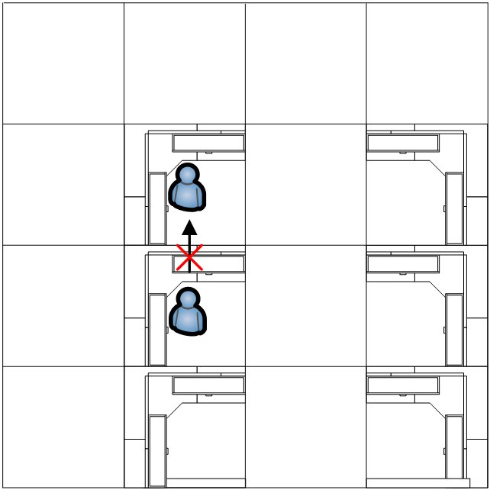
Impossible movements

Slide 55
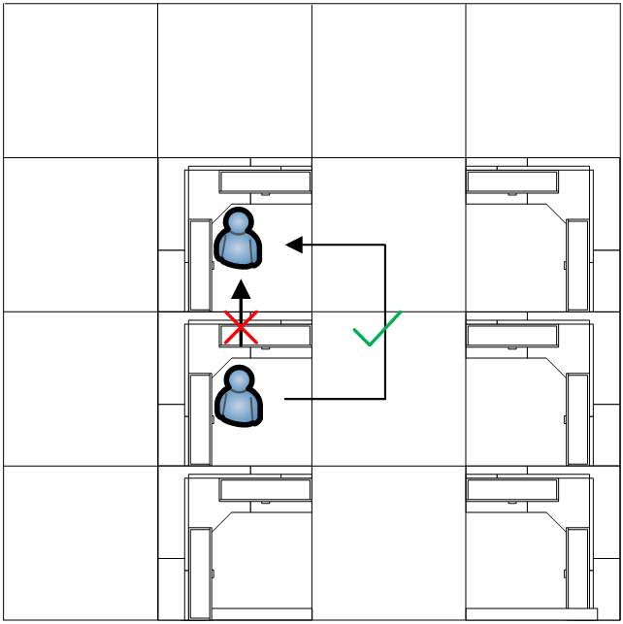
Impossible movements

Slide 56
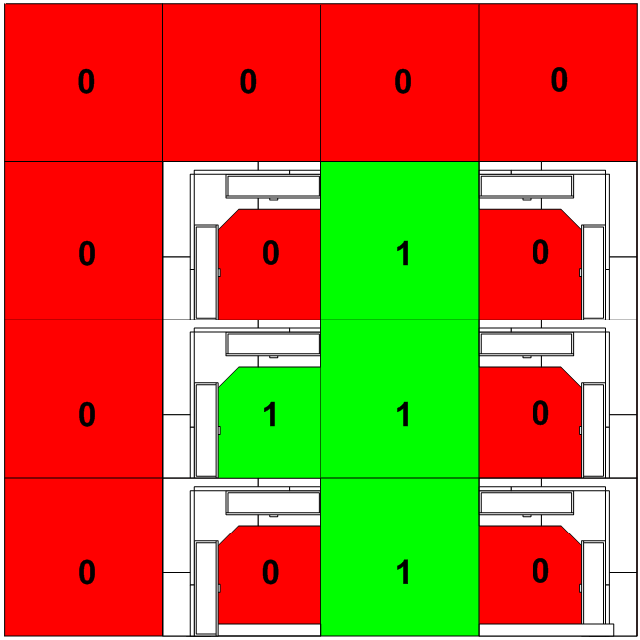
Phase 2: Trajectory Ring Filter

Slide 57
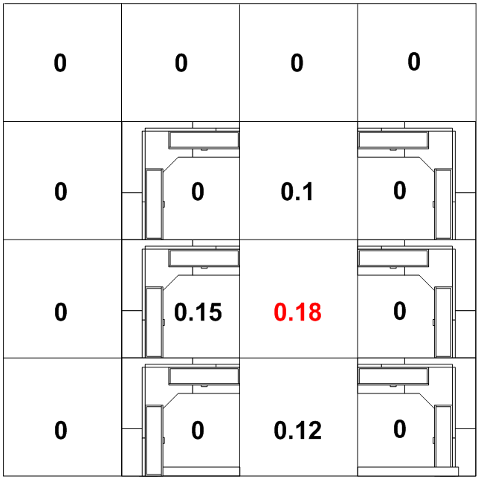
Phase 3: Refinement

Slide 58
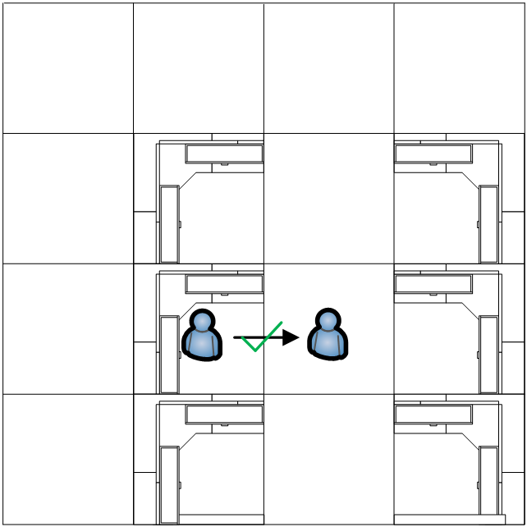
Here you are!

Slide 59
Viterbi optimal trajectory
Single subject localization
Multiple subjects localization
ViterbiScore =

Slide 60
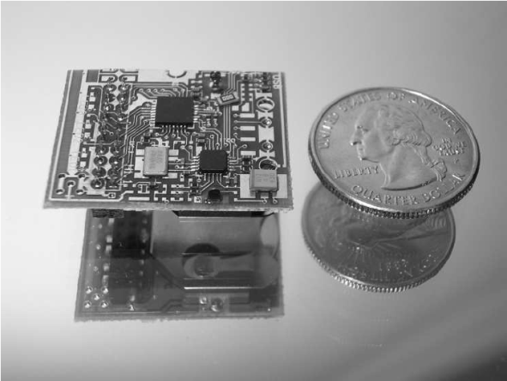
System Description
Hardware: PIP tag
Microprocessor: C8051F321
Radio chip: CC1100
Power: Lithium coin cell battery
Protocol: Unidirectional heartbeat (Uni-HB)
Packet size: 10 bytes
Beacon interval: 100 msec

Slide 61
Office deployment
Total Size: 10 × 15 m

Slide 62
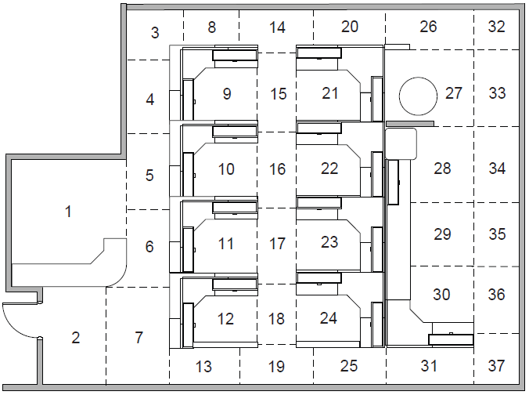
Office deployment
37 cells of cubicles, aisle segments

Slide 63
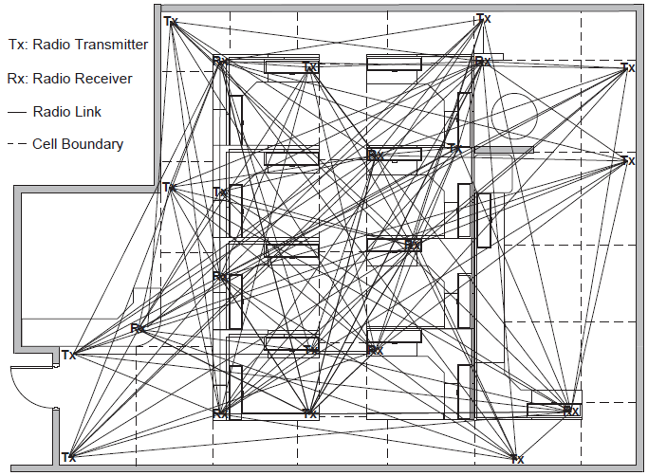
Office deployment
13 transmitters and 9 receivers

Slide 64
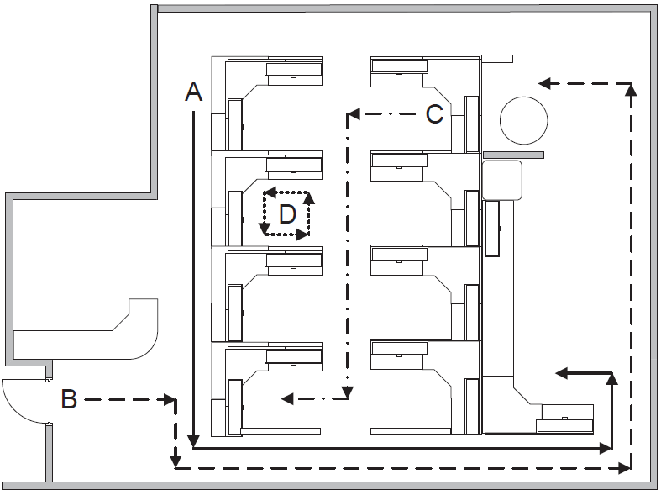
Office deployment
Four subjects’ testing paths

Slide 65
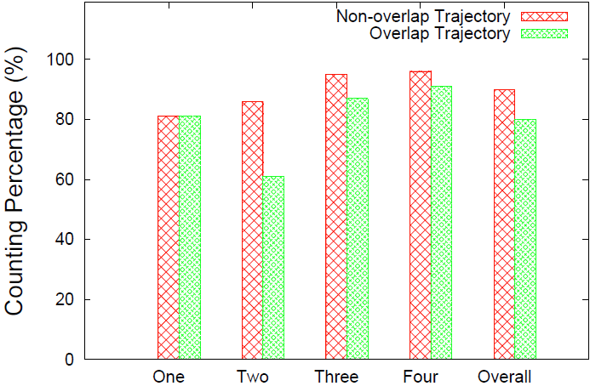
Counting results

Slide 66
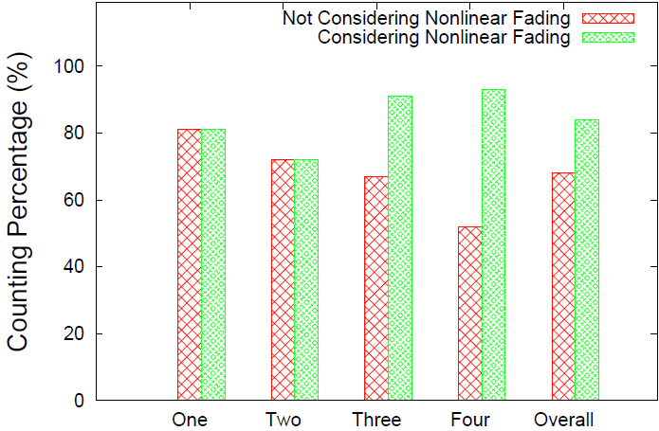
Counting results

Slide 67
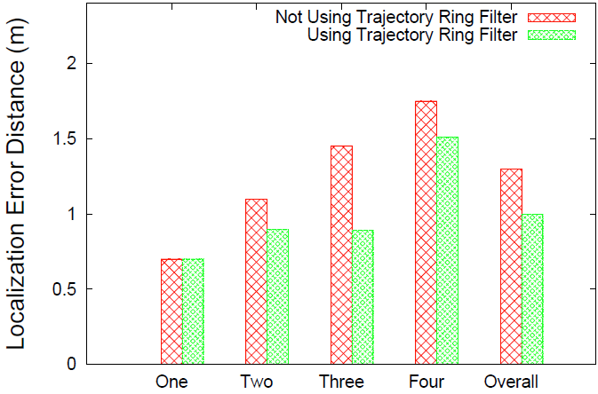
Localization results

Slide 68
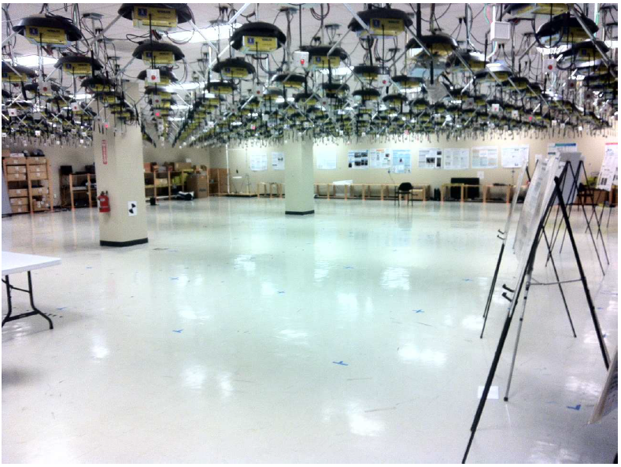
Open floor deployment
Total Size: 20 × 20 m

Slide 69
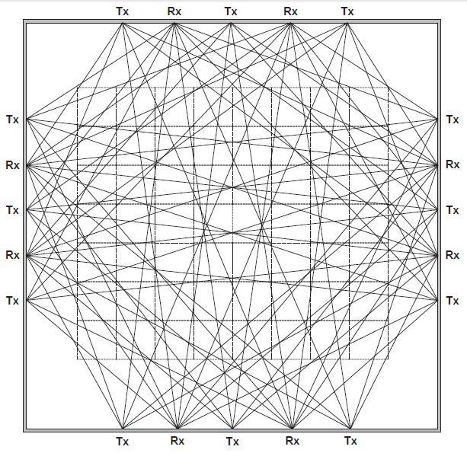
Open floor deployment
56 cells, 12 transmitters and 8 receivers

Slide 70
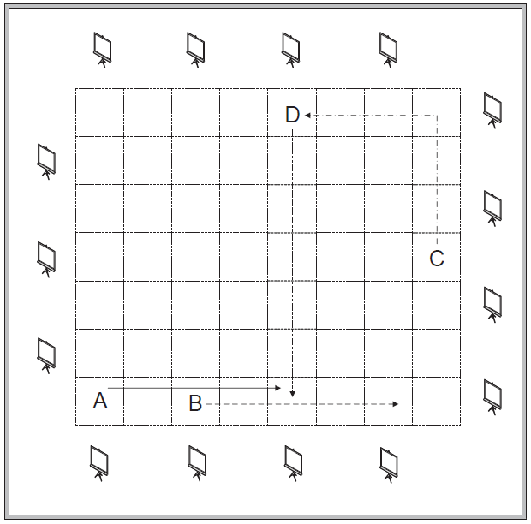
Open floor deployment
Four subjects’ testing paths

Slide 71
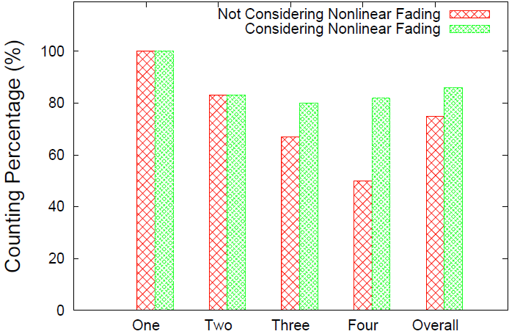
Counting results

Slide 72
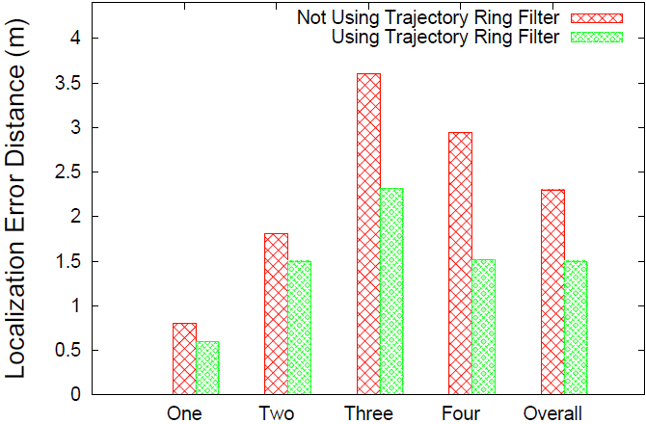
Localization results

Slide 73
Conclusion and Future Work
Conclusion
Calibration data collected from one subject can be used to count and localize multiple subjects.
Though indoor spaces have complex radio propagation characteristics, the increased mobility constraints can be leveraged to improve accuracy.
Future work
Count and localize more than 4 people

Slide 74
Q & A
Thank you

