Slide 1
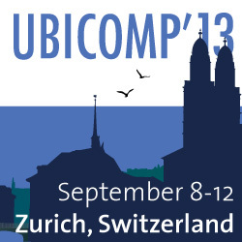
Crowd++: Unsupervised Speaker Count with Smartphones
ACM UbiComp’13
September 10th, 2013
Chenren Xu, Sugang Li, Gang Liu, Yanyong Zhang,
Emiliano Miluzzo, Yih-Farn Chen, Jun Li, Bernhard Firner

Slide 2
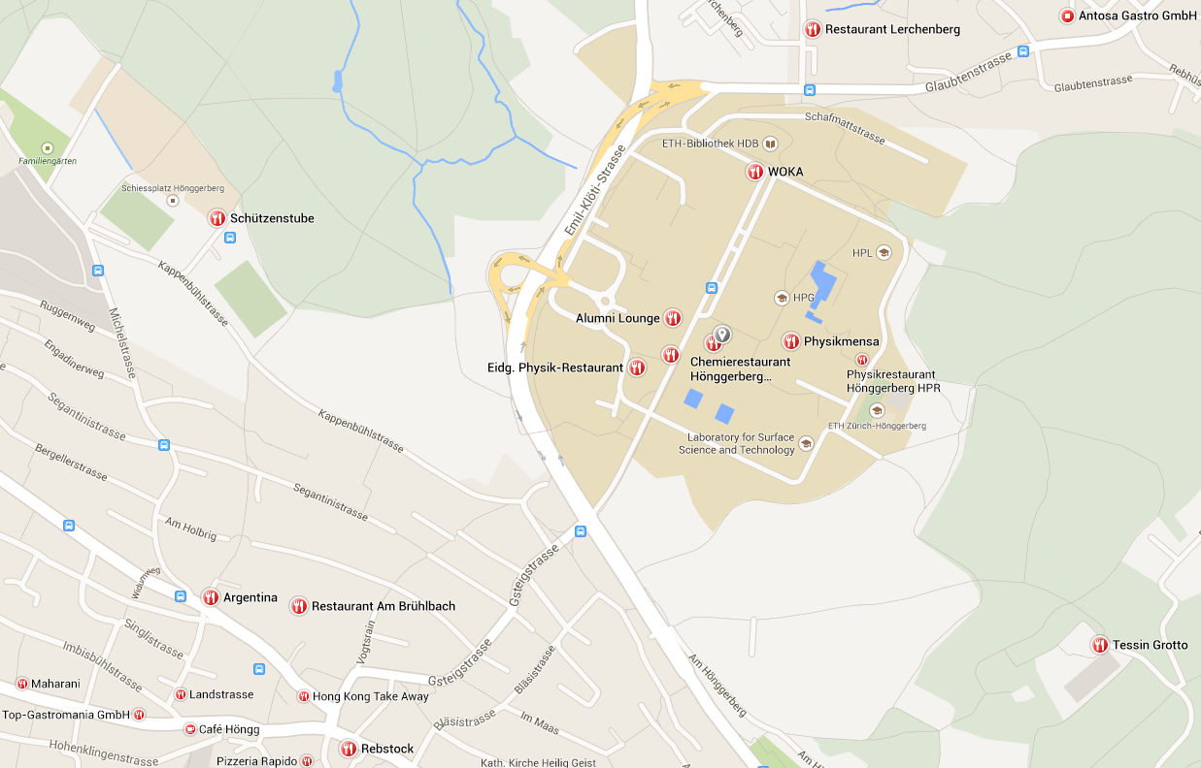
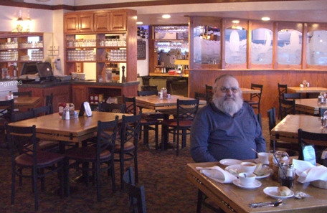
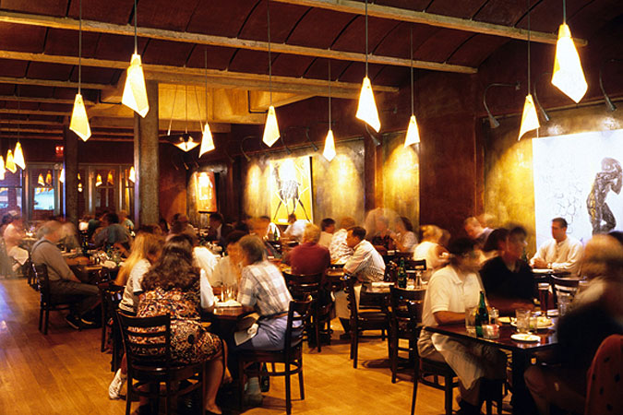
Scenario 1: Dinner time, where to go?
I will choose this one!

Slide 3
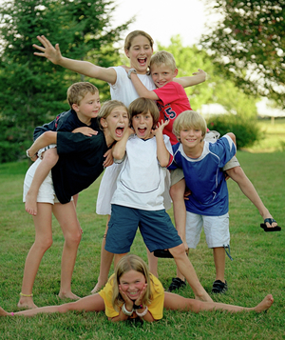
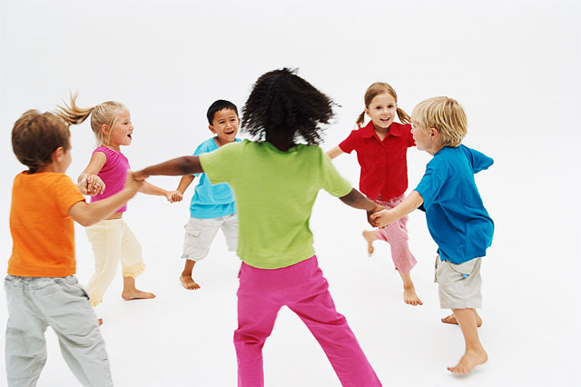
Scenario 2: Is your kid social?

Slide 4
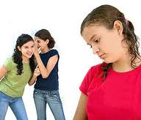
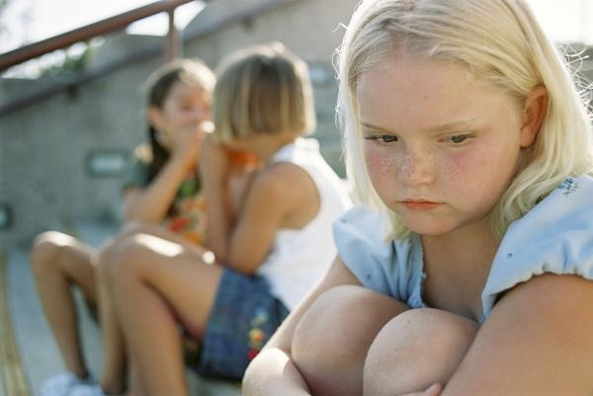
Scenario 2: Is your kid social?

Slide 5
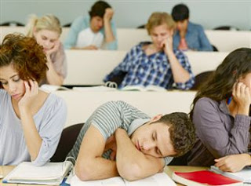
Scenario 3: Which class is attractive?
She will be my choice!

Slide 6
Solutions?
Speaker count!
Dinner time, where to go?
Find the place where has most people talking!
Is your kid social?
Find how many (different) people they talked with!
Which class is more attractive?
Check how many students ask you questions!
Microphone + microcomputer

Slide 7
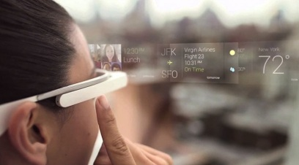
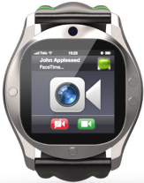
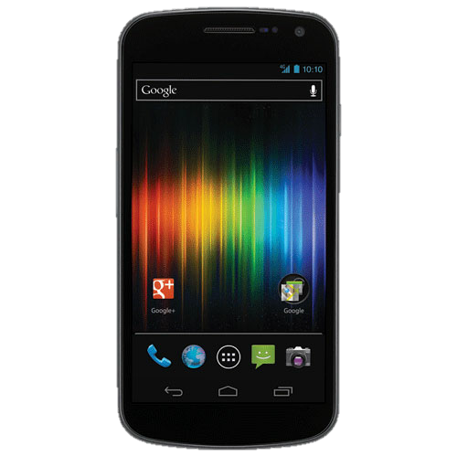
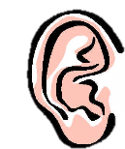
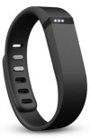
The era of ubiquitous listening
Glass
Necklace
Watch
Brace
Phone

Slide 8
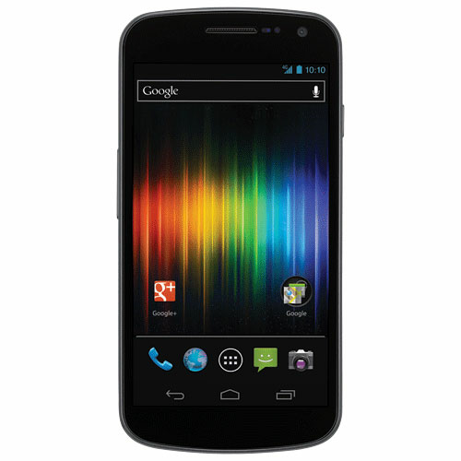
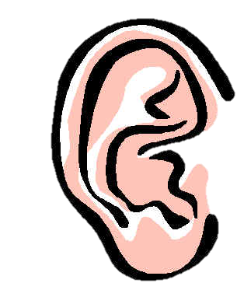
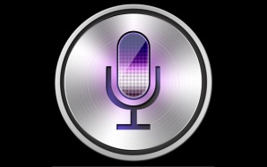
What we already have
Next thing:
Voice-centric sensing

Slide 9
Voice-centric sensing
Speech recognition
Speaker
identification
Family life
Bob
Alice
Stressful
Emotion detection
3
Speaker count
2

Slide 10
How to count?
Challenge
No prior knowledge of speakers
Background noise
Speech overlap
Energy efficiency
Privacy concern

Slide 11
How to count?
Challenge | Solution
No prior knowledge of speakers | Unique features extraction
Background noise | Frequency-based filter
Speech overlap | Overlap detection
Energy efficiency | Coarse-grained modeling
Privacy concern | On-device computation

Slide 12
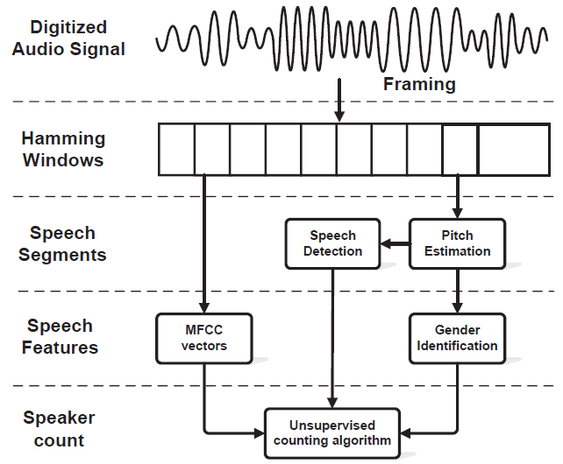
Overview of Crowd++

Slide 13
Speech detection
Pitch-based filter
Determined by the vibratory frequency of the vocal folds
Human voice statistics: spans from 50 Hz to 450 Hz
Human voice
50
450
f (Hz)

Slide 14
Speaker features
MFCC
Speaker identification/verification
Alice or Bob, or else?
Emotion/stress sensing
Happy, or sad, stressful, or fear, or anger?
Speaker counting
No prior information
Supervised
Unsupervised

Slide 15
Speaker features
Same speaker or not?
MFCC + cosine similarity distance metric
MFCC 2
θ
MFCC 1
We use the angle θ to capture the distance between speech segments.

Slide 16
Speaker features
MFCC + cosine similarity distance metric
Alice’s MFCC in speech segment 3
Bob’s MFCC in speech segment 2
θd
θs
Bob’s MFCC in speech segment 1
θd > θs

Slide 17
Speaker features
MFCC + cosine similarity distance metric
histogram of θs
histogram of θd
1 second
speech segment
2-second
speech segment
3-second
speech segment
We use 3-second for basic speech unit.
.
.
.
10-second
speech segment
10 seconds is not natural in conversation!

Slide 18
Speaker features
MFCC + cosine similarity distance metric
3-second speech segment
15
30

Slide 19
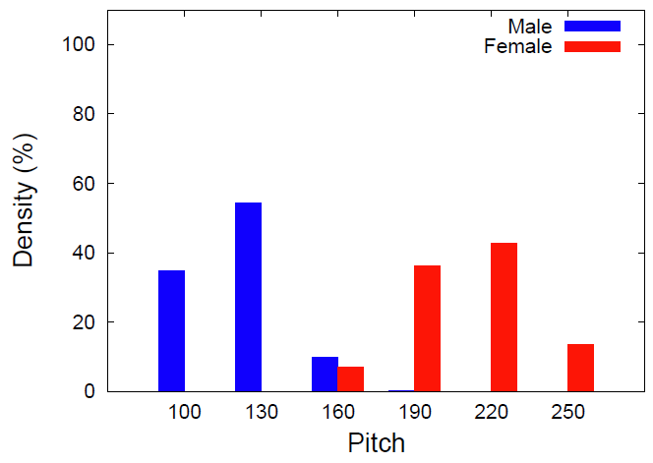
Speaker features
Pitch + gender statistics
(Hz)

Slide 20
Same speaker or not?
IF MFCC cosine similarity score < 15
AND
Pitch indicates they are same gender
Same speaker
ELSEIF MFCC cosine similarity score > 30
OR
Pitch indicates they are different genders
Different speakers
ELSE
Not sure

Slide 21
Conversation example
Time
Speaker A
Speaker B
Speaker C
Overlap
Overlap
Silence
Conversation

Slide 22
Unsupervised speaker counting
Phase 1: pre-clustering
Merge the speech segments from same speakers

Slide 23
Unsupervised speaker counting
Ground truth
Segmentation
Same speaker
Pre-clustering

Slide 24
Unsupervised speaker counting
Ground truth
Segmentation
Merge
Pre-clustering

Slide 25
Unsupervised speaker counting
Ground truth
Segmentation
Keep going …
Pre-clustering

Slide 26
Unsupervised speaker counting
Ground truth
Segmentation
Same speaker
Pre-clustering

Slide 27
Unsupervised speaker counting
Ground truth
Segmentation
Merge
Pre-clustering

Slide 28
Unsupervised speaker counting
Ground truth
Segmentation
Keep going …
Pre-clustering

Slide 29
Unsupervised speaker counting
Ground truth
Segmentation
Same speaker
Pre-clustering

Slide 30
Unsupervised speaker counting
Ground truth
Segmentation
Merge
Pre-clustering

Slide 31
Unsupervised speaker counting
Ground truth
Segmentation
Merge
Pre-clustering
.
.
.
Pre-clustering

Slide 32
Unsupervised speaker counting
Phase 1: pre-clustering
Merge the speech segments from same speakers
Phase 2: counting
Only admit new speaker when its speech segment is different from all the admitted speakers.
Dropping uncertain speech segments.

Slide 33
Unsupervised speaker counting
Counting: 0

Slide 34
Unsupervised speaker counting
Counting: 1
Admit first speaker

Slide 35
Unsupervised speaker counting
Counting: 1
Not sure
Counting: 1

Slide 36
Unsupervised speaker counting
Counting: 1
Drop it
Counting: 1

Slide 37
Unsupervised speaker counting
Counting: 1
Different speaker
Counting: 1

Slide 38
Unsupervised speaker counting
Counting: 1
Admit new speaker!
Counting: 2

Slide 39
Unsupervised speaker counting
Counting: 1
Counting: 2
Same speaker
Counting: 2

Slide 40
Unsupervised speaker counting
Counting: 1
Counting: 2
Same speaker
Counting: 2
Different speaker

Slide 41
Unsupervised speaker counting
Counting: 1
Counting: 2
Merge
Counting: 2

Slide 42
Unsupervised speaker counting
Counting: 1
Counting: 2
Not sure
Counting: 2

Slide 43
Unsupervised speaker counting
Counting: 1
Counting: 2
Not sure
Counting: 2
Not sure

Slide 44
Unsupervised speaker counting
Counting: 1
Counting: 2
Drop
Counting: 2

Slide 45
Unsupervised speaker counting
Counting: 1
Counting: 2
Different speaker
Counting: 2

Slide 46
Unsupervised speaker counting
Counting: 1
Counting: 2
Different speaker
Counting: 2
Different speaker

Slide 47
Unsupervised speaker counting
Counting: 1
Counting: 2
Admit new speaker!
Counting: 3

Slide 48
Unsupervised speaker counting
Counting: 1
Counting: 2
Counting: 3
Ground truth
We have three speakers
in this conversation!

Slide 49
Evaluation metric
Error count distance
The difference between the estimated count and the ground truth.

Slide 50
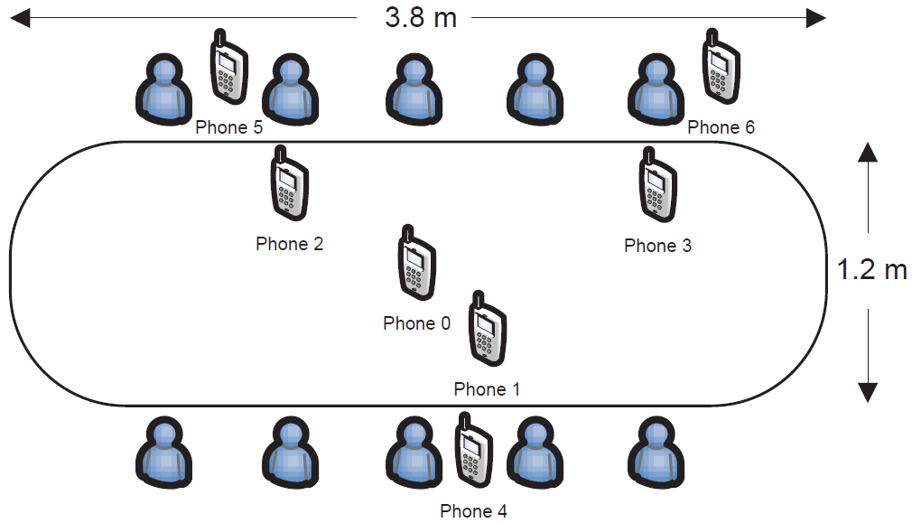
Benchmark results

Slide 51
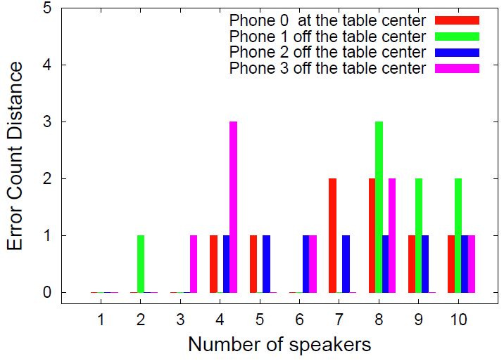
Benchmark results
Phone’s position on the table
does not matter much

Slide 52
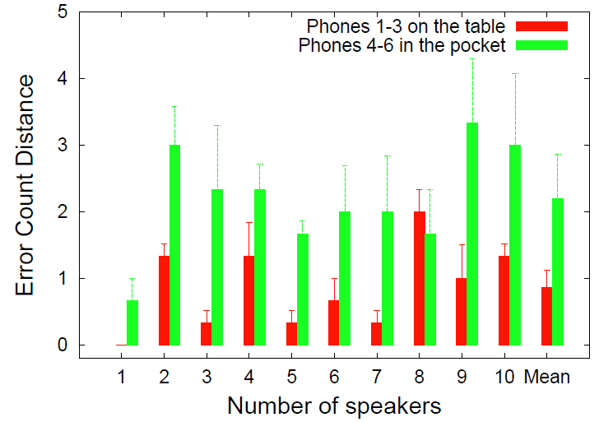
Benchmark results
Phones on the table are better than inside the pockets

Slide 53
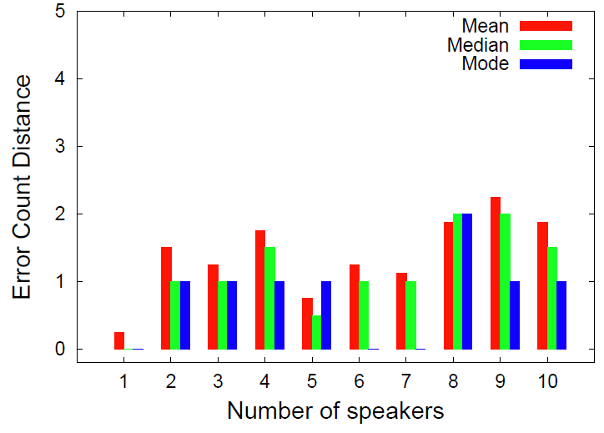
Benchmark results
Collaboration among multiple phones provide better results

Slide 54
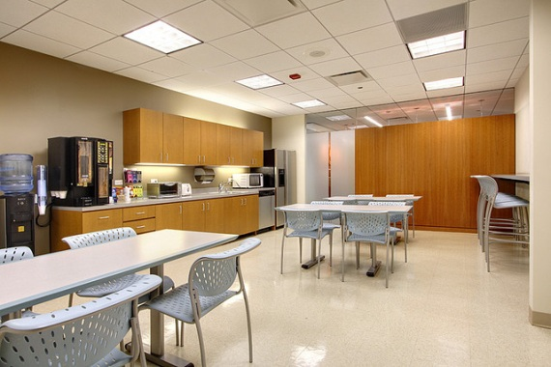
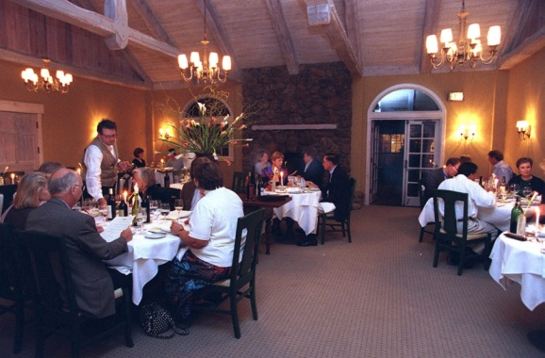
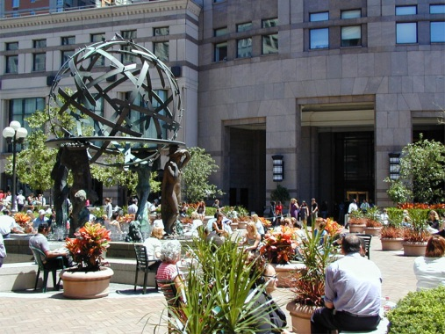
Large scale crowdsourcing effort
120 users from university and industry contribute 109 audio clips of 1034 minutes in total.
Private indoor
Public indoor
Outdoor

Slide 55
Large scale crowdsourcing results
 | Sample number | Error count distance
Private indoor | 40 | 1.07
Public indoor | 44 | 1.35
Outdoor | 25 | 1.83
The error count results in all environments are reasonable.

Slide 56
Computational latency
Latency (msec) | HTC EVO 4g | Samsung Galaxy S2 | Samsung Galaxy S3 | Google Nexus 4 | Google Nexus 7
MFCC | 42.90 | 36.71 | 24.41 | 22.86 | 23.14
Pitch | 102.71 | 80.36 | 58.11 | 47.93 | 58.33
Count | 175.16 | 150.47 | 89.01 | 83.53 | 70.23
Total | 320.77 | 267.54 | 171.53 | 154.32 | 151.7
It takes less than 1 minute to process a 5-minute conversation.

Slide 57
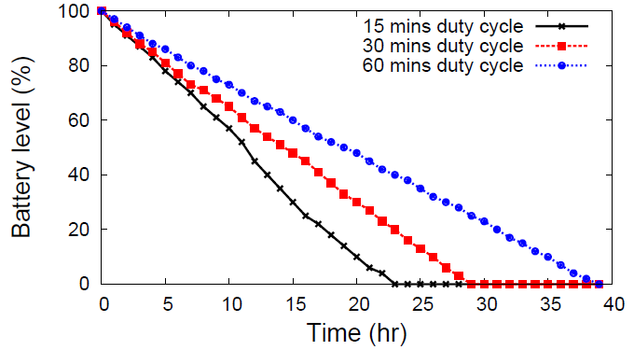
Energy efficiency

Slide 58
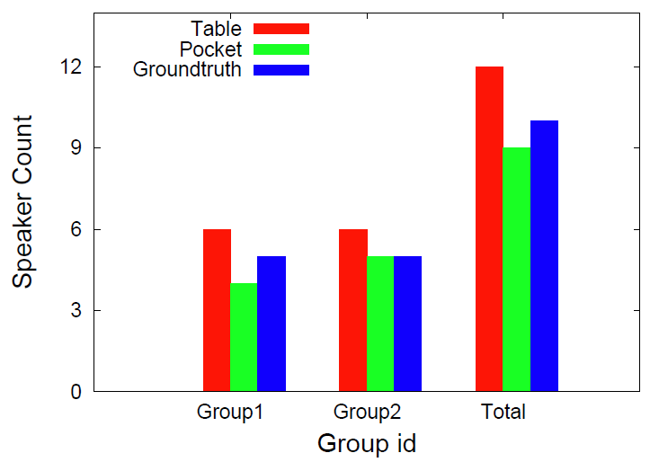
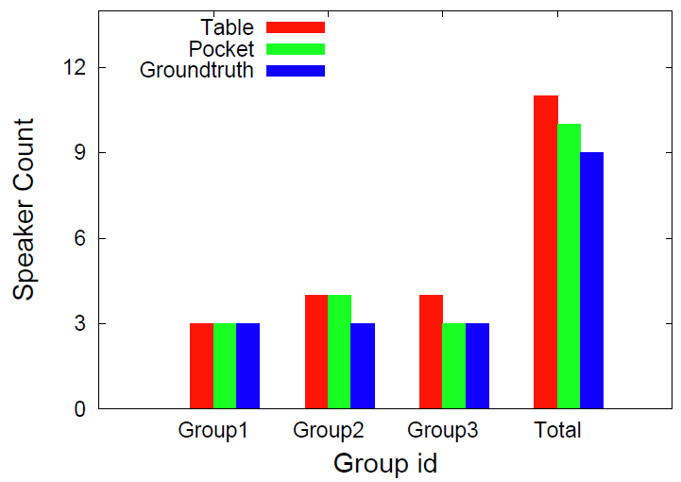
Use case 1: Crowd estimation
Group 2
Group 1
Group 2
Group 1
Group 3

Slide 59
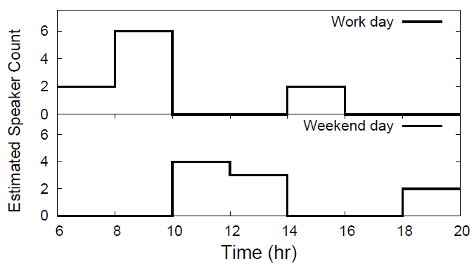
Use case 2: Social log
Ph.D student life snapshot before UbiComp’13 submission
Class
Home
Research
Meeting
Research
His paper is accepted!
Sleeping
Lunch
Research
Dinner

Slide 60
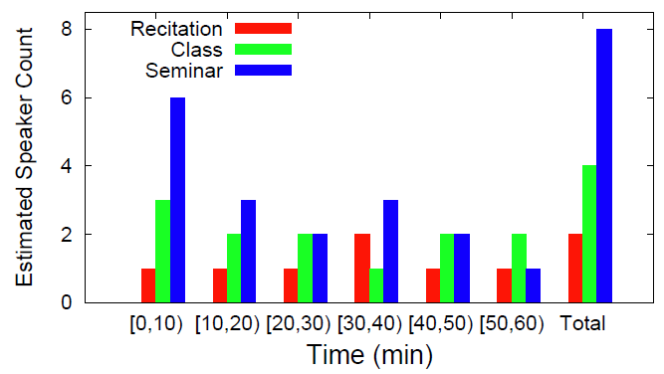
Use case 3: Speaker count patterns
Different talks show very different speaker count patterns as time goes.

Slide 61
Conclusion
Smartphones can count the number of speakers with reasonable accuracies in different environments.
Crowd++ can enable different social sensing applications.

Slide 62
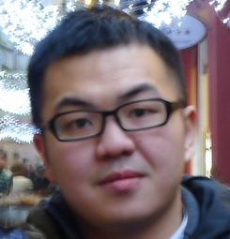
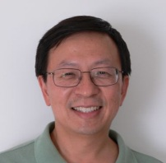
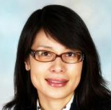
Thank you
Chenren Xu
WINLAB/ECE
Rutgers University
Emiliano Miluzzo
AT&T Labs
Research
Sugang Li
WINLAB/ECE
Rutgers University
Yih-Farn Chen
AT&T Labs
Research
Gang Liu
CRSS
UT Dallas
Jun Li
Interdigital
Communication
Yanyong Zhang
WINLAB/ECE
Rutgers University
Bernhard Firner
WINLAB/ECE
Rutgers University

