Slide 1
Vehicle Verification Using Deep Learning for Connected Vehicle Sharing Systems
Hansi Liu
Rutgers University
Notes:
Good morning everyone, My name is Hansi Liu from RU. thanks for having here
Today I’d like to talk about an EXTENSTION work of a connected vehicle system that shares sensing information.

Slide 2
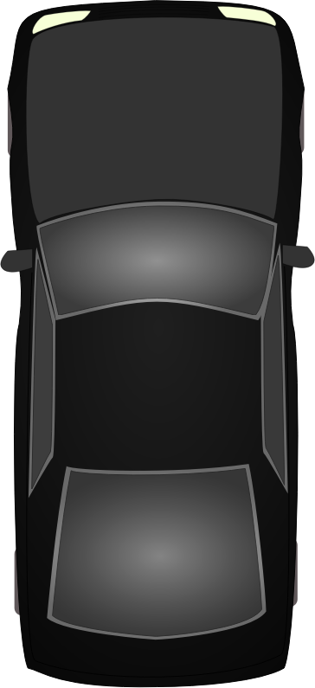
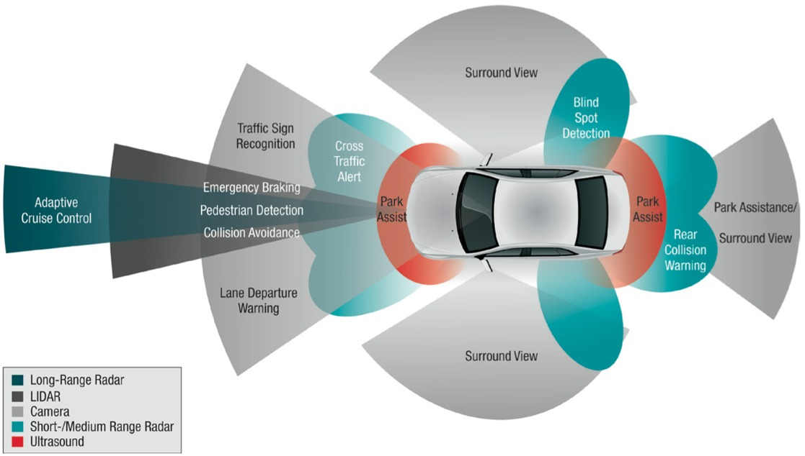
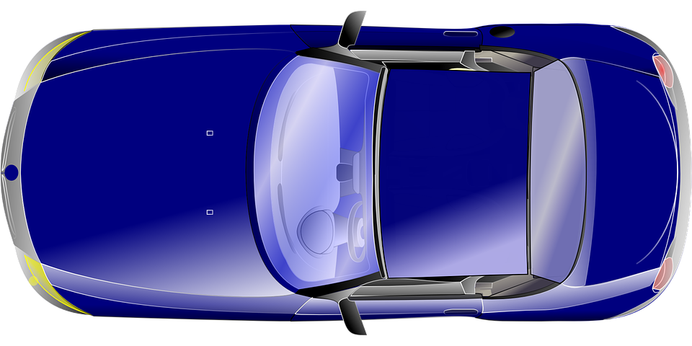
Limited sensing range
Bang
Cannot be seen by Blue due to blockage
Various sensors on a vehicle for surrounding awareness
Limited sensing range causes hazards or accidents
Sharing perception between vehicles can prevent such accidents
Notes:
It all began with the sensing range.
These days, A smart vehicle is equipped with various sensors to be aware of the surroundings
Although these sensors allow certain level of situation awareness, each individual vehicle’s sensing range is limited, which poses hazards on safety driving environments.
Animation example
How to prevent such hazards? – sharing perceptions between vehicles

Slide 3
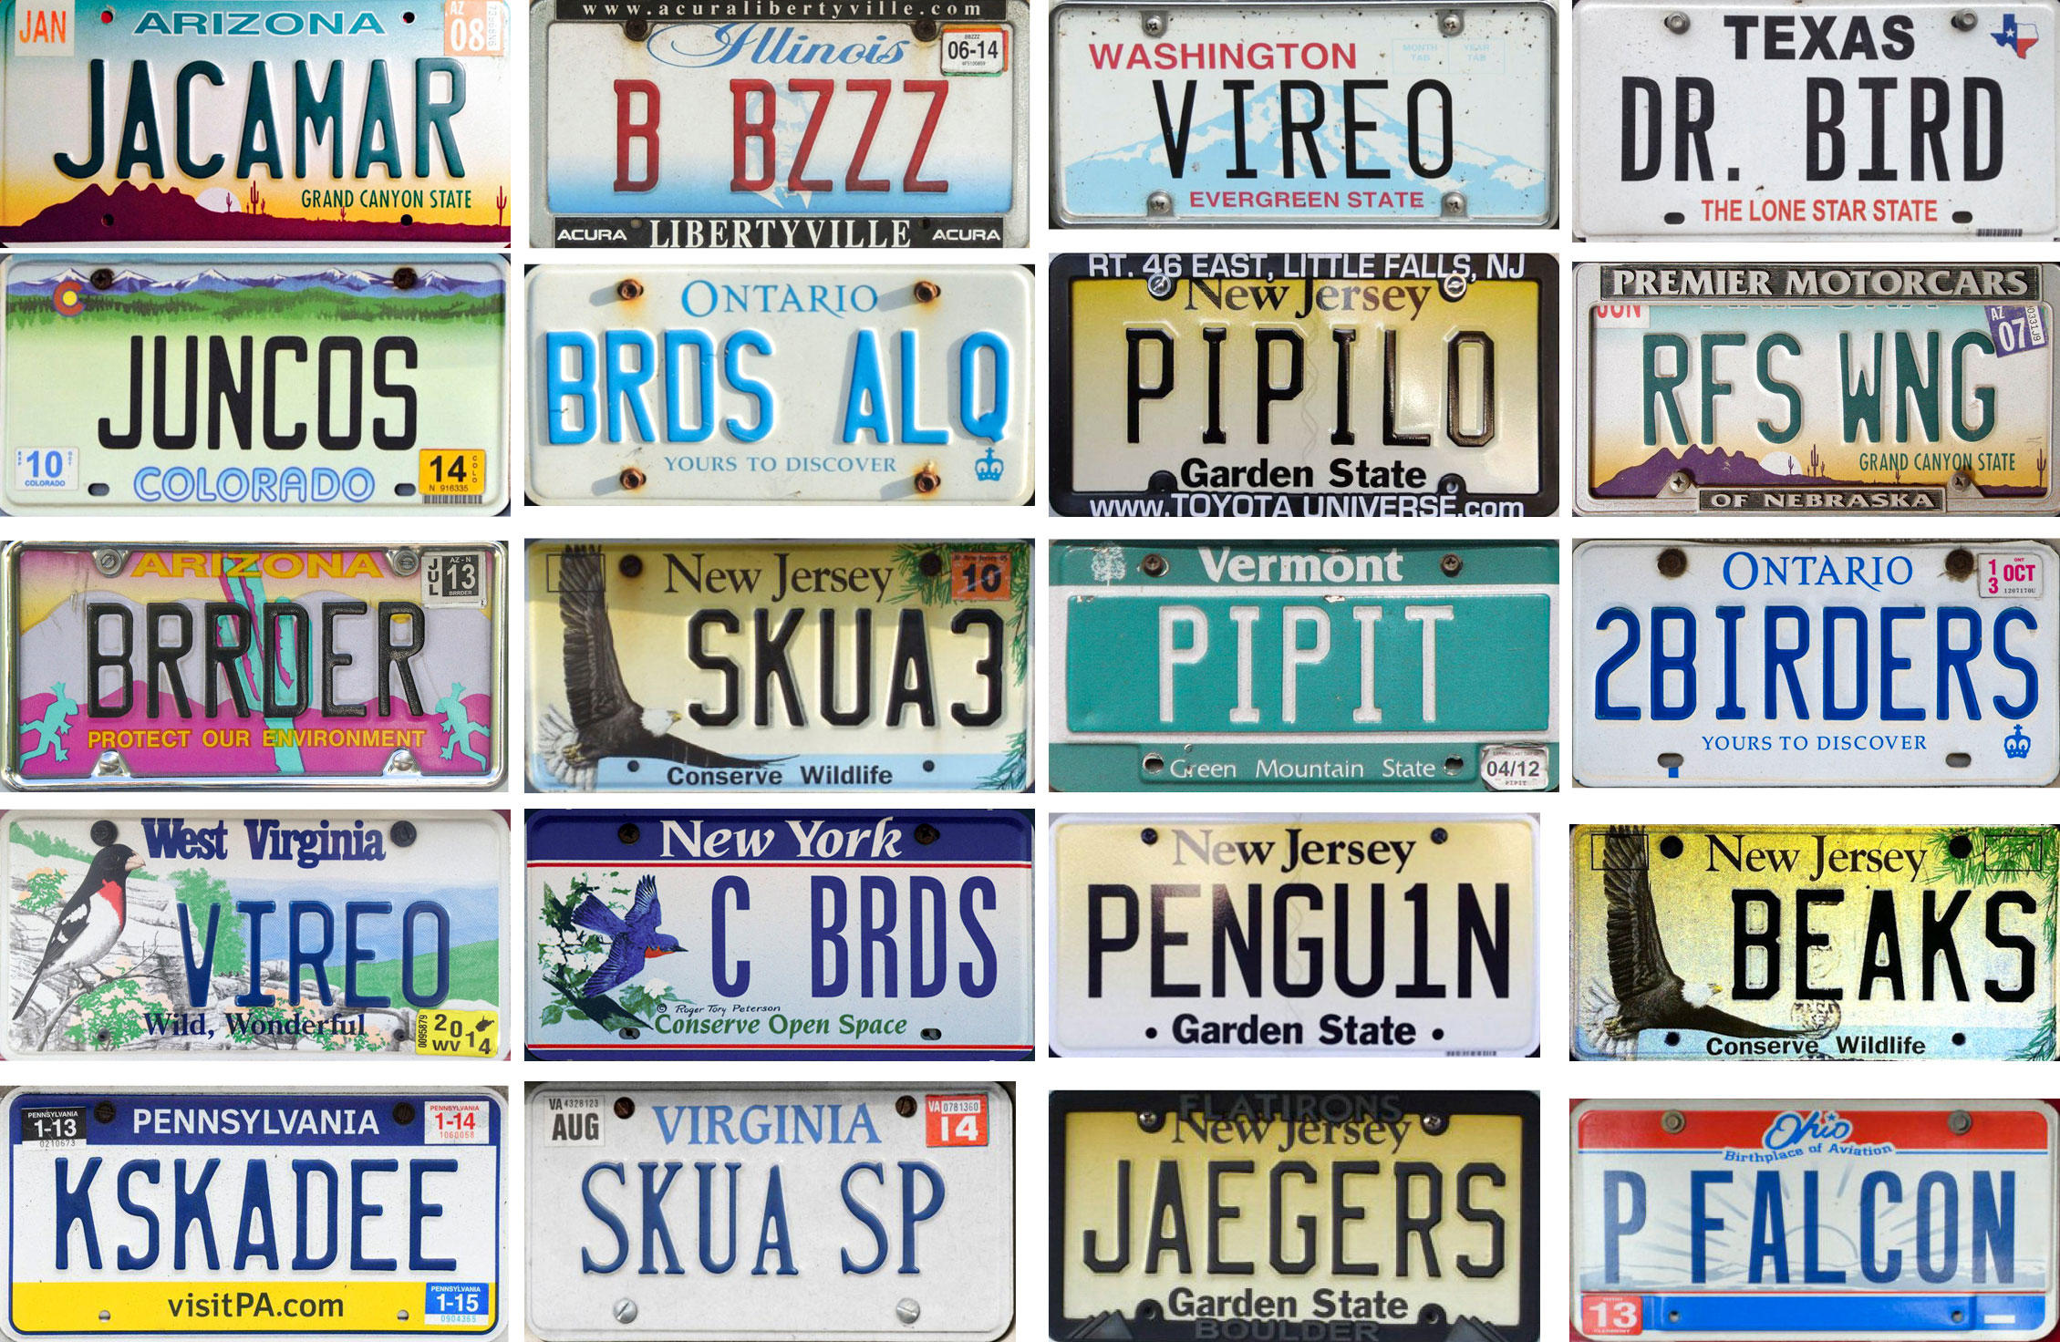
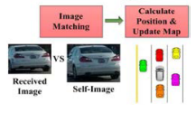
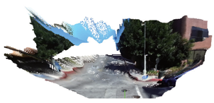
Existing connected vehicle sharing systems
Goal: Share information to construct a more complete view
DSRC Sharing
Each participating vehicle’s own information
GPS, velocity [1]
Unique IDs, (license plate numbers) [2]
Sensor sharing
Each participating vehicle’s own and surrounding information
Vehicles’ profile images
Dense point cloud [3]
[1] Fujii et al. “Cooperative Vehicle Positioning via V2V Communications and Onboard Sensors”
[2] Meng et al. “OmniView: A Mobile Collaborative System for Assisting Drivers with a Map of Surrounding Traffic”
[3] Qiu et al. “AVR: Augmented Vehicular Reality”
Notes:
Recently there are numbers of works that focusing on sharing information for connected vehicle systems. (don’t say ”perception sharing”)
The main goal of these works is to share each participating vehicle’s information with each other and construct a more complete view
We categorize these works into two categories.
DSRC based sharing: its own information only
Sensor sharing: not only its own, but also the surrounding information

Slide 4
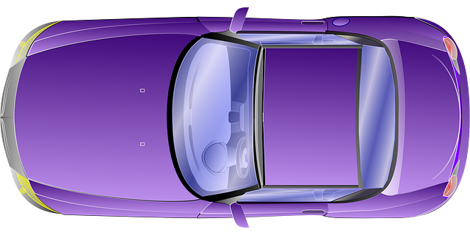
Vehicle verification when sharing & merging views
Information sharing between two individual views
Accurate merging provides a merged “global” view
Merging can be challenging:
different image sizes
occlusion or overlapping of the vehicle
Different perspective and illumination
correct merging?
Notes:
<Stress the importance of correct merging>
Here we are more interested in camera sensing and sharing, since camera is ubiquitous and usually don’t need special configurations.
The basic idea of sharing and merging is as follows:
(Show animation)
During the merging step it’s important to identify whether two vehicles are the same or not. This is usually an verification or association task.
After correct merging, a global view is construct and now the blue can see the red.
[Need to show why merging is challenge. first show an easy merging example by putting two cars close to each other, then a more challenging example, by changing all the vehicle to black, with large position errors, so that after the copy moving the two vehicles are not overlapping.]

Slide 5
FusionEye Overview
Detect and estimate vehicles’ distance
Extract appearance features
Share information and fuse topology
Bipartite merging algorithm
Perception Generation
View 1
View 2
Object detection
Object detection
Feature extraction
Feature Extraction
Perception Sharing
Topology Fusion
2
s1
2
s2
1
s3
1
1
s3
1
s4
s5
0
s6
0
0
s6
0
Hansi Liu, Pengfei Ren, Shubham Jain, Mohannad Murad, Marco Gruteser, and Fan Bai, “FusionEye: Perception Sharing for Connected Vehicles and its Bandwidth-Accuracy Trade-offs” (SECON19)
Notes:
In the previous work, we proposed a system called FusionEye, which explores the design space of a perception sharing system as well as the merging accuracy and bandwidth trade-offs
The system has three major components: Perception Generation, Perception Sharing and Topology Fusion.
In Perception Generation: we first detect the vehicles for individual views, then we extract various features for the detected vehicles.
Then in the perception sharing component we share these features via wireless network to allow these information to be merged and fused at one end, which comes to the third component: Topology fusion.
In the topology fusion component, we proposed a bipartite merging algorithm that associate vehicles from two views.
An advantage of this bipartite merging algorithm is that it supports various features representations as the edge score here represents similarity and can be computed by different combinations of features.
And this allows us to explore the accuracy-bandwidth trade-off, to find out what information shall be shared to achieve accurate and efficient merging.

Slide 6
FusionEye’s bipartite merging
Vehicles abstracted as nodes
Edge scores describes dissimilarity
Each association decision is a matching
The most likely association decision is the matching that has the minimum sum of scores
2
s1
s2
4
s3
1
s4
s5
3
s6
0
Notes:
Here let’s take a closer look at the bipartite merging algorithm
as the bipartite graph shows,
each node represents a detected vehicle, and different color denotes different views.
The edge scores describes two vehicles dissimilarity, the less the score is, the more similar they are.
This fully connected bipartite graph contains all the potential association pairs for all the detected vehicles in two views. We prune this bipartite graph such that it becomes an optimal matching that has minimum sum of scores (Show animation)

Slide 7
FusionEye edge scores
Suppose car A detects vehicle u, car B detects vehicle v
Scores to describe {u, v}’s dissimilarity
Spatial score: $s_{dist} = \left|\left|depth_{u}−depth_{v}\right|−D_{GPS} \right|$
$D_{AB}$: the longitunal distance between Car A and Car B
Color score: $s_{color} =\left\|\frac{H_{u}}{\left\|H_{u}\right\|} −\frac{H_{v}}{\left\|H_{v}\right\|}\right\|$
$H_{u}$: color histogram (24x1)
Keypoint score: $s_{desc}=\frac{Σ_{i}^{N}\left\|desc{\left[i\right]}_{u} −desc{\left[i\right]}_{v}\right\|}{N}$
$desc\left[i\right]$: the ith SIFT descriptor (128x1) or SURF descriptor (64x1)
Notes:
In more details, let’s take a look at the edges of the bipartite graph
The edge scores are computed using different features of the detected vehicles
Spatial score: we convert two vehicles depth to the same coordinate system and compute their differences, the smaller the score is, the more likely the two cars are at the same place.
Color score: we extract color histogram for each vehicle using 24 bins, and compute the Euclidian distance between two normalized color histogram vector.
Keypoints: we compute the average difference for all the keypoint matches from two detected vehicles.
In the bipartite merging algorithm, we use different combinations of these scores.

Slide 8
Limitation of FusionEye
Bipartite matching can contain false positives
Need thresholds for further pruning
Scores are not discriminative enough
How to find better representations to describe dissimilarity?
2
4
s3
1
3
s6
0
Notes:
Unfortunately, the bipartite merging has limitations
As we know, the algorithm always find the match that has the minimum sum of edge scores, even if two sides’ vehicles are different.
Thus we need to find a good threshold to further prune the false positive edges,
However, from the experiments we notice current metrics cannot provide us with discriminative edge scores, which means we cannot find a good threshold heuristically for further pruning and the false positives cannot be eliminated.
So what should we do? How to find better representations to describe dissimilarity?

Slide 9
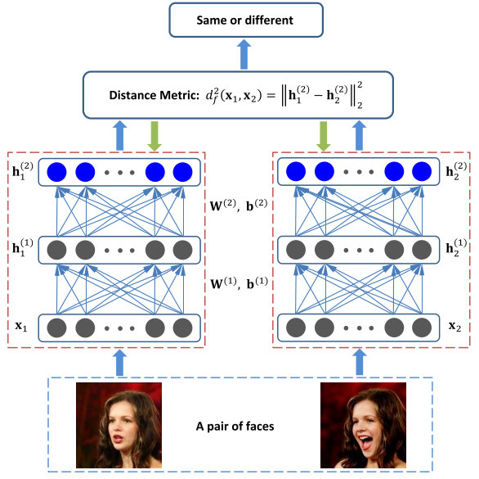
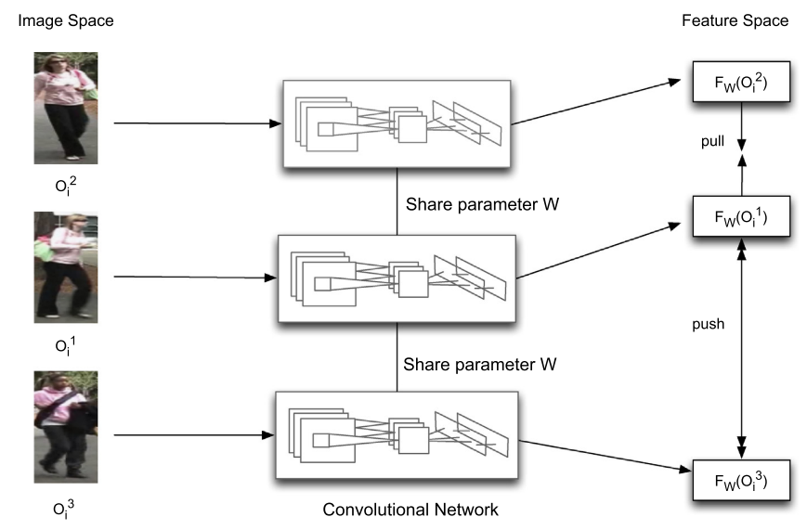
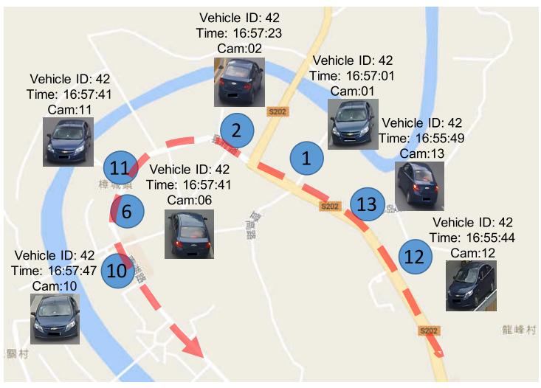
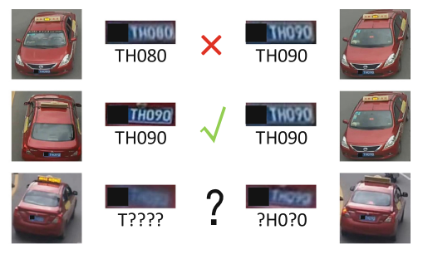
Deep learning for object verification
Face re-identification
Siamese architecture [1]
Triplet architecture [2]
Vehicle surveillance
Appearance
Unique ID [3]
Spatial information[4]
[1] Hu, J., Lu, J., & Tan, Y. P. 2014. Discriminative deep metric learning for face verification in the wild.
[2] Ding, S., Lin, L., Wang, G., & Chao, H. 2015. Deep feature learning with relative distance comparison for person re-identification.
[3] Xinchen Liu, Wu Liu, Tao Mei, and Huadong Ma. 2016. A deep learning-based approach to progressive vehicle re-identification for urban surveillance
[4] Yantao Shen, Tong Xiao, Hongsheng Li, Shuai Yi, and Xiaogang Wang. 2017. Learning deep neural networks for vehicle re-id with visual-spatio-temporal path proposals
Notes:
Well, if we take a closer look at this merging task, we’ll find it is essentially a verification problem, which is given two images, identify whether the objects are the same or not.
If the objects are faces, then it’s a face verification or reidentification problem. In recent work of face verification, deep learning architectures are widely adopted to extract robust features. There are Siamese architectures, which trains on image pairs and triplet architectures, which trains on image triplets, the basic idea for these architectures is to learn a metric such that same faces are close to each other while difference faces are far from each other.
Here we care about more about vehicles, recent work on vehicle verification focuses more on surveillance reidentification, which is identify if the vehicle images taken from multiple surveillance cameras belong to the same vehicle. In this domain, not only appearances information is useful, unique ID such as license plate number，or spatial information such as trajectory is also useful to represent a vehicle. And these representations can be used to infer the similarity of vehicle images.
Our work is different than the surveillance verification. How?
So we incorporate face verification’s method along with useful spatial information to identify similarity.

Slide 10
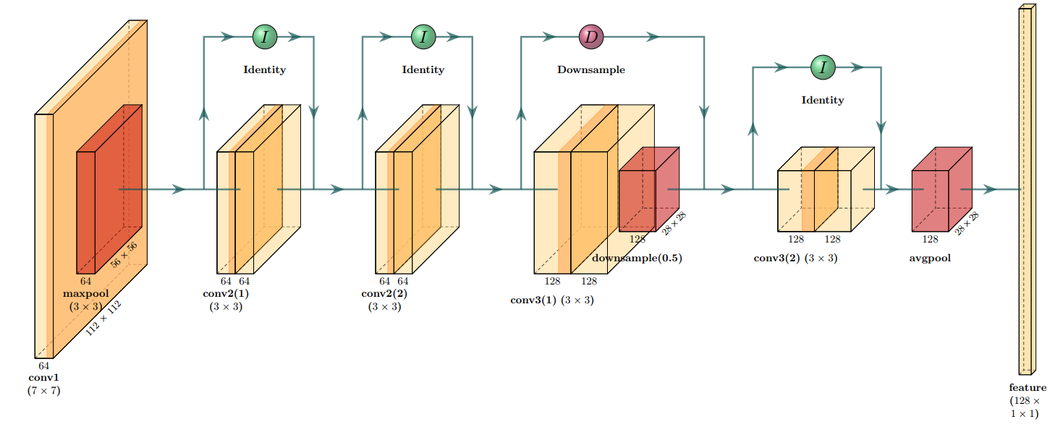
Siamese architecture for vehicle verification
Similarity ground truth
Two network branches
Shared weights
Modified pre-trained ResNet-18
Img A
Deep neural network
$$f_{u}$$
Contrastive Loss
Image pair
Img B
Deep neural network
$$f_{v}$$
Notes:
Show Siamese architecture
Modified ResNet-18
We get rid of some of the deeper layers so that the feature map (28x28) here is directly fed into the avg pool layer and the output feature size is 128 x 1

Slide 11
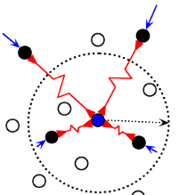
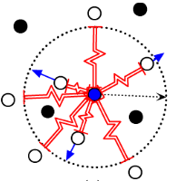
Contrastive Loss
$$L= \frac{1}{2N}\sum_{i}^{N}{\left(1 −y\right){\left(f_{u} −f_{v}\right)}^{2}+y×{\max\left(margin−{\left|\left|f_{u}−f_{v}\right|\right|}_{2}, 0\right)}^{2}}$$
$y=0$ for same pairs, $y=1$ for different pairs
Pushes similar images together
Pulls dissimilar images apart
$margin=0.2$ in experiment
Hadsell, R., Chopra, S., & LeCun, Y. (2006). Dimensionality reduction by learning an invariant mapping. In 2006 IEEE Computer Society Conference on Computer Vision and Pattern Recognition (CVPR'06) (Vol. 2, pp. 1735-1742). IEEE.
Notes:
When y = 0, images are same, first half of the equation, we wish to features are as close as possible so that loss is minimized
When y = 1, images are not the same second half of the equation
We which the difference between two features is larger than the margin, so that the loss is minimized
Margin is a parameter describe the “strictness” of the pulling and pusing, in expeimtn, we choose margin to be 0.2

Slide 12
Incorporating kinematic information
Recall FusionEye’s spatial score:
How to incorporate the scores in our deep architecture?
$$s_{dist} = \left|\left|depth_{u}−depth_{v}\right|−D_{GPS} \right|$$
Similarity ground truth
Img A
Deep neural network
$$f_{u}$$
Fc (129, 64)
$$depth_{u}$$
$$GPS_{A}$$
$$s_{u}$$
Contrastive Loss
Image pair
Img B
Deep neural network
$$f_{v}$$
Fc (129, 64)
$$depth_{v}$$
$$GPS_{B}$$
$$s_{v}$$
Notes:
We just show the training architecture when we only learn from appearance info, ie pixel value,
Notice that in FusionEye we have the estimated distance for each vehicle, how can we use this info?
Recall fusionEyes dist score is computed as the following:, compute the difference of longitudinal distance under the same coordinate system. The smaller the score is, the more likely that two vehicles are the same.
We realize that when computing the contrastive loss, we also calculate the distance between the output features. And we also wish the difference between similar vehicles re small. So we think maybe we can incorporate the spatial scores into the features, so that the difference between two features not only reflect appearance difference, but also this spatial score.
Introduce the transformation. So that when calculating the Euclidian distance, the last entry of the feature vector is essentially calculating the dist score.
Introduce Fully connected layer, the usage is to let the network figure out itself how much weight it should put on the spatial information.

Slide 13
Experiments
Dataset
NTP time synchronization
40-50mph speed
~2 hour video, ~2800 pairs of valid frames
~3.3G information exchanged
Training policy
5-fold cross validation
Random rotation within 20 degrees
Learning rate: starting at 0.001
Batch size: 32 (pairs)
Pytorch
Notes:
Assumptions:
Side by side driving
Few lane changes
Straight road
Data collection
NTP time synchronization
40-50mph speed
~2 hour video, ~2800 pairs of valid frames
~3.3G information exchanged
Show data
In order to learn from both appearance and spatial info, we construct a metadata format as shown here

Slide 14
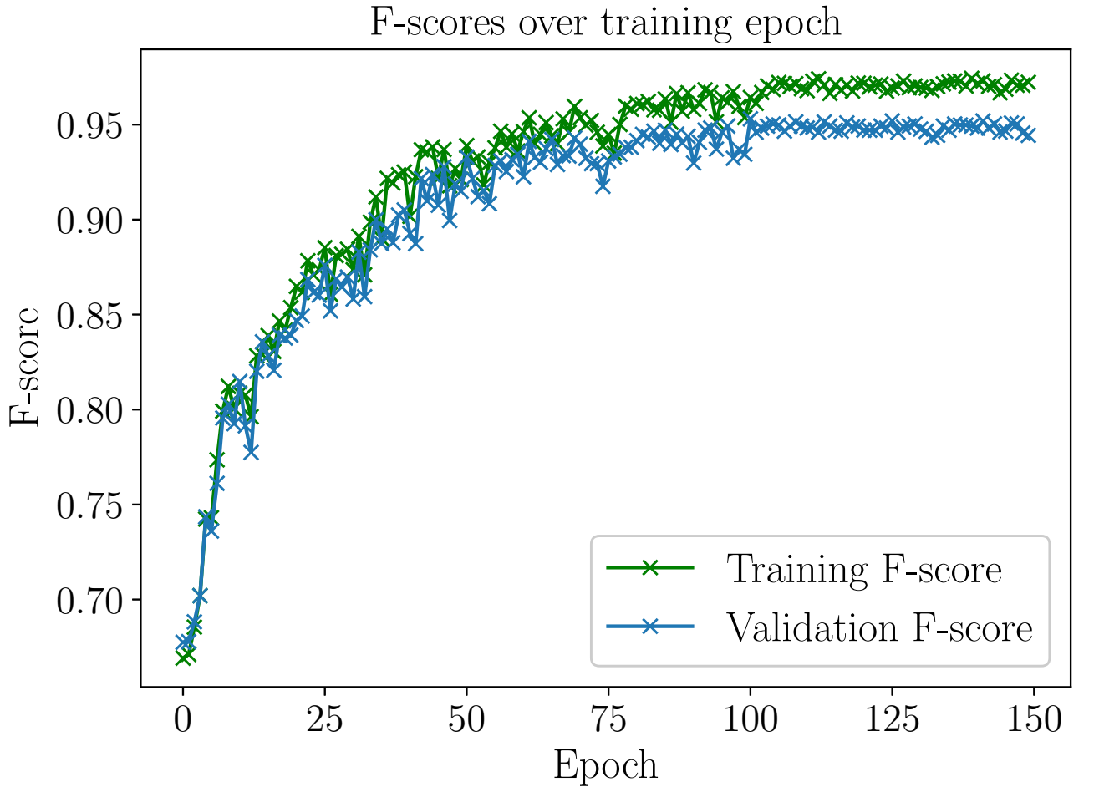
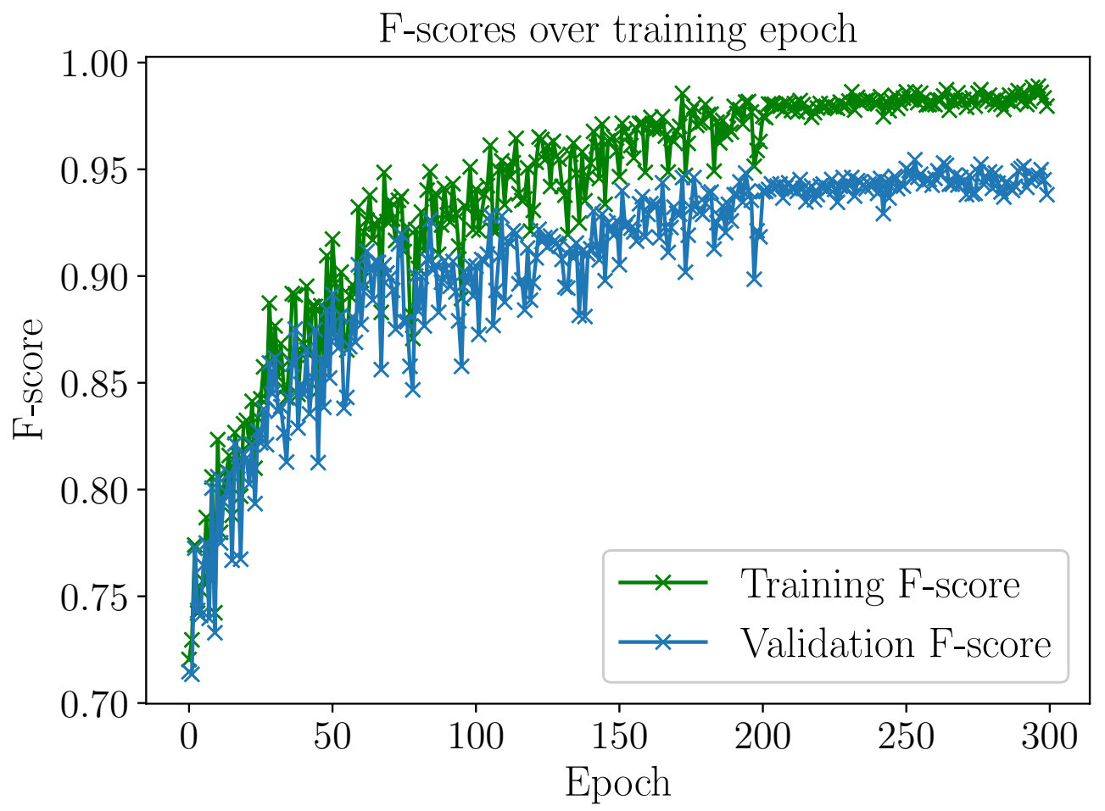
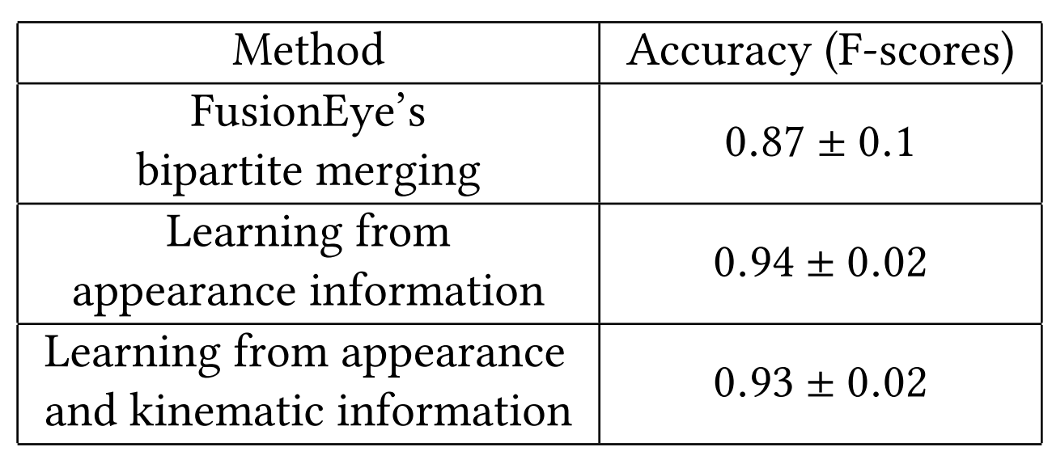
Results on verification accuracy
Deep learning provides better representations
Kinematic info not helpful?
Learning from appearances information
Learning from appearances and kinematic information
Notes:
Training history,
Here we show the history of f-scores during training.
F-score here is compute by tpr, fpr, tnr, and fnr. Here tpr means….. you guys can infer the rest.
First we show when only learning from appearances, converge faster, 94% accuracy
Then we show when learning from both appearance and spatial info. Converges slower, as we are adding a new layer of FC layer and train that layer from scratch. The accuracy is 93%
Obviously, we see that deep learning features
Why spatial info doesn’t help much here?

Slide 15
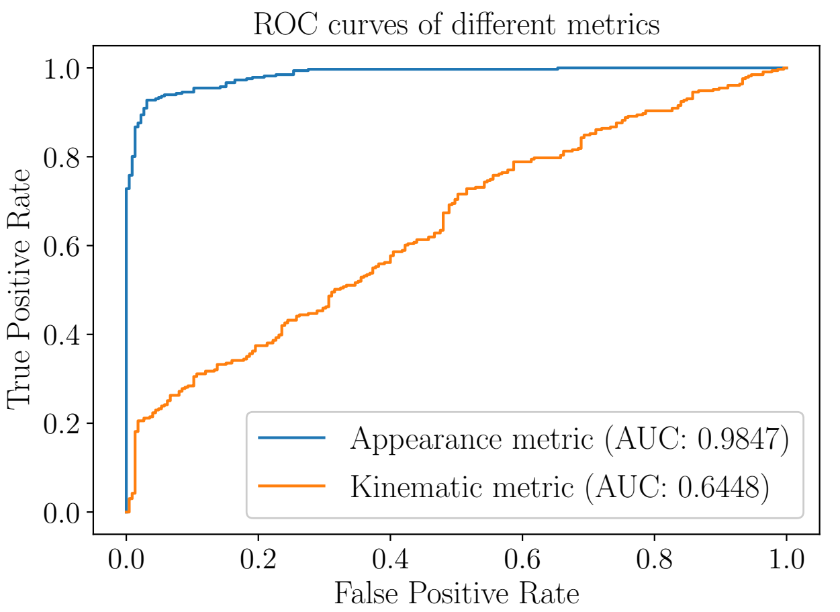
Discussion
2
2
2
4
1
s2
1
s2
1
s3
4
4
3
0
s4
0
s3
0
s6
3
3
Video frame k
Video frame k+1
Video frame k+2
FusionEye’s bipartite scores are discriminative “locally”
Deep learned features are discriminative “globally”
FusionEye Edge score distribution
Deep learned feature score distribution
Notes:
To understand why distance is not helpful here, we compute ROC curve separately
Distance scores are not discriminative
Deep learned features are discriminative
What does it mean? Why kinematic info’s ROC curve is so bad but in FusionEye when we use these scores to merge we can still achieve ~86% acc?
Locally
Globally
What makes spatial info not discriminative? It turned out that GPS is noisy and estimated depth can be noisy. Further detail can be found in the paper and FusionEye paper

Slide 16
Wrap up
Conclusion
Deep features are more robust and discriminative
Spatial info didn’t provide robustness as expected due to sensing noise.
Future work
Scale it up
More than 2 vehicles
1-to-many communication
Drive it around
Varying relative positions
Curvy lanes
Varying number of lanes
Notes:
It’s never too ambitious to set these goals, we are phd students after all. Thank you very much

Slide 17
Thank You
Hansi Liu
WINLAB, Rutgers University
hansiiii@winlab.rutgers.edu

Slide 18
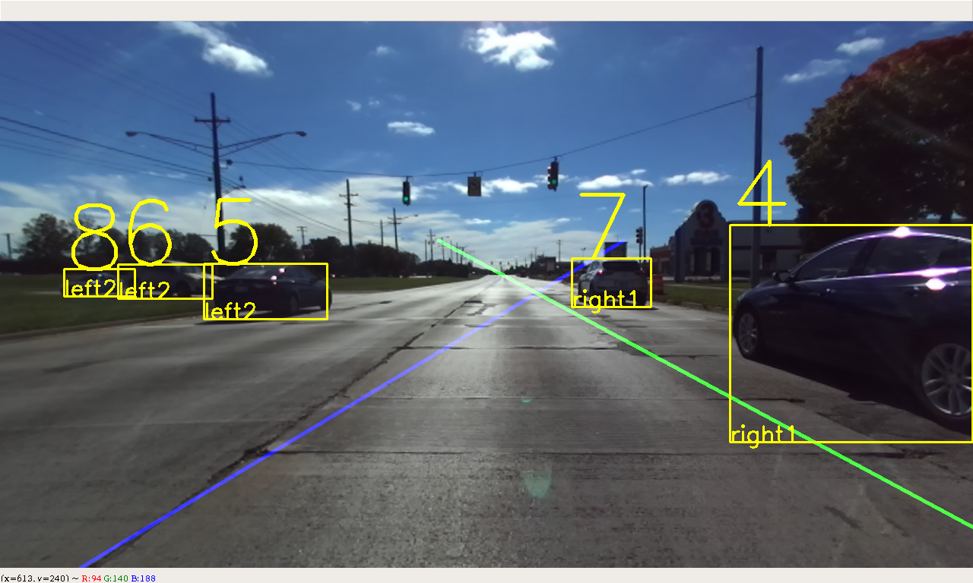
Perception Generation
Vehicle detection
YOLO: pre-trained deep neural network
Lane level position determination
Distance between bounding box corner and lane marker
Notes:
Now let’s discuss the system in detail,
The first component is perception generation
In the right is a typical front view of a vehicle driving on the road.
We first conduct vehicle detection using a pre-trained deep neural network called YOLO, which highlight each detected vehicle using a bounding box. We further assign an ID number to each vehicle
Then we determine each vehicle’s lane position by referring to the distance between the bounding box corner and the lane marker.(Show animation)
If the distance is small, then the vehicle is in the first left/right lane, if it’s larger than a threshold (here we choose the threshold to be 1/3 of the bounding box width), then the vehicle is in the second left/right lane or further.

Slide 19
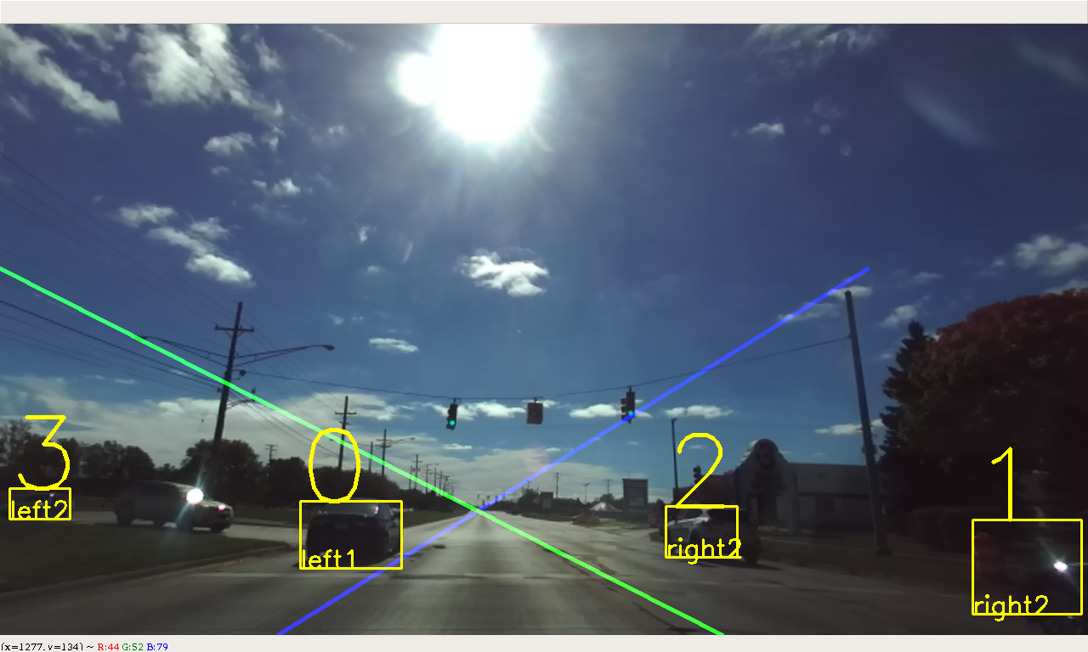
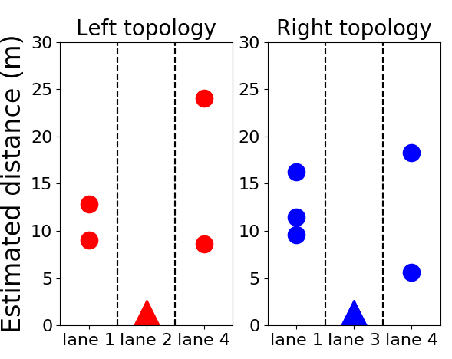
Perception Generation cont.
Usally we need depth camera or structure from motion to…..
Here we can estimate the depth with the detectged vehicle’s lane position (On the straight road,,,assuming the lane width and the known lane level position, we can )
What we have:
Distance estimation
Left view
Right view
$$L$$
Pixel coordinates
3D world coordinates
Estimated distance
$$X≈L$$
Camera matrix
$$X$$
$x=f_{x} ⋅X+c_{x}⋅Z$, $w=Z$
$$x_{p}=f_{x} ⋅\frac{X}{Z}+c_{x}$$
d?
$$D=Z=f_{x} ⋅\frac{n×L}{{|x}_{p}−c_{x}|}$$
$$x_{p}$$
Notes:
Besides detecting vehicles for each view, we also estimated each vehicle’s distance. (here we are interested in the longitudinal distnace)
Using camera projection geometry, Assume the world coordinate system is coincident with camera’s coordinate system.
We need the lateral coordinates in pixel as well as lateral position in the real world coordinate to estimate a vehicle’s depth.
(Show animation), as the diagram shows, we assume the observing vehicle and the detected vehicle is driving on the highway in a lane-keeping fashion,
The lateral distance between them is approximately the lane width, as each vehicle intends to drive in the center of the lane.
Using this approximation, we able to estimate each detected vehicle’s depth.(Show formula)
Using each vehicle’s depth, and lane level position, we able to construct individual topology for each observing vehicle, (Show animation)

Slide 20
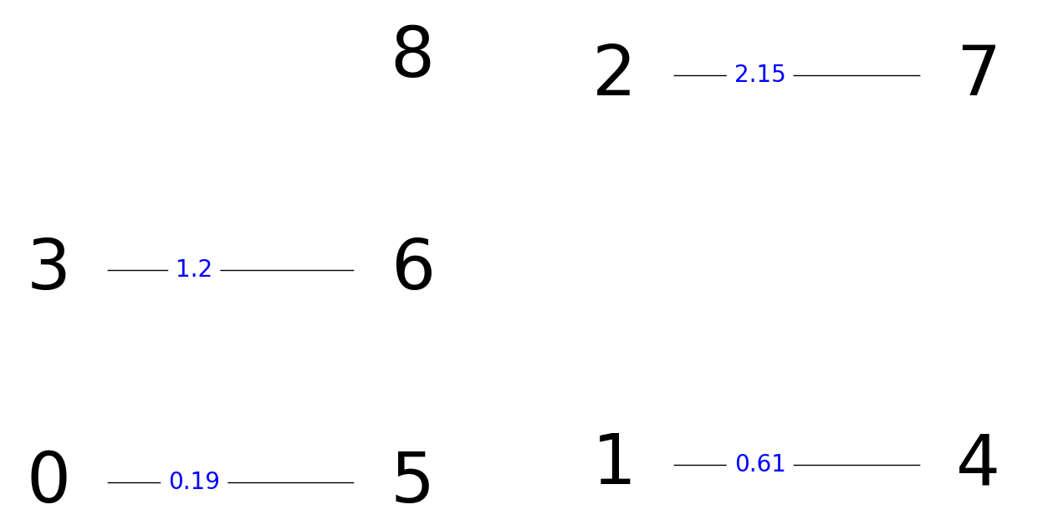
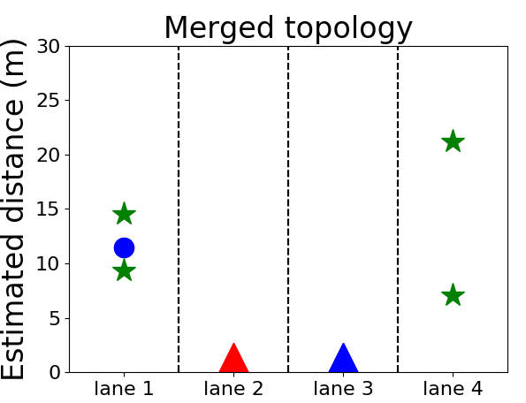
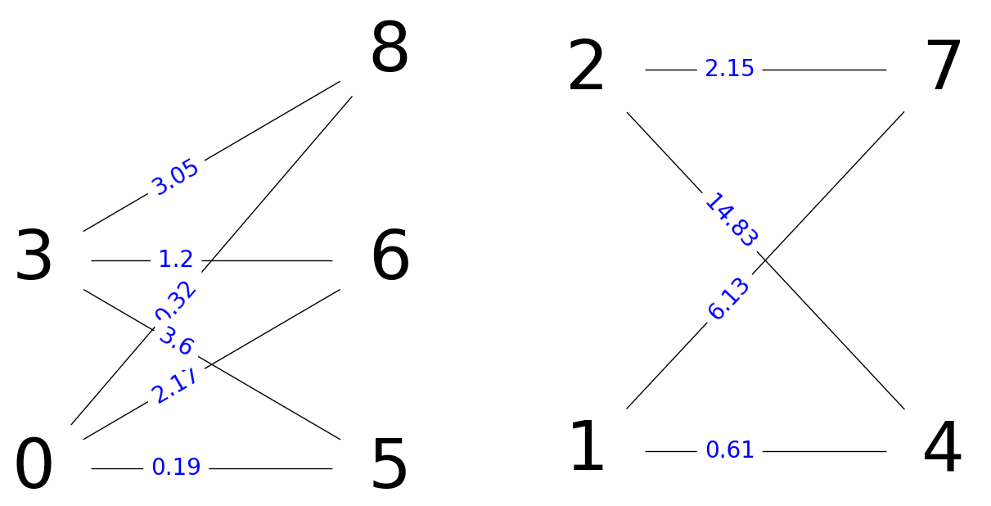
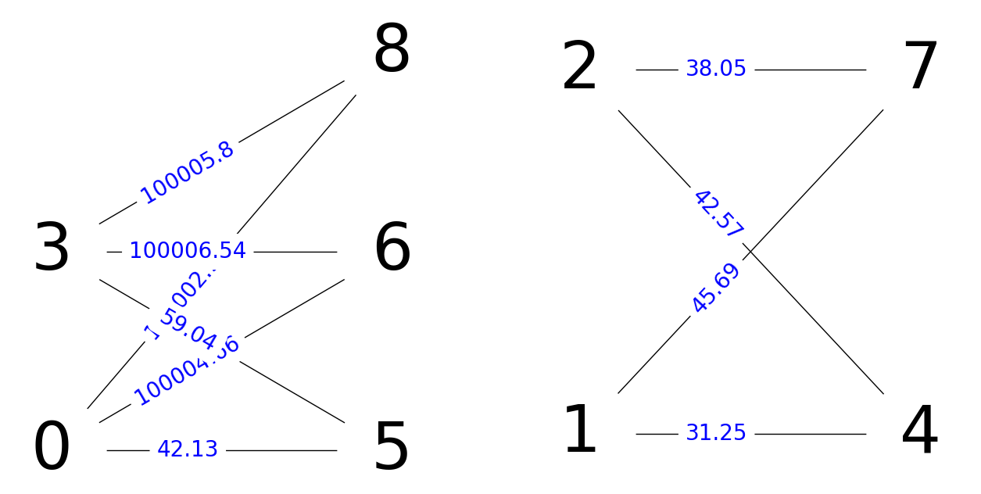
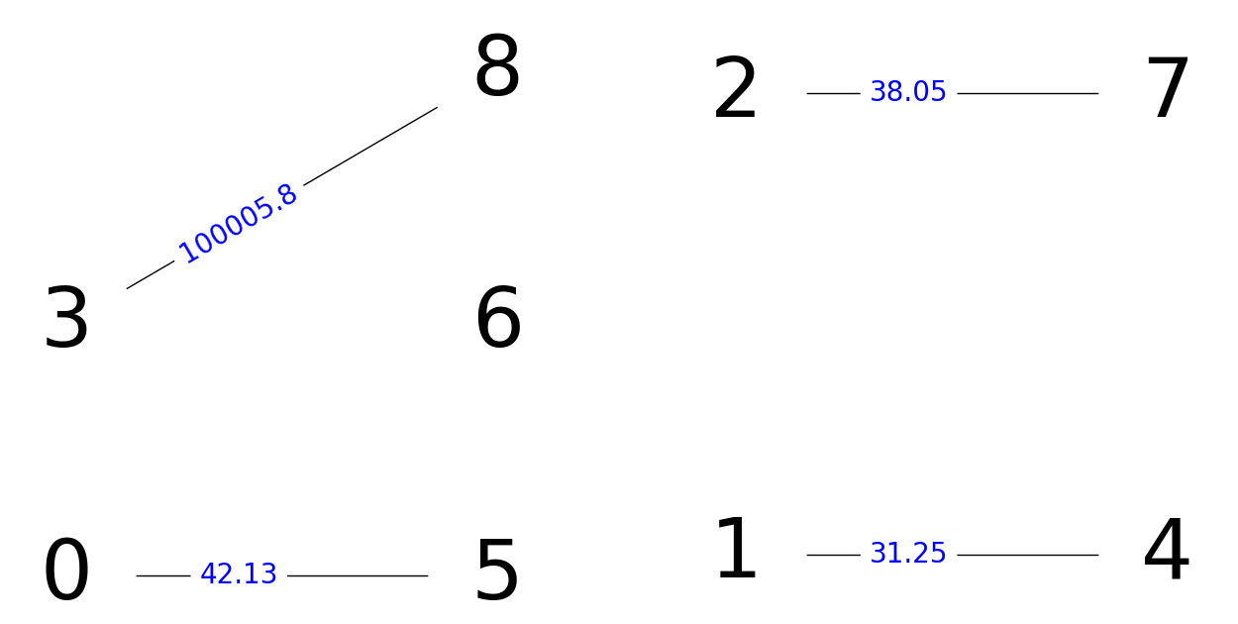
Merging results
Merge using depth, color histogram, and SURF
Merge using depth only
Notes:
Here we show a merging example. Here are the two front views from two observing vehicle, and their individual topology
First we merge the two views using depth socre only, (show animation)
We found that 3-6 is falsely matched
Then let’s use depth, color histogram and SURF score(Show anumation)
This time we got correctly associate every pair of vehicles.
Using the correct association, we are able to construct the merged topology as shown here(show animation)

Slide 21
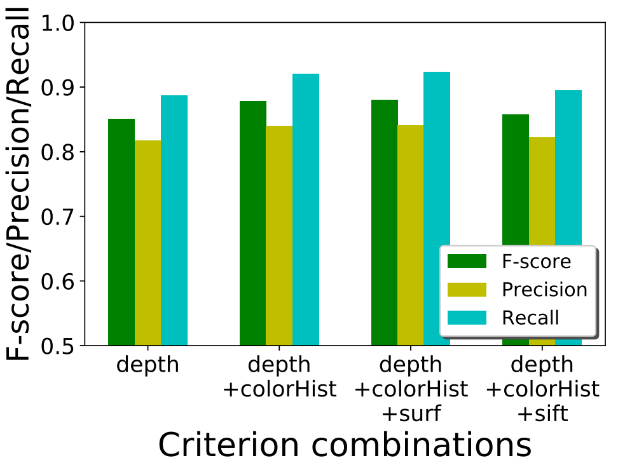
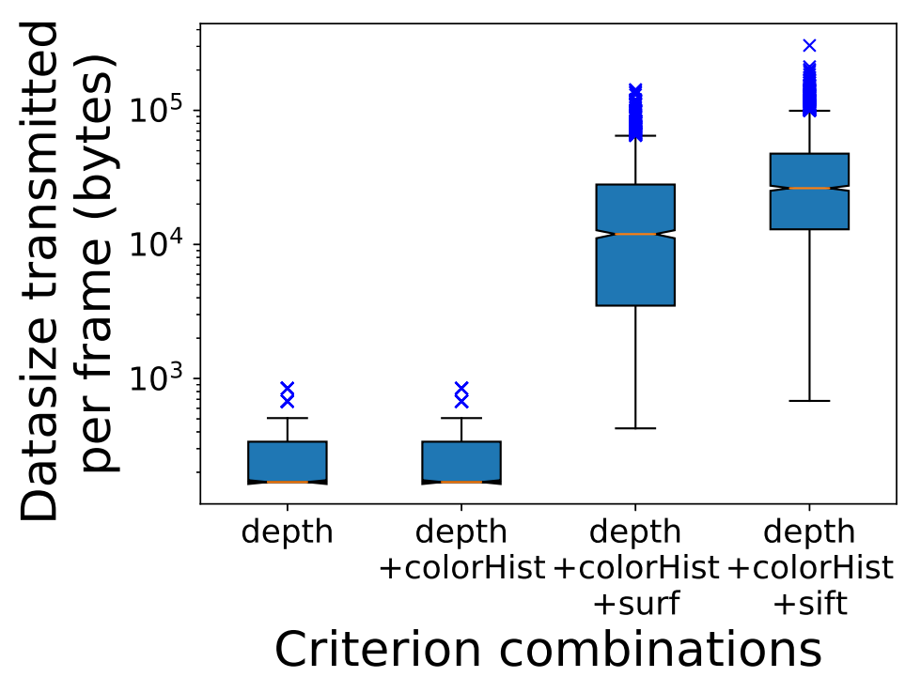
Merging accuracy & Bandwidth
Be precise about the numbers
Notes:
Now its time to show the accuracy and bandwidth trade offs
Let’s first focus on accuracy first
The figure on the left presents precision, recall, and F-scores for 4 merging policies in which different combinations of features that are used to compute the edge scores in the bipartite graph.
The best accuracy comes with depth+colorHist+surf, which is 0.88 in terms of f-score
We notice that in general the performance of the merging algorithm improves as we incorporate more fine-grained descriptors to compute edge scores.
Naturally, the merging accuracy improves as the description of a vehicle becomes more comprehensive and robust as more information is taken into account. But the improvement in terms of accuracy is only marginal.
(also notice, the last combination, (depth+chist+sift) gives us slightly worse performance.)
We are also interested how much information is shared to achieve such accuracy. The figure on the right presents the average transmitted data size for a video frame.
We can see that the first two combinations uses much less data size. (around hundreds of bytes) While the SURF and SIFT features consumes significantly more bandwidth(average of more than 10k bytes) during transmission.

Slide 22
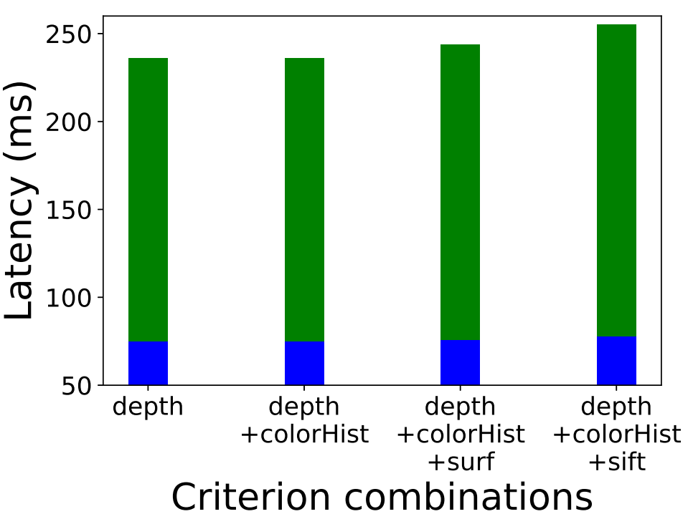
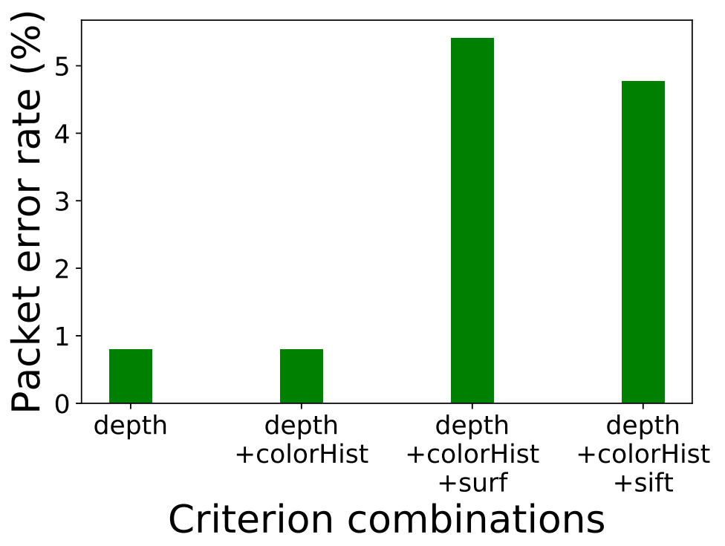
Transmission Analysis
Notes:
Here we also care about other statistics such as latency and packet error rate
Recall latency: the duration from the time a video frame is grabbed by the camera till all necessary information is received by the receiver side so that the merging process can start.
We also observe that the more comprehensive the criterion is, the higher the latency becomes.
The baseline latency is shown in blue for each bar, which consists of image processing time including vehicle detection using YOLO, estimating depth value according to the bounding box coordinates as well as computing SIFT/SURF descriptors for that bounding box patch.
Next is packet error rate: the ratio of the number of dropped packets to the total number of transmitted packets of a certain type of feature combination
We observe that since surf and sift packets are more bandwidth comsuming, those packets are more easily to be dropped during the transmission.
Recall that SIFT/SURF features only offer slightly better accuracy, the transmission analysis here gives us an insight that maybe SURF/SIFT features does not provide a big win in terms of accuracy-bandwidth trade off.

