Slide 1

A Transport Protocol for Content-Centric Networking with Explicit Congestion Control
Feixiong Zhang, Yanyong Zhang (Rutgers Univ.), Alex Reznik (InterDigital), Hang Liu (The Catholic University of America), Chen Qian (Univ. of Kentucky) and Chenren Xu (Rutgers Univ.)

Slide 2



Content Statistics
In North America, video and audio streaming make up more than half of mobile data traffic, led by YouTube, Pandora and Netflix
YouTube
  100 hours of video are uploaded every minute
  Over 6 billion hours of video are watched each month
Netflix
  Over 50 millions of Netflix streaming subscribers
Pandora
  1.36 billion listener hours and 72.7 million listeners in Sep 2013
Observation:
More and more Internet usage is about content distribution/retrieval.
We care about content and is oblivious to location.

Slide 3
Content-centric networking
Content-centric networking (CCN): facilitate content distribution/retrieval from network architecture perspective
Features:
  Content name based routing
  Receiver-driven hop-by-hop transport
  Multi-source/multi-path transfer
Content cache
Data(foo.s1)
Interest(foo.s1)
Content server
receiver
Interest(foo.s2)
Data(foo.s2)
Interest(foo.s3)
Data(foo.s3)
Content cache

Slide 4
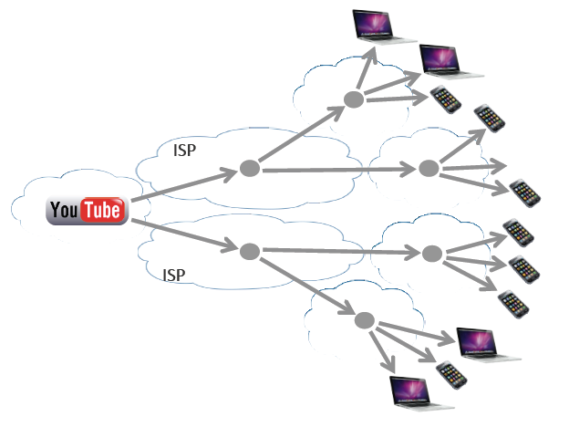

Transport control in CCN
How to deal with the new challenges in transport control for content delivery in CCN?

Slide 5
Existing methods
sender-centric, end-to-end (e.g. traditional TCP): doesn’t fit content delivery well
RTT-based congestion detection (e.g. ICP, ICTP): doesn’t work well under multi-source/multi-path
quota-based traffic shaping (e.g. HR-ICP): can’t adopt to dynamic workloads

Slide 6
CHoPCoP design
CHoPCoP: chunk-switch hop pull control protocol
Receiver-driven hop-by-hop transport
Explicit congestion signaling by random early marking (REM)
Fair share Interest shaping (FISP)
AIMD-based receiver interest control (RIC)
Notes:
CCN data chunk is large in size because of extra fields in the packet (e.g. signature). Large chunk can cause fragmentation. we thus propose that a chunk is segmented to multiple small packets before the content provider sends it out and the receiver aggregates received packets into a complete chunk.

Slide 7
Receiver-driven hop-by-hop transport
Receiver-driven:
  The receiver paces content retrieval and delivery
  Interest-Data transmission
  No explicit “end” concept
  Connectionless communication: no three-way handshake
hop-by-hop transfer: Each router performs
  Forwarding packets
  Packet processing
  Resource management

Slide 8
Explicit congestion signaling
With multiple sources/ multiple paths, the following metrics are unsuitable
  RTT value
  Packet arrival sequence
Random early marking (REM): intermediate router
  estimates congestion level based upon the size of the outgoing data queue,
  marks data packet according to the mark probability function.
Mark probability function for REM

Slide 9
Fair share Interest shaping
FISP conducts flow-based interest control based on
  each flow’s queue requirement
  delay Interest accordingly at certain probability
Delay all incoming Interest if overly-congested
Release all delayed Interests when total queue requirement falls below a threshold
Delay probability function

Slide 10
Receiver Interest control
AIMD-based receiver Interest window control
Detects congestion when marked packets are received
  Decreases the window size accordingly
Interest timer and retransmission for reliability

Slide 11
CHoPCoP Implementation
Complete protocol stack is implemented as a user-level daemon using Click modular router.
Detailed evaluation at ORBIT testbed.

Slide 12
The Effectiveness of REM
C is cooperative and slows down Interest issuing when marked packets are observed
For CHoPCoP, receiver side Interest window is much smoother
the receiving data rate is much higher
no timeout is observed at the receiver

Slide 13
The Effectiveness of FISP
C is non-cooperative, issuing requests at constant rate
Router’s outgoing data queue is 1500KB
  with FISP, the router’s outgoing data queue can be kept at ~1050KB.
  Without FISP, router queue overflows and the router keeps congested
Interest rate: 140 per second
Interest rate: 160 per second
Interest rate: 200 per second

Slide 14
A Multi-Source, Single-Flow Scenario
Poor performance of ICP and HR-ICP: single RTT estimator can not predict network congestion in multi-source environment.

Slide 15
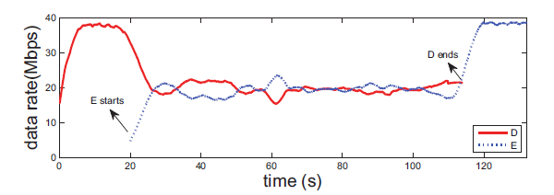
Fairness
Two receivers request different files
  D starts at time 0
  E starts at time 20s

Slide 16
FISP vs. Quota-based Interest Shaping
D: CIR of 20
E: Interest rate varies from 40 to 180, with a 20 Interests per second increase in each run

Slide 17
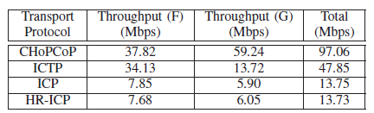
A larger network topology
Two sources (A and B)
Two receivers (F and G)
Link EF: bottleneck between A/B and F
Link CD: bottleneck between A/B and G

Slide 18
Conclusion
REM: provides congestion detection timely and correctly in a multi-source/multi-path setting
FISP: ensures fair sharing of network resources among different flows
RIC: guarantees full bandwidth utilization while reacts to REM signal to avoid saturating the network

Slide 19
Questions & Answers

