Slide 1
Spectrum MRI: Towards Diagnosis of Multi-Radio Interference in the Unlicensed Band

Slide 2
Introduction
Spectrum Overlap in the 2.4Ghz band
Specifications of different standards in the 2.4Ghz Band
Standards | PHY Characteristics
802.11b | DSSS + BPSK, QPSK, CCK
802.11g | OFDM + BPSK,QPSK,mQAM
Bluetooth | FHSS + GFSK
ZigBee | DSSS + BPSK, QPSK
Others | Cordless Phones, Microwave Ovens, etc.
Increasing density & data rate of radio devices leading to interference limitations.
No means of co-operation and arbitration in the unlicensed spectrum
Is it possible to classify and diagnose multi-radio interference problems by
passive monitoring?

Slide 3
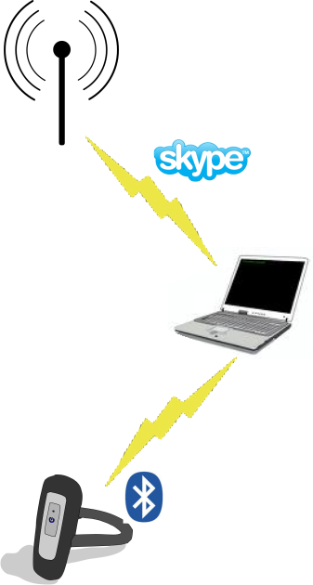
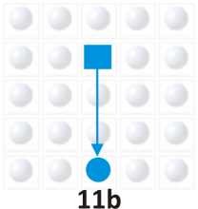
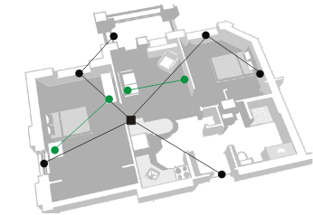
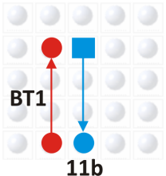
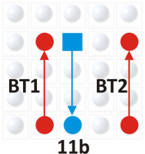
Common Examples
VoIP over WiFi using a Bluetooth headset
ZigBee Alarm system co-existent with high rate streaming links
Bluetooth links near 802.11b WiFi link
Throughput: 4.92 Mbps
Throughput: 1.92 Mbps
Throughput: 0.42 Mbps
Voice quality degradation due to co-located radios
Alarm system messages blocked by WiFi streaming video traffic
Bluetooth causes a large drop in WiFi throughput

Slide 4
Interference Basics: Intra WiFi
DIFS
DIFS
DIFS
DIFS
DIFS
A
Frame
Frame
defer
B
Frame
defer
Frame
C
defer
D
Frame
Waiting for free channel
Actual Transmission time
Waiting time for each link increases with addition of new links leading to
throughput drop for every user
Combined throughput of all devices also goes down with increasing number
of links due to increase in collision time

Slide 5
Interference Basics: WiFi-BT
Bluetooth hops on 79 1Mhz channels, WiFi Bandwidth = 20 Mhz
⇒ Chances of frequency overlap = 20/79 ≈ 25%
Slower WiFi packets occupy more time ⇒ More chances of time overlap

Slide 6
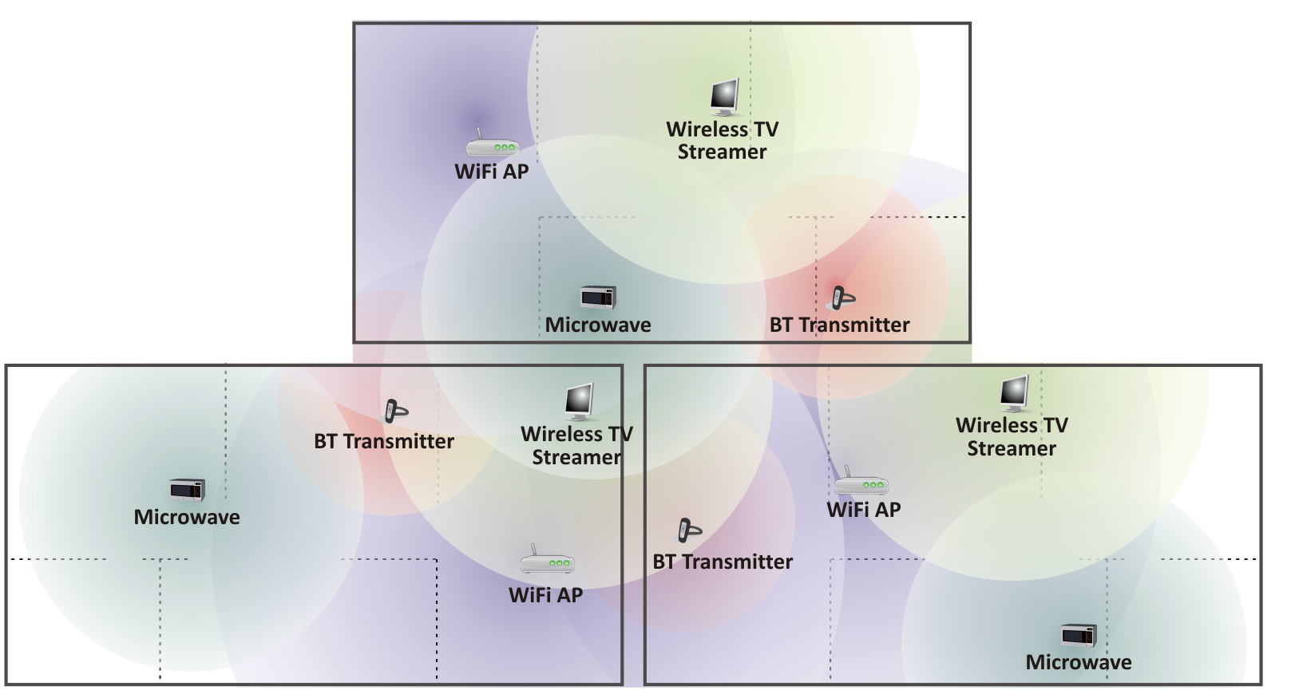
Interference From Neighbors
Interference Regions of multiple wireless devices operating in a home setting
Interference problem compounds in closely packed neighbourhoods

Slide 7
Interference Localization
Ideally we would like to locate sources of interference
But indoor localization is a hard problem in itself
requirement of multiple sensors, training data
physical dimensions needed for accuracy
non-uniform transmit power poses additional problem for localization
We take the approach of logical topology discovery when physical topology is hard to find
system based on user registered devices indexed by their MAC identification

Slide 8
Project Overview
Network Discovery and Diagnosis Tools
802.11 Probing in Monitor mode
Bluetooth Spectrum sensing
Zigbee Channel Sniffing
Low-cost Spectrum Analyzer
Device side performance logs
Bluetooth Active Sniffing
Network Layer Info from Wired-end
Localization from multiple sensors
Hierarchical Probing
Emulation Data from Representative Problem Scenarios
Diagnosis Inference Algorithm
Collection &
Integration
Server
Framework
Direct Configuration Change
Control Channel
Performance Improvement & QoS Support
Use of Common Channel for Control

Slide 9
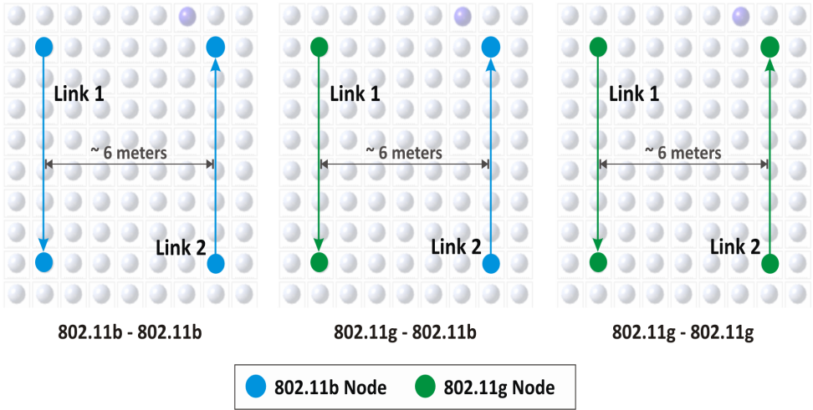
Problem Detection
Exploring what the problem is
Developing tools for data collection
Applying diagnosis algorithms
Intra 802.11 Interference
Inter-radio Interference
– 802.11-Bluetooth Interference
– 802.11-ZigBee Interference
– Bluetooth-ZigBee Interference
Complex Multi-radio Interference
1. Intra 802.11 interference
Topology | Link 2 at 11 Mbps | Link 2 at 1Mbps
11b-11b | 3.76 Mbps | 1.19 Mbps
11g-11b | 25.10 Mbps | 17.60 Mbps
11g-11g | 17.91 Mbps | 9.67 Mbps
Link 1 Throughput for varying Link 2 rates

Slide 10
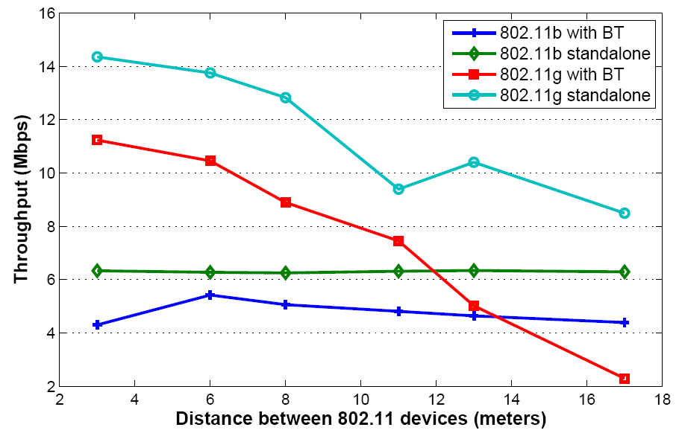
Problem Detection
2. Bluetooth – 802.11 interference
Configurations:
802.11b: TCP at 11 Mbps
802.11g: TCP at 24 Mbps
Bluetooth: UDP with 512 Kbps offered load
Distance between 802.11 Rx & Bluetooth Tx: 25cm

Slide 11
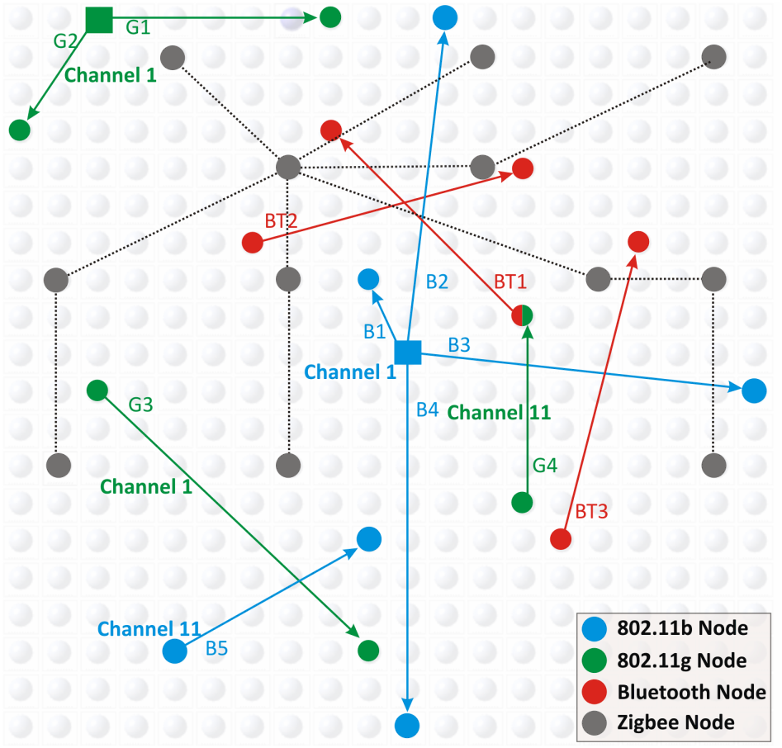
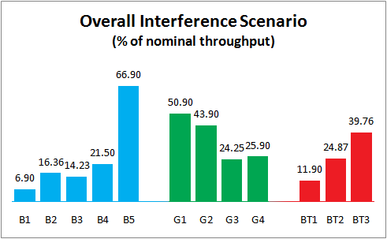
Problem Detection
3. Multi-radio Interference Scenario
Drop in Zigbee throughput: From 83% packet reception to < 2% packet reception

Slide 12
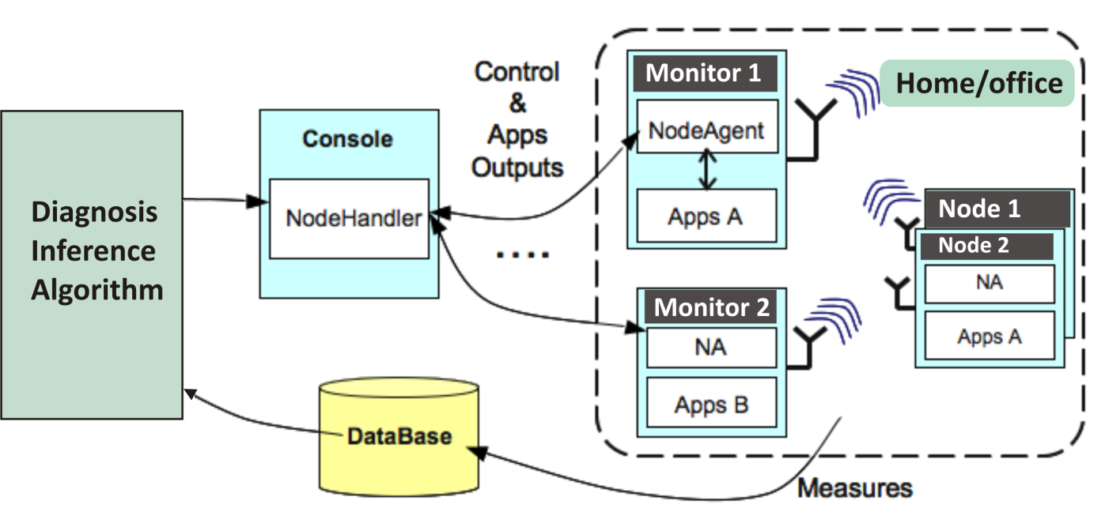
Developing Tools
Exploring what the problem is
Developing tools for data collection
Applying diagnosis algorithms
Use OML as the underlying framework for data collection
Modify/develop tools which log traces to this framework for different radios
Identify the parameters of interest for each kind of radio
Important and hard topic of synchronization of multiple traces
- Combine traces from similar monitors
- Time synchronize traces from disparate monitors
Develop algorithms for adaptive control of the monitors

Slide 13
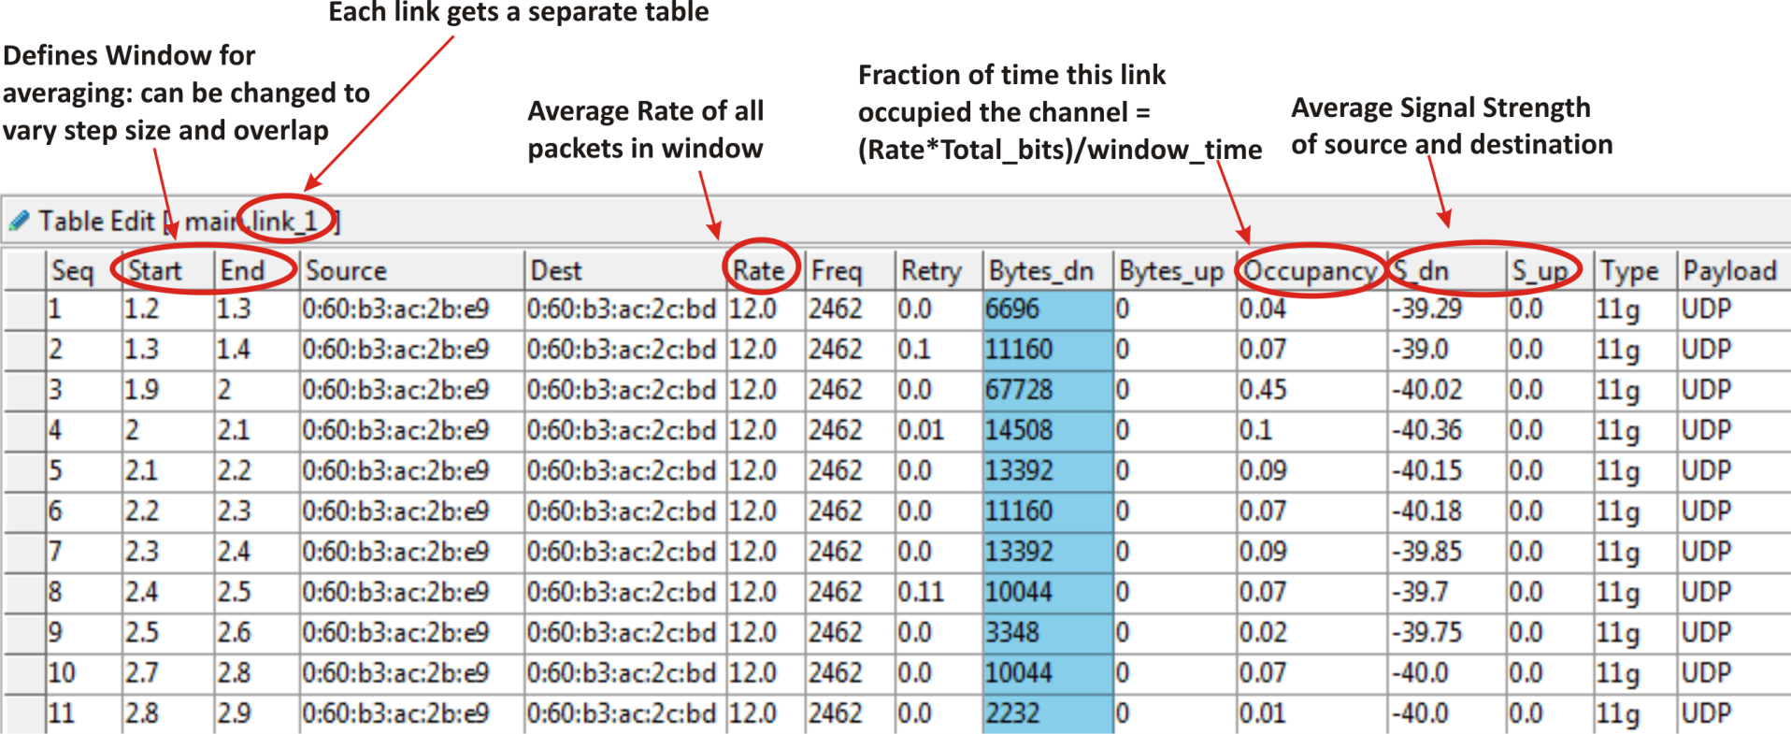
Developing Tools: 802.11
1. 802.11 Sniffing (Promiscuous mode)
Snapshot of a link table from the database
Separate table for each link seen by each sensor
Another table for recording all the beacons seen by the monitors

Slide 14
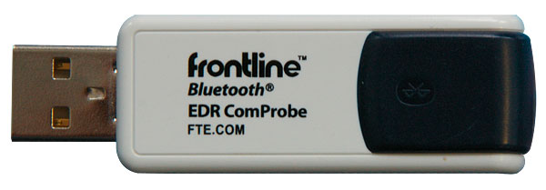
Developing Tools: Bluetooth
2. Bluetooth Packet Sniffing
If the Master BDAddr is known, it is possible to sniff the piconet
But implementation issues due to hardware inaccessibility
Commercial sniffer-FTS4BT ( ~ $10,000 !!) that does this
Snapshot of the Bluetooth sniffing information

Slide 15
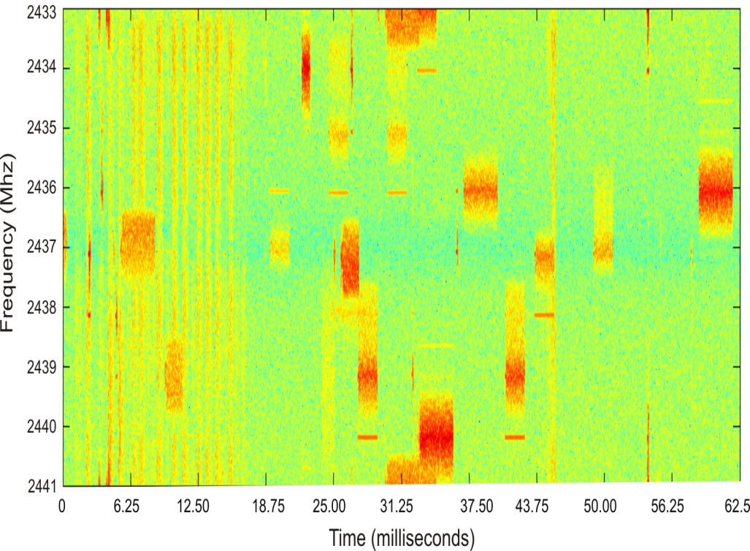
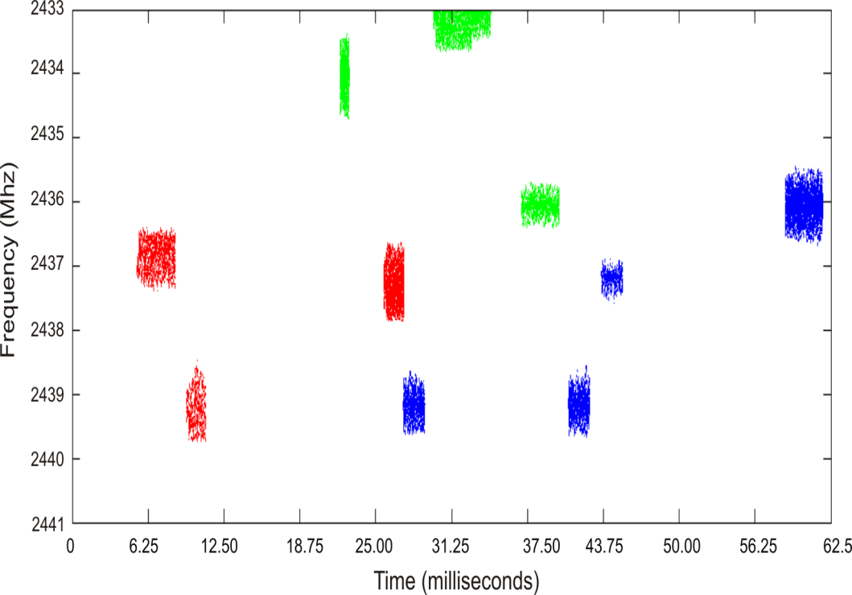
Developing Tools: Spectrum
3. Spectrum Analysis for Bluetooth
Scan narrow band spectrum using USRP-GNURadio
Find high energy 1Mhz bursts in scanned data
Extract start times of each packet detected
Estimate no. of piconets by binning the start times which are separated by an integer number of slots

Slide 16
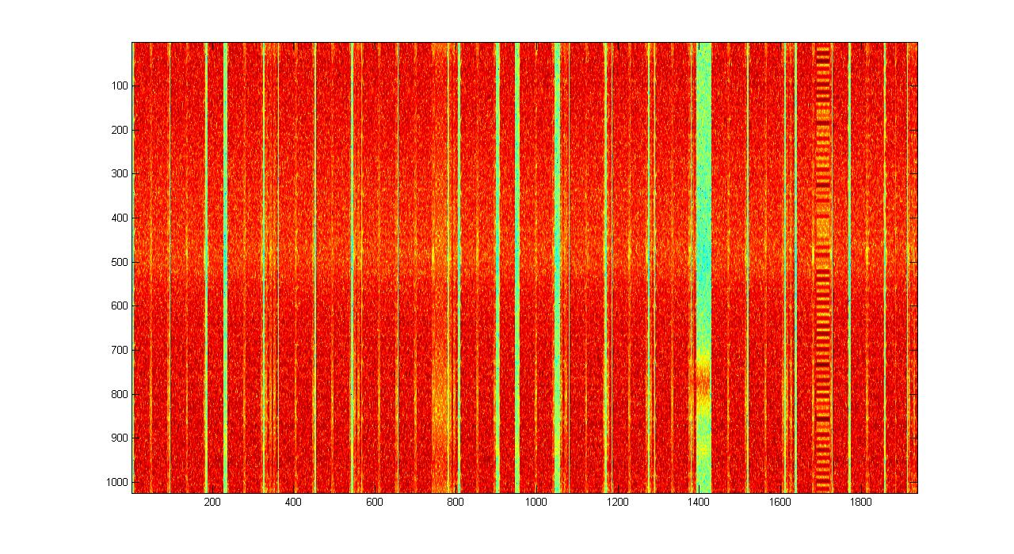
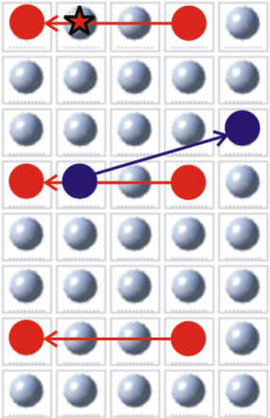
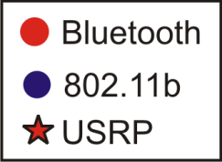
Developing Tools: Bluetooth
Problem Case: High Powered 802.11 nearby
Theoretically possible to detect
with additional processing
802.11b Tx Power: 20dbm (100mW)
Bluetooth Tx Power: 4dbm (2.5mW)
Solution:
Move to another region in the spectrum (Bluetooth present but Interference absent)
Scan between channels 1 & 6, 6 & 11

Slide 17
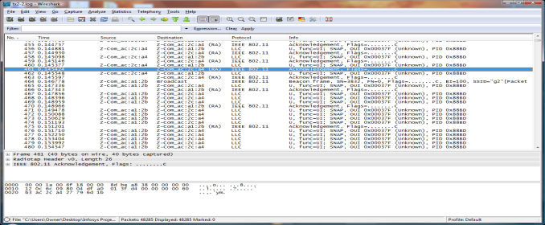
Diagnosis Algorithms
Exploring what the problem is
Developing tools for data collection
Applying diagnosis algorithms
Multi-radio Database
Simplistic Diagnostic Examples
Drop in 802.11 Rate +
Start of Bluetooth capture
Increased no. of MAC retries +
Traffic in adjacent channel
Loss in periodic ZigBee data +
Detection of video stream
ACK reception at monitor but repetitive retransmissions
Spectrum detection of wide-band interferer like Microwave
Continuous Channel hogging as in DoS attack
Many transmissions on same 802.11 channel
Time Synchronized
Time Synchronized

Slide 18
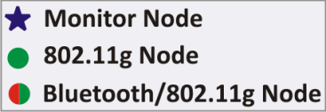
Diagnosis Algorithms
A more concrete example
Throughput
Improvement
25.2 Mbps
24.8 Mbps
Throughput
No. of MAC
retransmissions
19.9 Mbps
Main Link
254 % Increase
14.4 Mbps
15.4 Mbps
Interfering Link
40.3 %
Increase
No
Interference
With
802.11g
With
Bluetooth
With
Bluetooth
With
802.11g
Change
802.11
Channel
Disable
Autorate
HD Video Example: Demo Recording

Slide 19
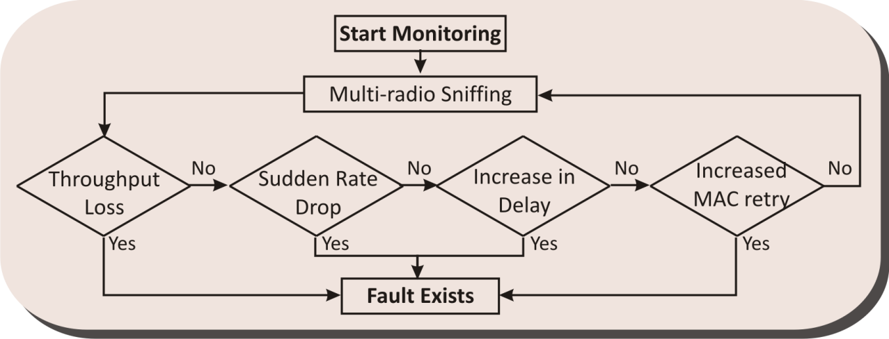
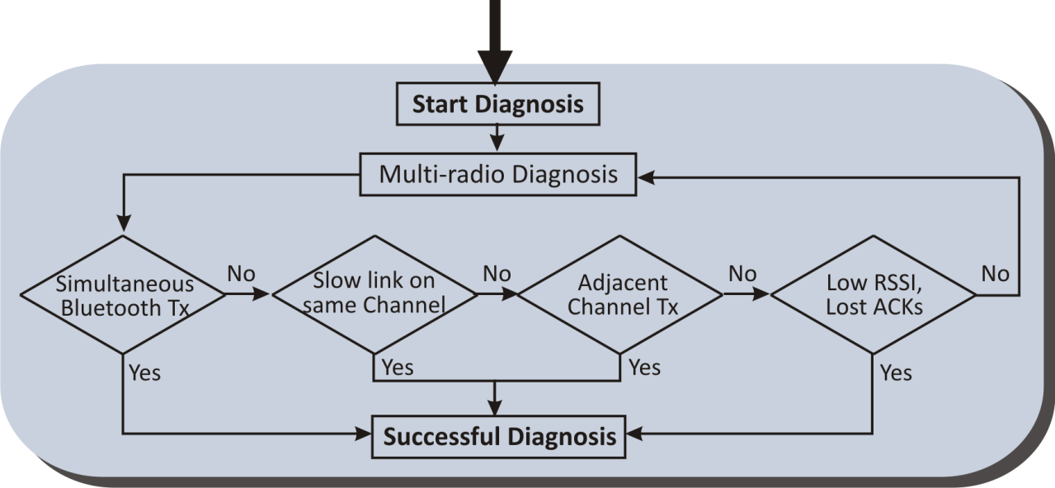
Diagnosis Algorithms
Rule Based Diagnosis
Diagnosis Inference Algorithm
Heuristic Expert System
Multi-radio Sniffing Database
Protocol Specifica-tions
References: [Yan ’09]
[Rayanchu ‘08]

Slide 20
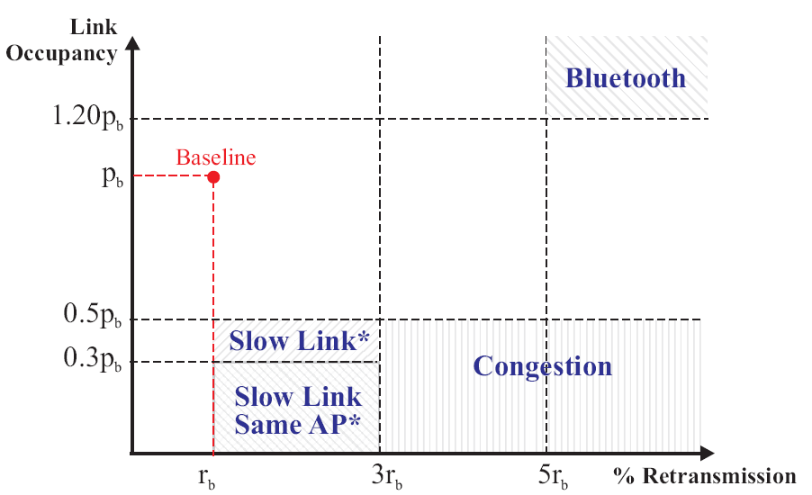
Some Insights
Possible to parameterize interferences based on observables:

Slide 21
Some Insights
Current work on characterization of problems vs parameters: filling up the table
Diagnostic
Parameters
 | Packet Error | Channel Occupancy | Round Trip Time | Rate fallback | % MAC Retries | Packet Collision | Spectral Occupancy
Poor signal strength | X | - | X | X | X | - | -
Excessive traffic | X | X | - | - | - | X | -
Adjacent channel interference
Hidden node problem
Channel hogging by slow link
Co-channel Interference
Microwave Oven Interference
2.4GHz Phone Interference
Bluetooth/ZigBee interference
Deliberate Jamming
Possible
Problems

Slide 22
Diagnosis Algorithms – Open Issues
Main emphasis of research on this aspect of Diagnosis Inference Algorithms
How to design the expert systems
How to choose parameters to sniff & log in database
How to apply data mining techniques for fault detection
Can we have multi-level hierarchical probing
What things can be done after diagnosis
What if we do have a common shared channel
How to make it feasible (cost, time, complexity)

Slide 23
References
[Golmie ’03] N. Golmie, N. Chevrollier, and O. Rebala, “Bluetooth and wlan coexistence: Challenges and solutions,” IEEE Wireless Communications Magazine, vol. 10, pp. 22–29, 2003.
[Shin ’07] S. Y. Shin, H. S. Park, S. Choi, and W. H. Kwon, “Packet error rate analysis of zigbee under wlan and bluetooth interferences,” IEEE Trans on Wireless Commun, vol. 6, no. 8, 2007.
[Jing ‘08] X. Jing, et al., “Distributed coordination schemes for multi-radio co-existence in dense spectrum environments: An experimental study on the orbit testbed,” in Proc. of DySPAN 2008, 3rd IEEE Symposium on New Frontiers in Dynamic Spectrum Access Networks, Oct. 2008.
[Gummadi ‘07] R. Gummadi, D. Wetherall, B. Greenstein, and S. Seshan, “Understanding and mitigating the impact of rf interference on 802.11 networks,” in Proc. of Sigcomm07, 2007.
[Bellardo ’03] J. Bellardo and S. Savage, “802.11 Denial-of-Service Attacks: Real Vulnerabilities and Practical Solutions,” Proc. 11th Usenix Security Symp., Usenix Assoc., 2003.
[Stranne ‘06] A. Stranne, O. Edfors, and B.-A. Molin, “Energy-based interference analysis of heterogeneous packet radio networks.” IEEE Trans on Commun., vol. 54, no. 4, 2006.
[Cheng ’07] Y.-C. Cheng, et al., “Automating cross-layer diagnosis of enterprise wireless networks,” in Proc. of Sigcomm07. ACM Press, , pp. 25–36., 2007.
[Sheth ‘06] A. Sheth, et al., “Mojo: a distributed physical layer anomaly detection system for 802.11 wlans,” in Proc. of MobiSys ’06, 2006.
[Yan ’09] B. Yan and G. Chen, “Model-based Fault Diagnosis for IEEE 802.11 Wireless LANs,” in Proc. of MobiQuitous ‘09, Toronto, Canada, July 2009.
[Rayanchu ‘08] S. Rayanchu, et al., “Diagnosing Wireless Packet Losses in 802.11: Separating Collision from Weak Signal”, in Proc. of IEEE Infocom ‘08, 2008.

