Slide 1
DAISY Data Analysis and Information SecuritY Lab
VibWrite: Towards Finger-input Authentication on Ubiquitous Surfaces via Physical Vibration
Presenter: Jian Liu
Jian Liu†, Chen Wang†, Yingying Chen†, Nitesh Saxena‡,
†WINLAB, Rutgers University, NJ, USA
‡University of Alabama at Birmingham, AL, USA
CCS 2017
Dallas, USA
Oct. 31 – Nov. 3, 2017
Notes:
1

Slide 2
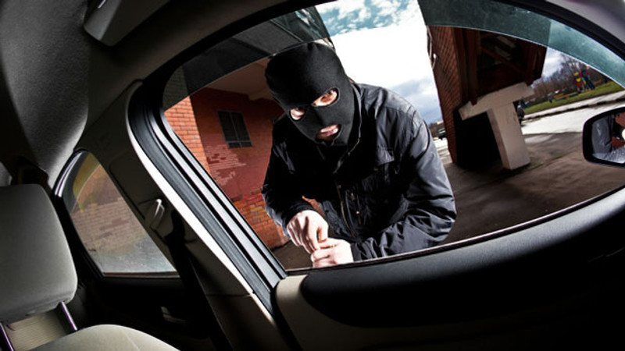
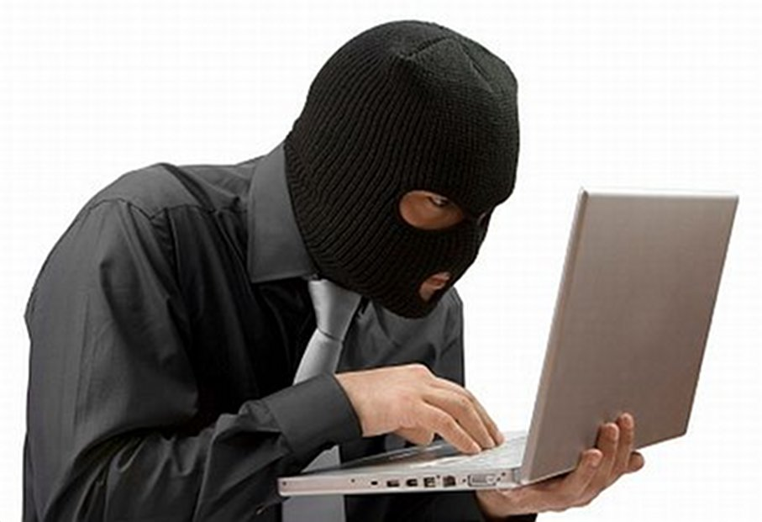
Importance of User Authentication
At almost every corner of our daily lives
Smart access systems require the authentication process to play a broader role
Vehicle Doors
Smart Homes
Apartment Buildings
Private Devices
Secret Documents

Slide 3
Smart Access Systems: Existing Authentication Techniques
Intercom
Camera
Card
Fingerprint
Involve costly equipment, complex hardware installation and diverse maintenance needs
The deployment of smart access systems will reach the market value of $9.8 billion by 2022

Slide 4
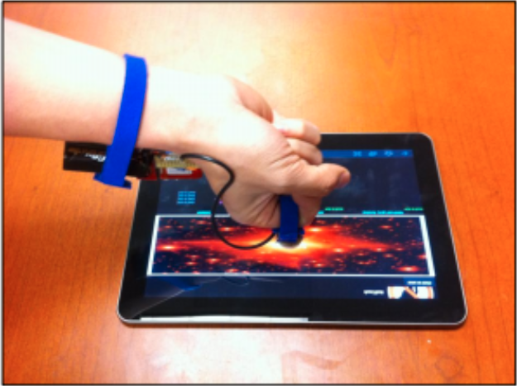
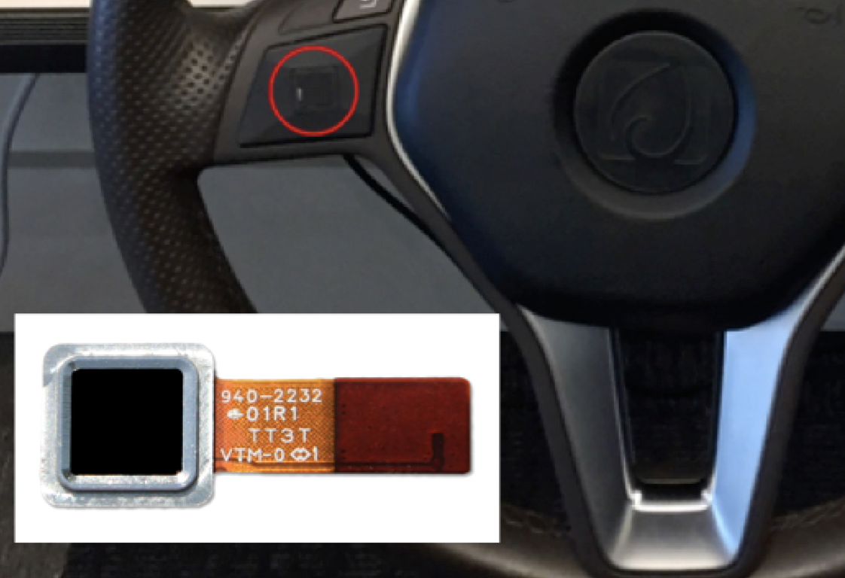
Trend of User Authentication
Low-cost low-power tangible user interfaces
Token devices (e.g., smart glove or pen) on touch screen
Capacitive Touch Authentication
Ultra-thin sensing pad can be deployed in automobiles
Existing techniques require that the touched surface possesses electric conductivity, or specialized sensing pad

Slide 5
Can we push the limits of the touched surface? - support authentication on any surface?
<Mission Impossible 5>
Convert any solid surface to an authentication surface for general user authentication!

Slide 6
Contributions
Finger-input authentication via vibration in smart access systems
Support any solid surface
Capture intrinsic human behavioral and physiological characteristics
Extract unique vibration features from finger-touch

Slide 7
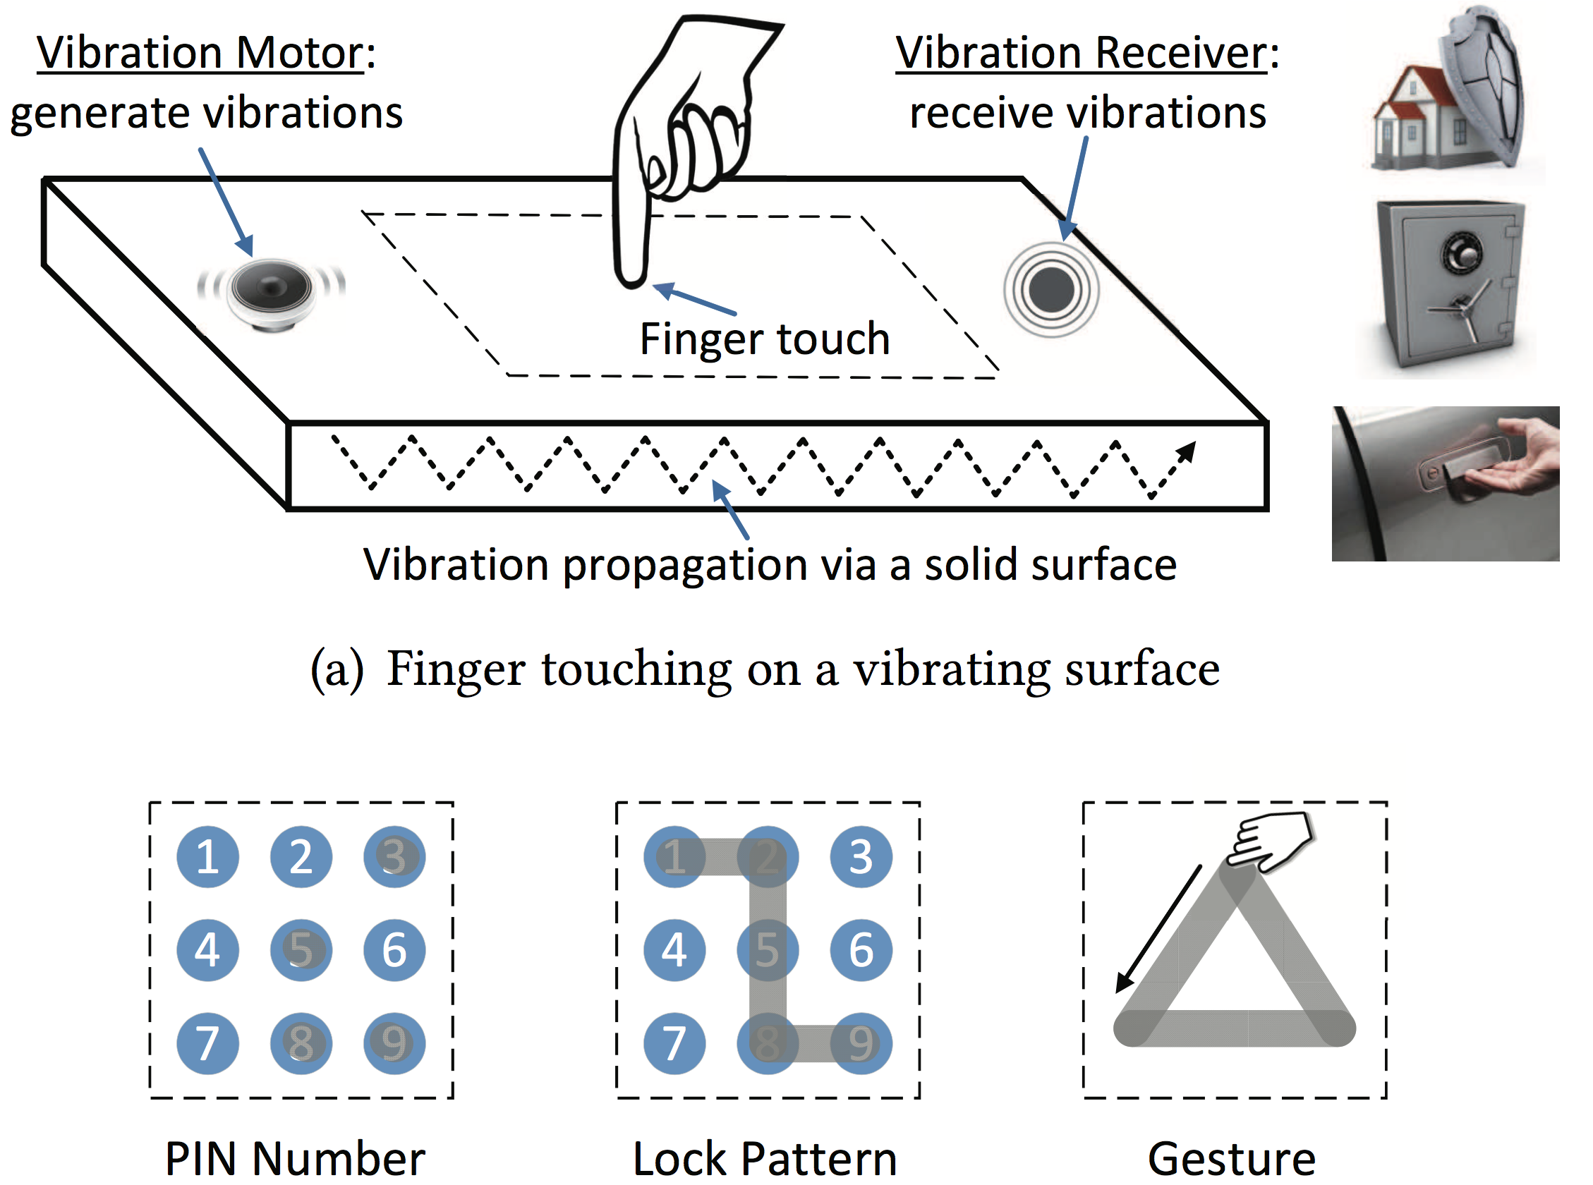
Contributions
Support three types of secrets
Correctly recognize the passcode entered by the legitimate users
Prototype
Notes:
Turn in to

Slide 8
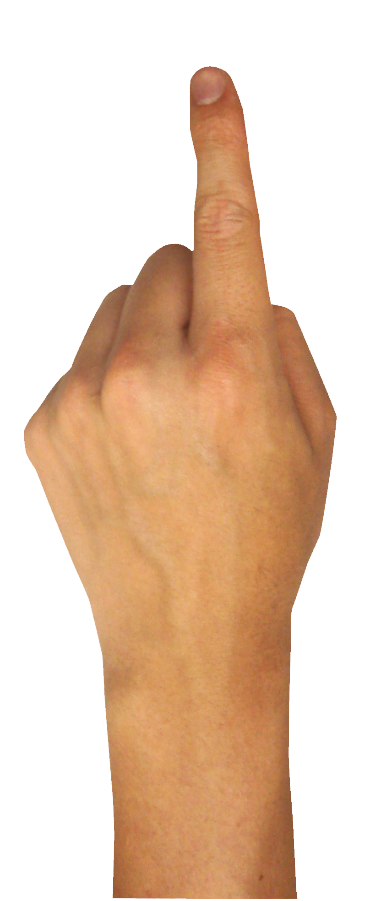
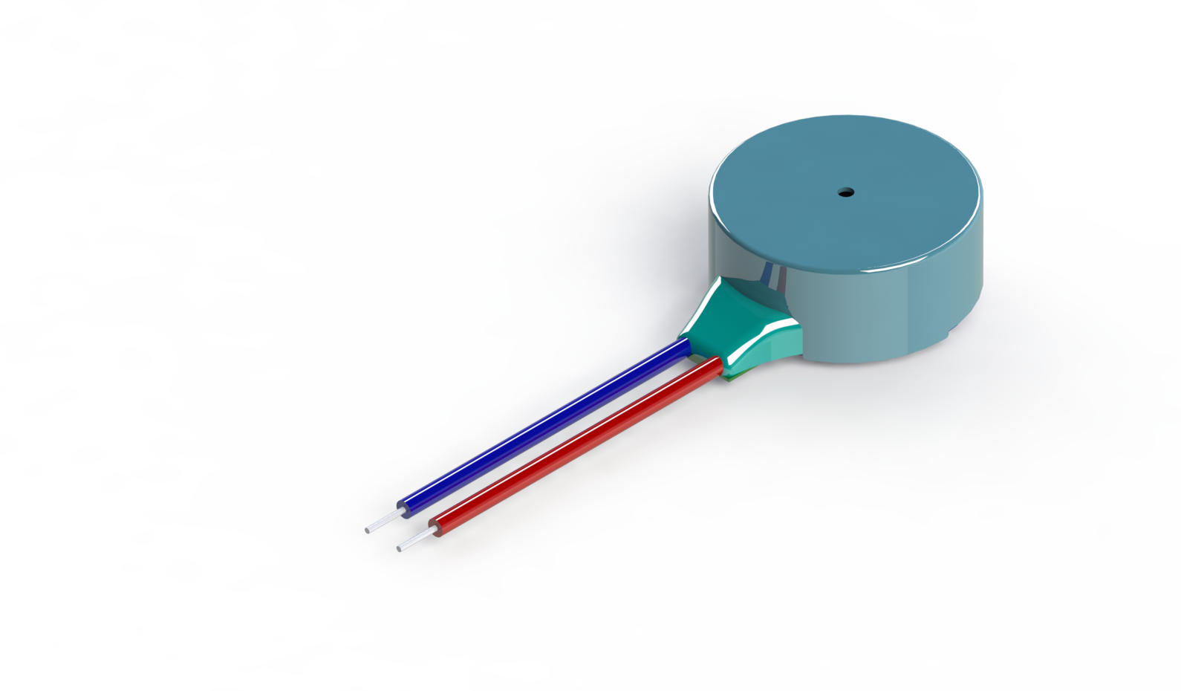
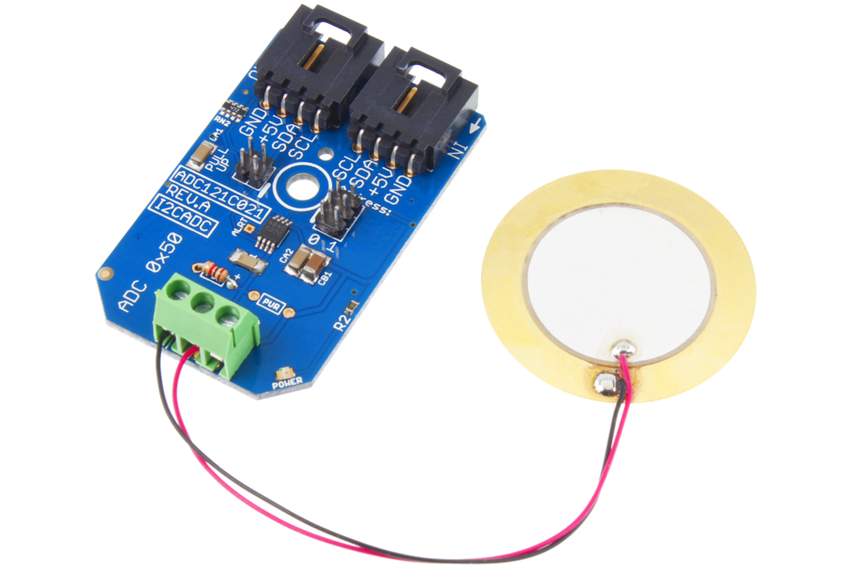
Basic Idea of Touch Sensing
Apply Physical Vibration
Vibration Motor
Vibration Receiver
Actively excite a surface resulting in the shockwave;
Measure the change of the vibration signals to sense touches.

Slide 9
Can we utilize such sensing technique to authenticate users and reject attackers?

Slide 10
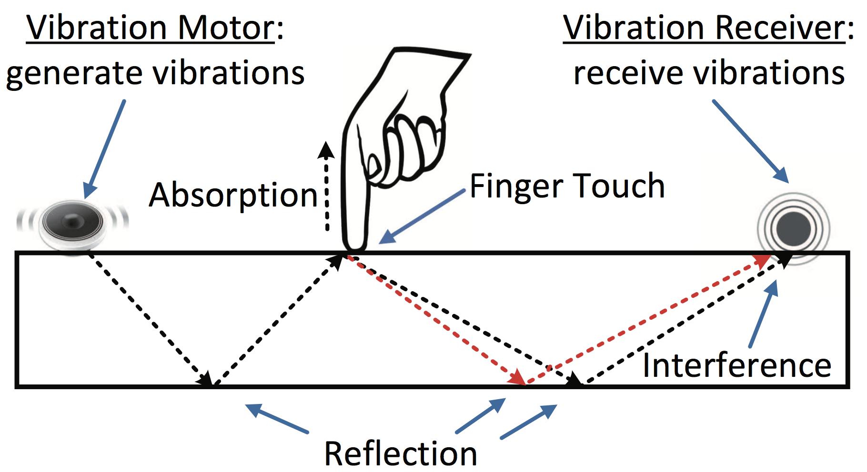
Insights for Authentication
Finger touch: behavioral and physiological characteristics
Unique features are embedded in a user’s finger input
Fingertip size and structure
Locations of touching, contacting area, touching force, etc.

Slide 11
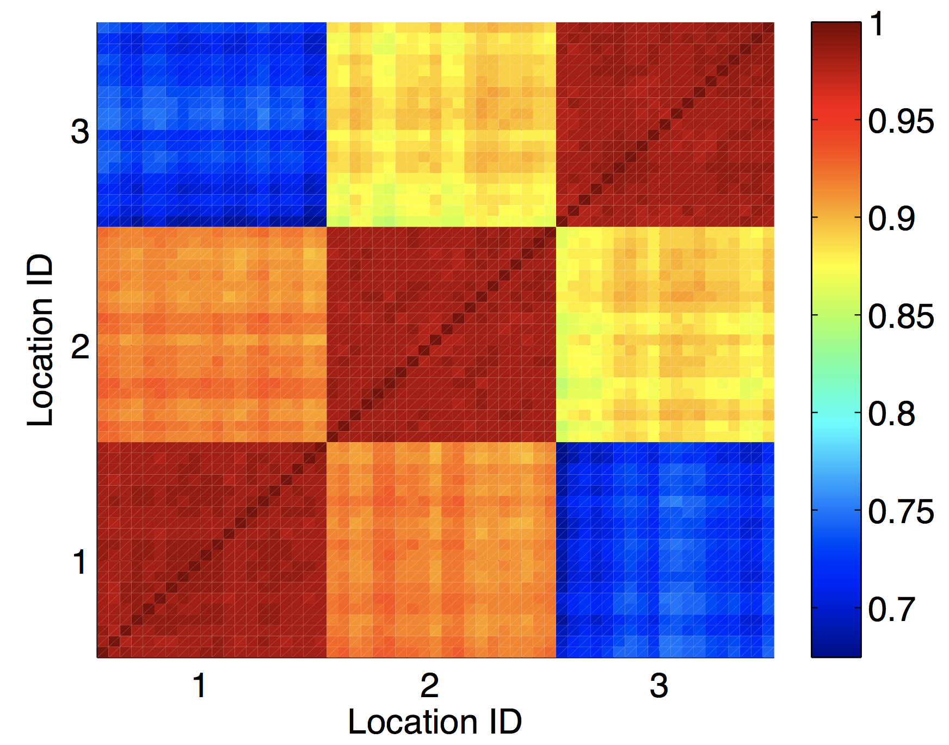
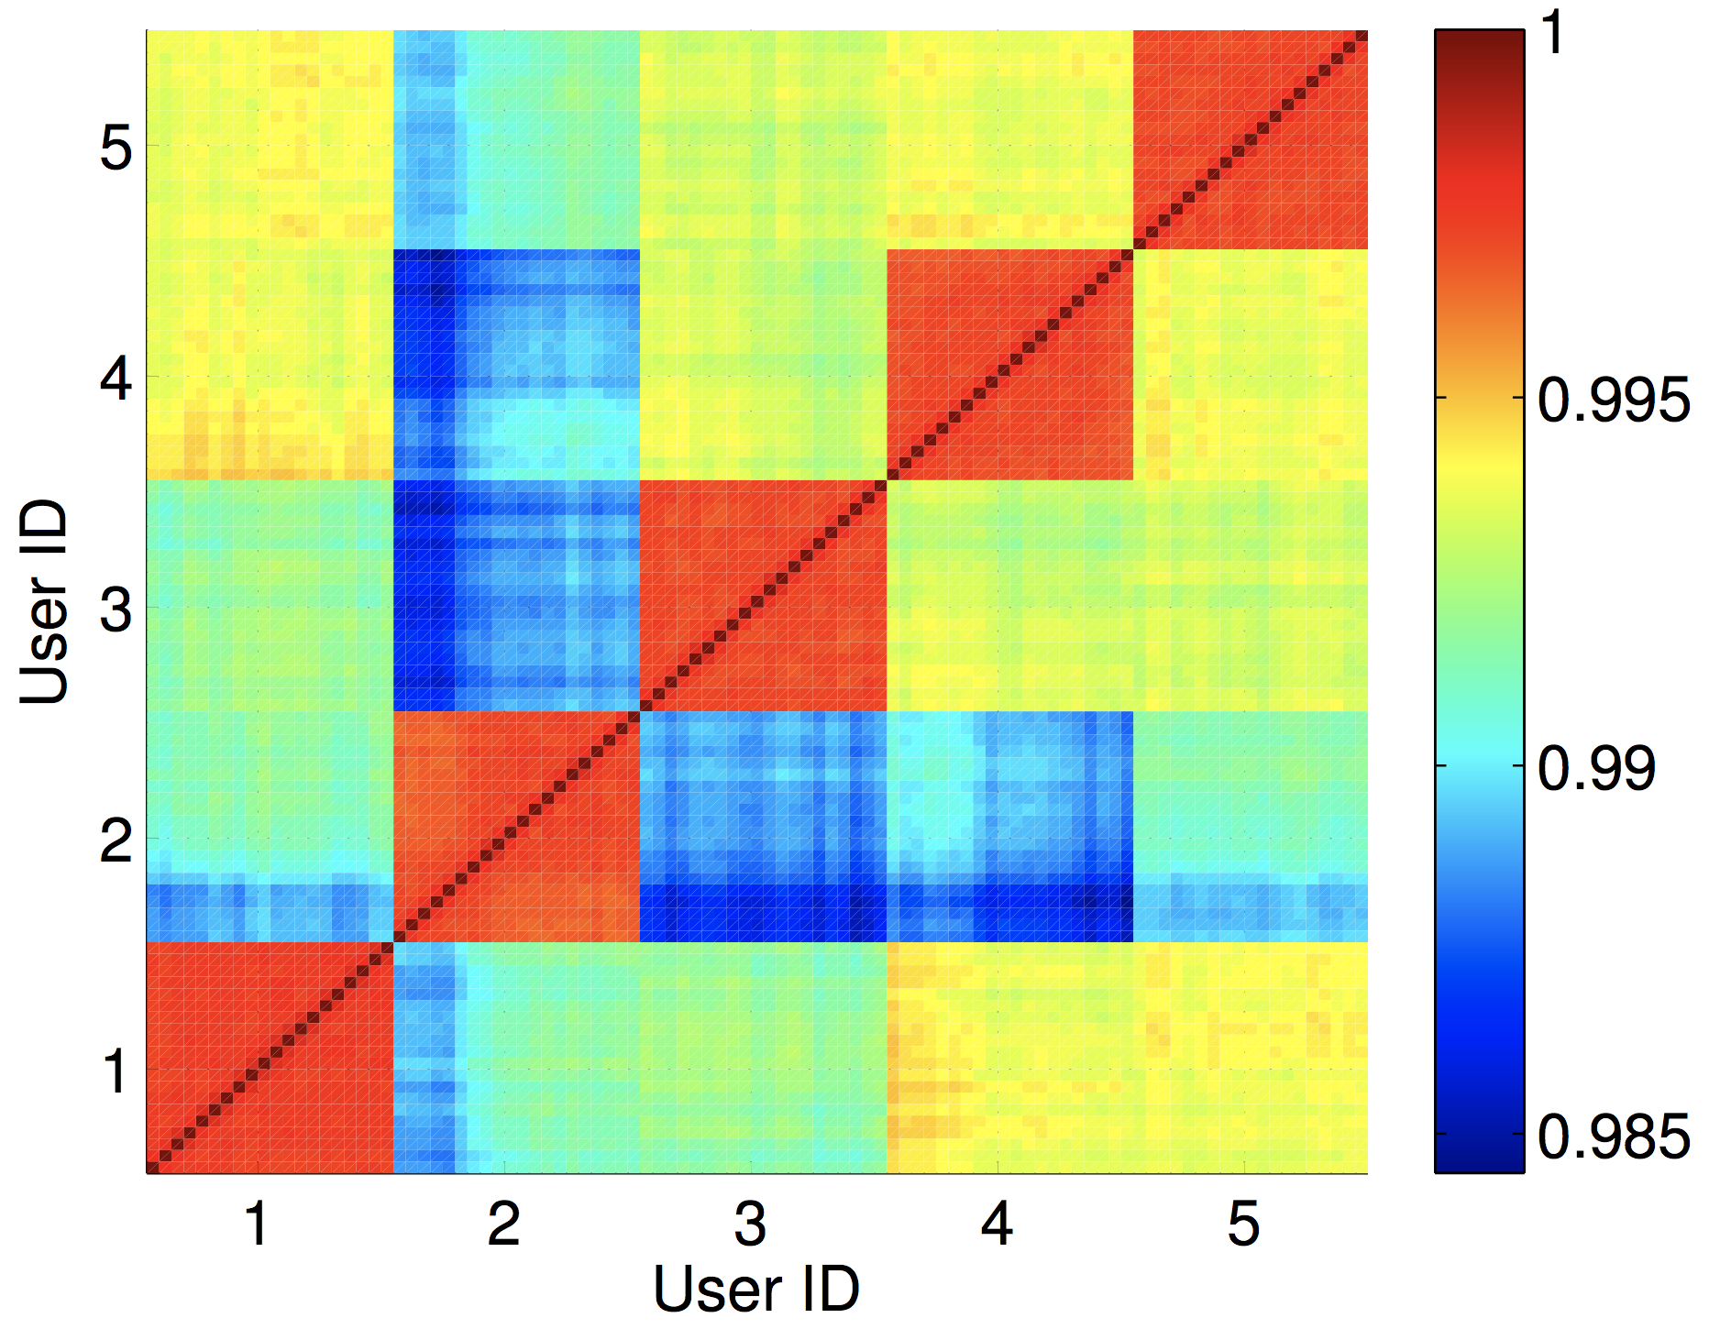
Observations
Pearson correlation (Similarity Comparison)
Same User, Different Location
Different User, Same Location
Key Observations
Discriminate different touching locations and touching fingers
Strongly influenced by unique human behavior/physiological traits

Slide 12
Attack Models
Blind Attack
An adversary randomly touches
Credential-aware Attack
An adversary has the prior knowledge of the legitimate user’s credentials, but does not possess the knowledge of the VibWrite setting details
Knowledgeable Observer Attack
Attackers know the passcodes & how the legitimate users inputs them
Side-channel Attack
Placing hidden vibration receiver & nearby microphones

Slide 13
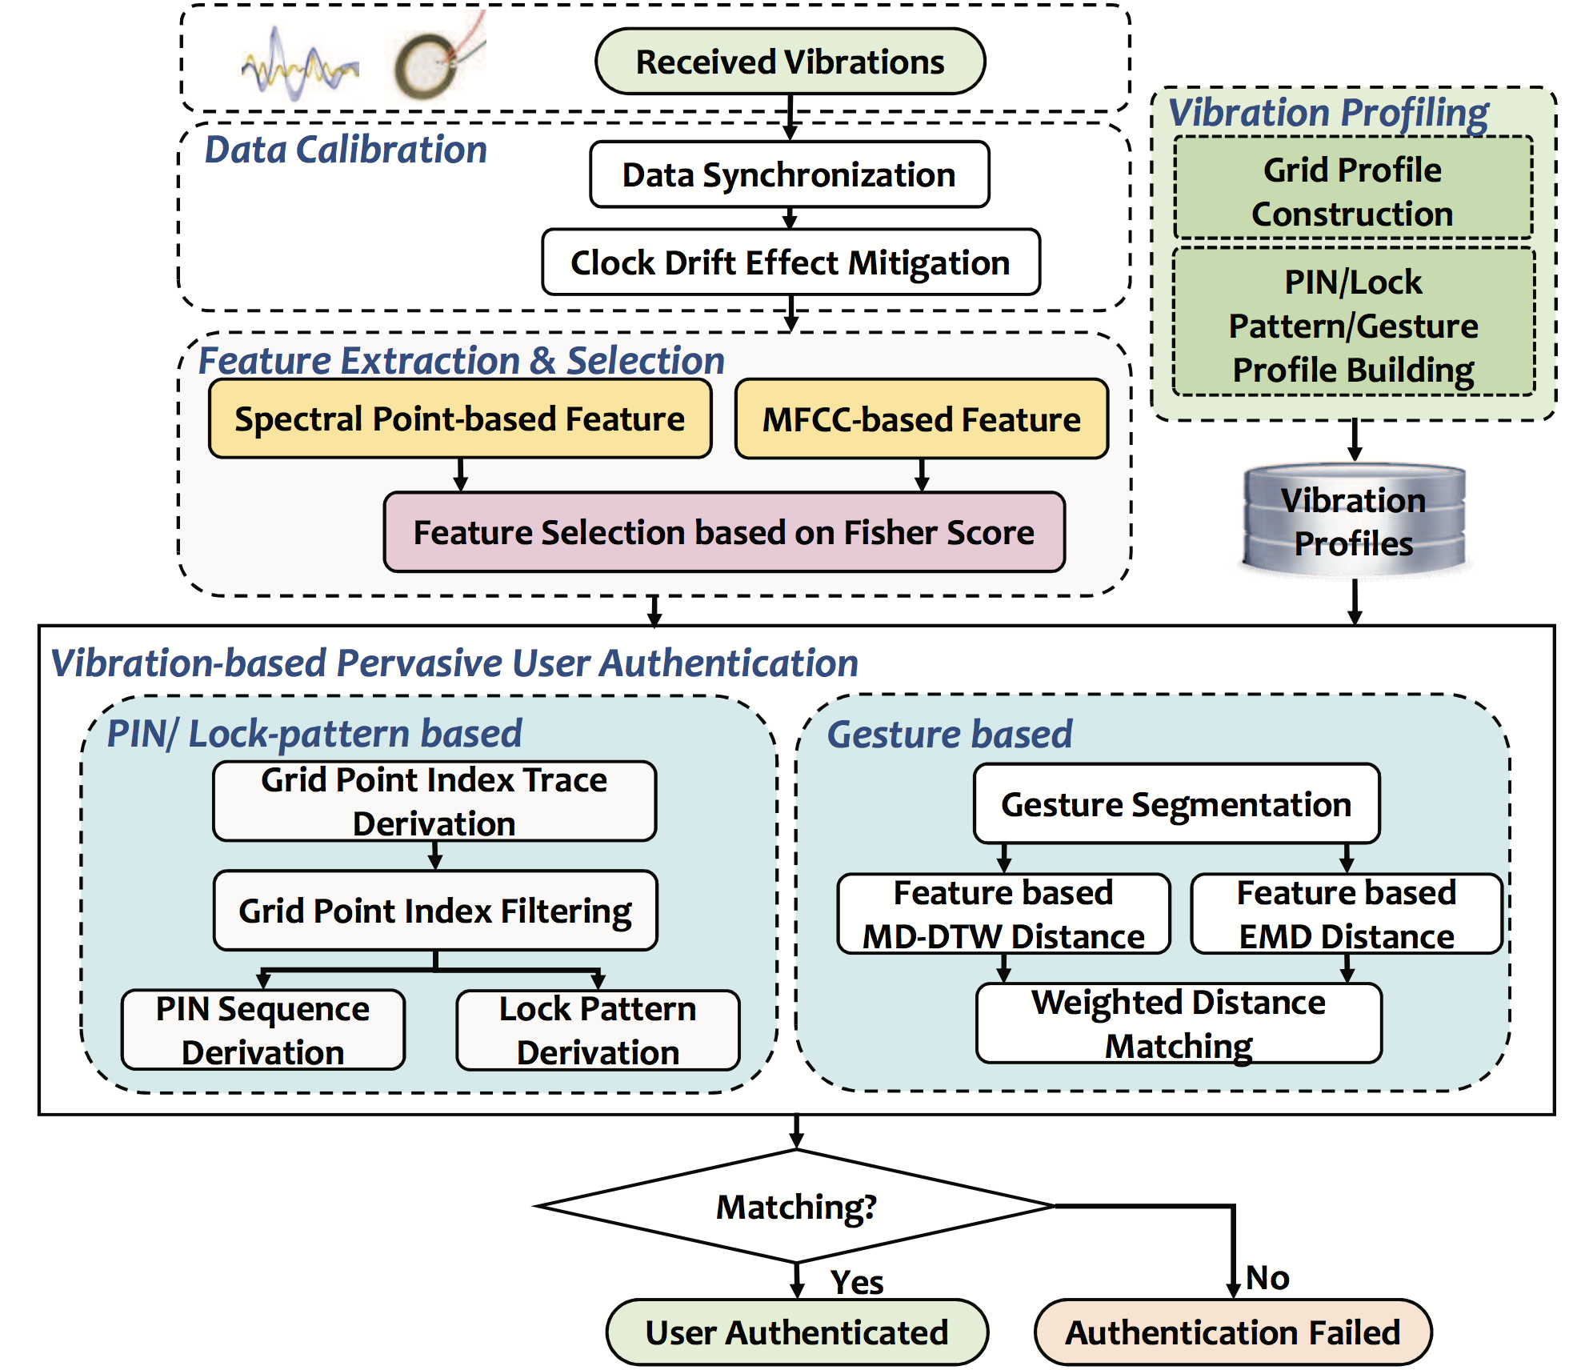
System Overview (VibWrite)
Notes:
Before it, add attack.

Slide 14
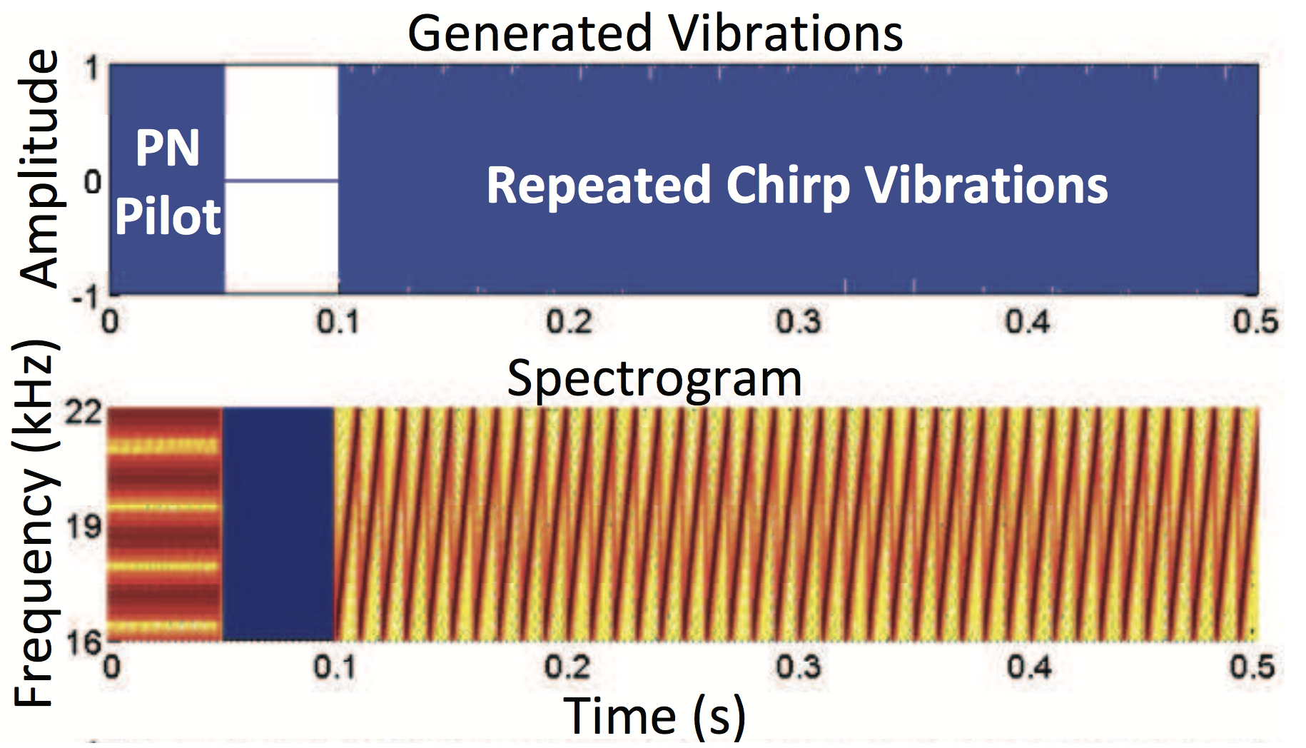
Vibration Signal Design
Repeated chirp vibration signals to linearly sweep frequency from 16kHz to 22kHz
Avoid distracting users
Frequency is much higher than the frequency range of other unrelated noises

Slide 15
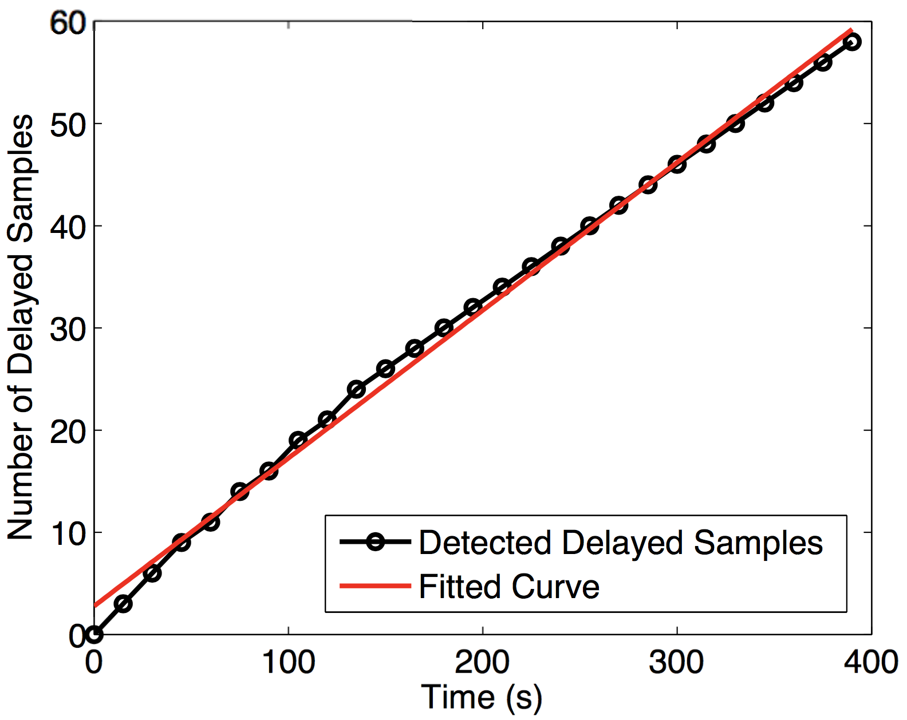
Vibration Signal Calibration
Vibration Signal Synchronization
Using cross-correlation between the PN sequence of the received vibration signal and the known generated PN sequence.
Clock Drift Effect Mitigation
Sampling rate may be not a fixed value over time due to imperfect clock
Estimate the sampling rate offset during a short calibration phase

Slide 16
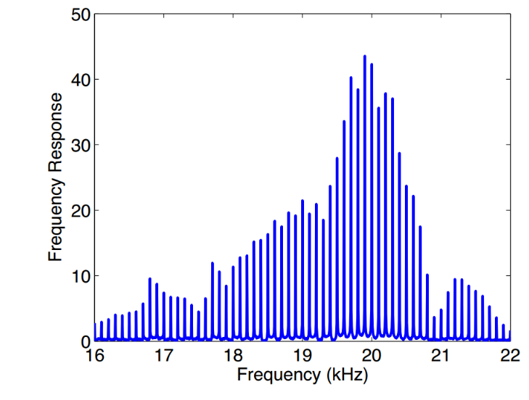
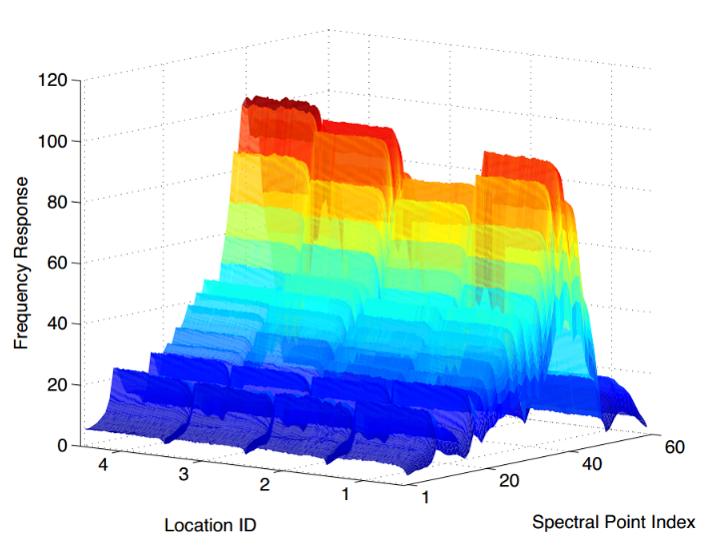
Spectral Point-based Feature Extraction
Analyze the received vibration signals in the frequency domain using a 200ms sliding window (16~22kHz)
Transmitted chirp vibration signal has fundamental frequencies 1/T (100Hz, T=10ms)
Spectral points are the most sensitive to the minute changes caused by finger touching
Spectral points at every 100Hz interval
Distinguishable spectral points when a finger presses 4 different locations

Slide 17
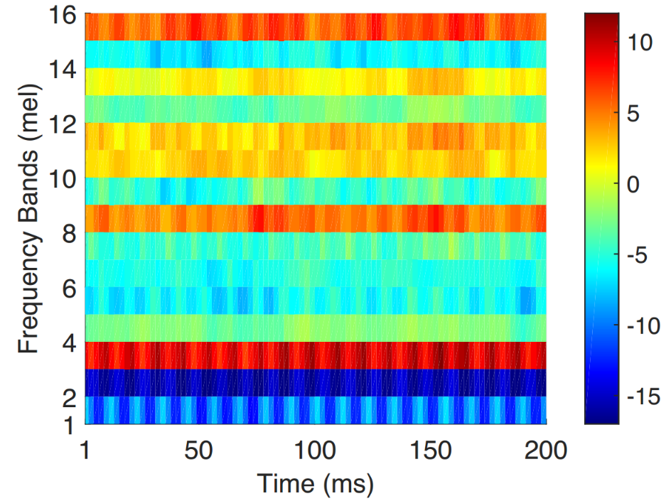
MFCC-based Feature Extraction
Mel-frequency cepstral coefficient (MFCC)
Short-term power spectrum of acoustic signals
Can well capture any changes associated with the vibrating surface
Example of the extracted MFCC features

Slide 18
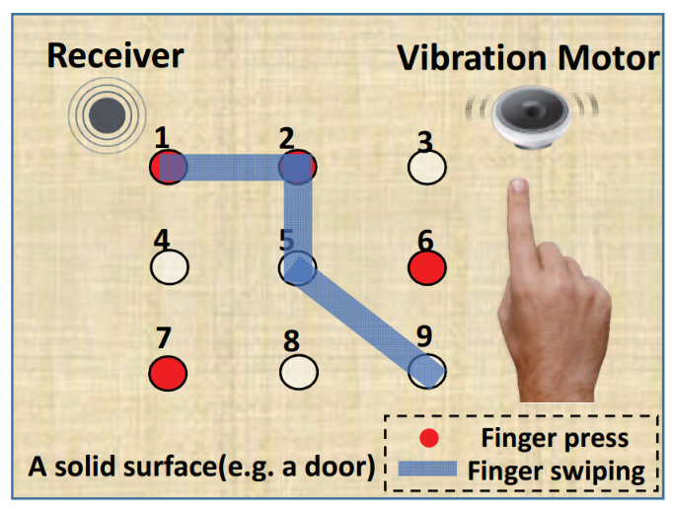
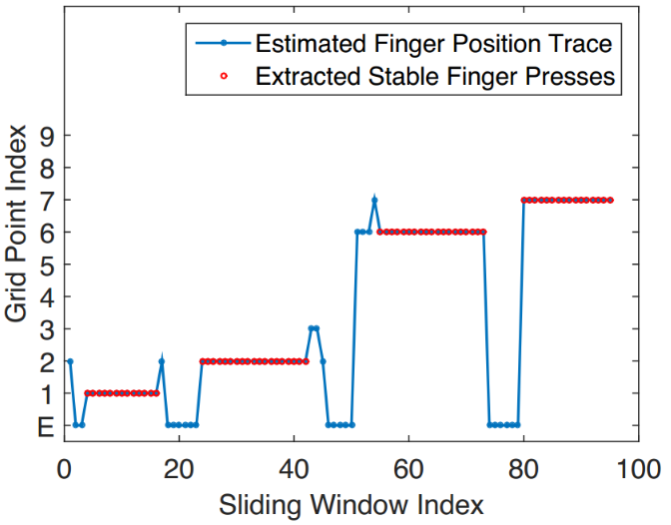
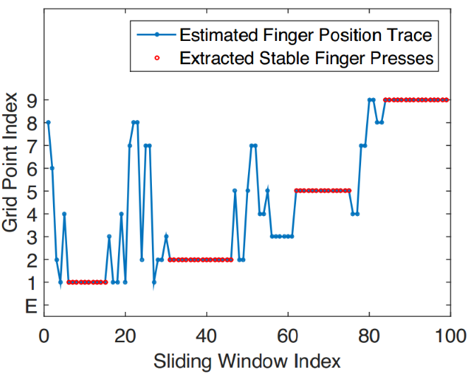
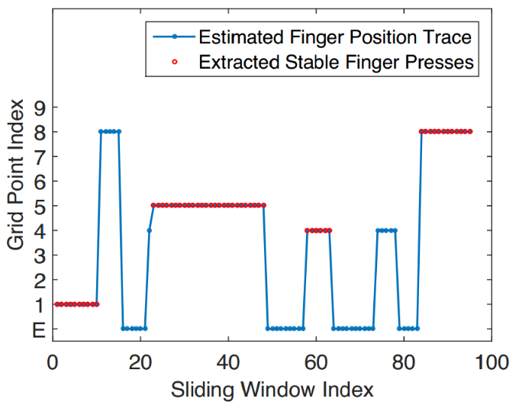
Authentication Using PIN Numbers & Lock Patterns
Deriving Grid Point Index Traces
SVM-based Grid Point Classifier
Grid Point Index Filtering
Segments that have consecutive same grid point indices
PIN Sequence/Lock-pattern Derivation
Remove the finger-press segments with shorter time duration
7
9
6
8
5
4
2
2
5
1
1
1
Passed
Passed
Attacker:Rejected

Slide 19
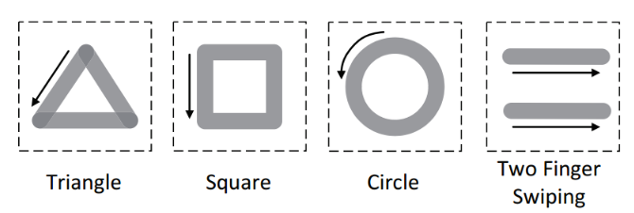
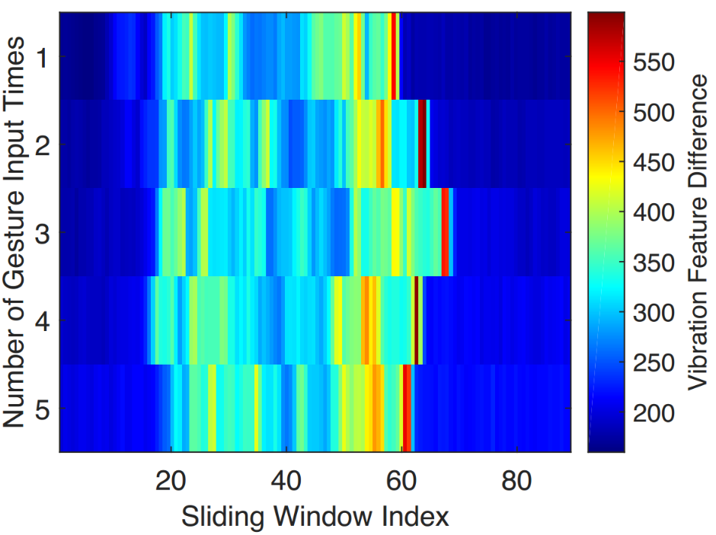
Authentication Using Gesture
Gesture Segmentation
Feature differences (received vibration signals vs. empty surface profile)
Distance Calculation of Feature Sequence
Dynamic Time Warping (DTW)
Earth Mover’s Distance (EMD)

Slide 20
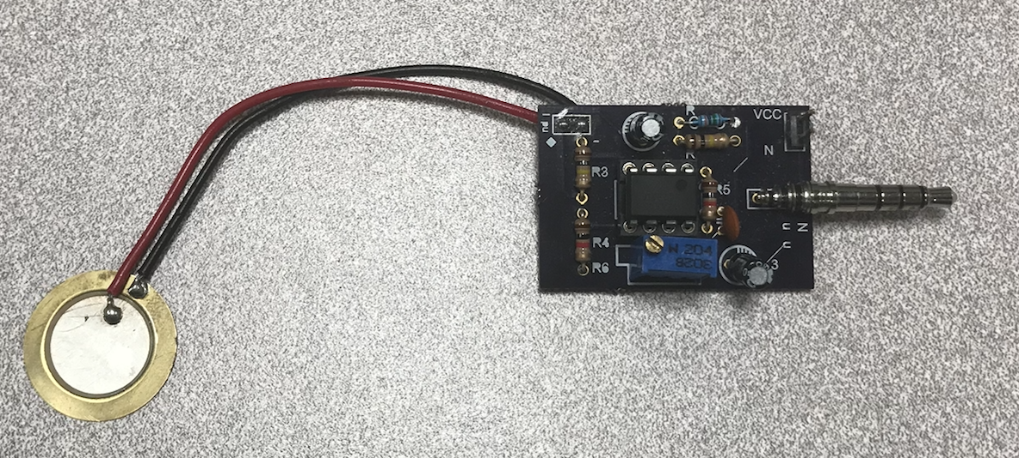
Experimental Setup & Prototyping
3*3 square-shaped grid in a typical office environment
Wooden table
Door panel
Prototyping
Linear Resonant Actuator (LRA) based motor
A piezoelectric sensor
15 participants were involved
450 genuine input passcodes for each motor/receiver placement
Notes:
Add a pic of sensor

Slide 21
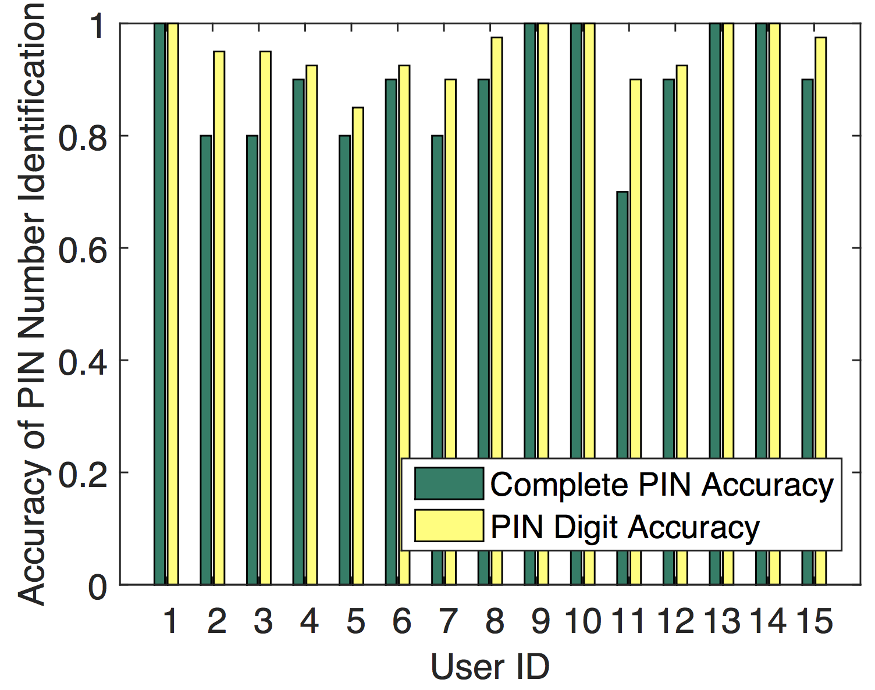
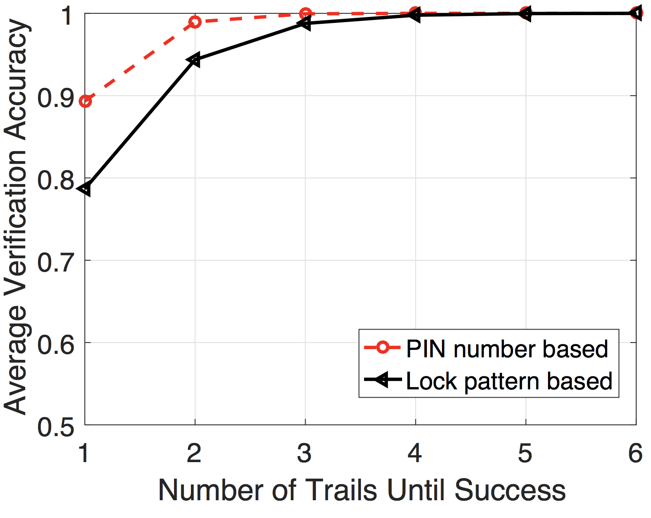
Verifying Legitimate Users
Over 95% verification accuracy of recognizing each PIN digit and recognizing the complete PIN sequence reaches 90%
Average verification accuracy of the lock pattern reaches 95% with two trials

Slide 22
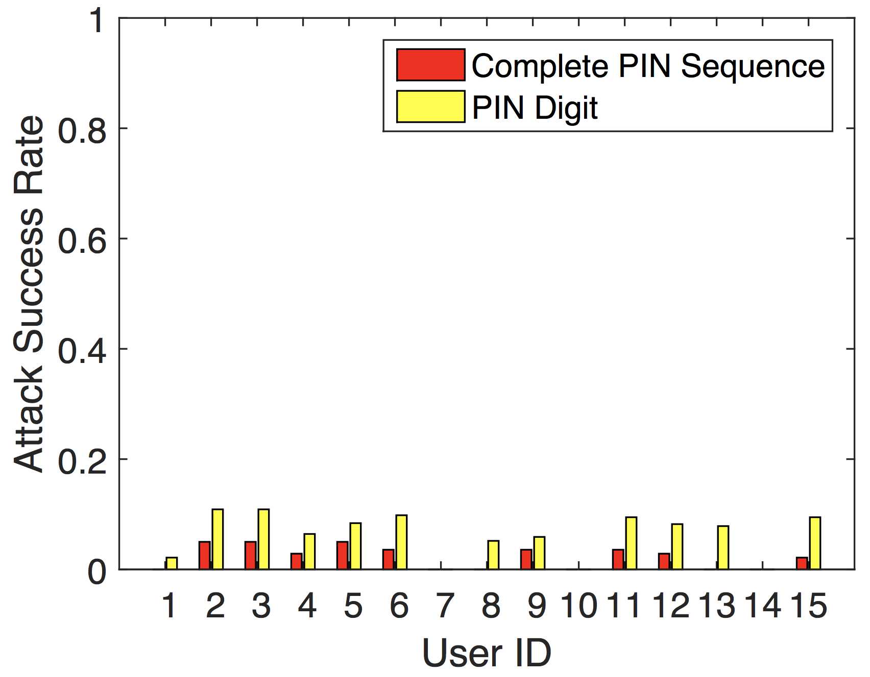
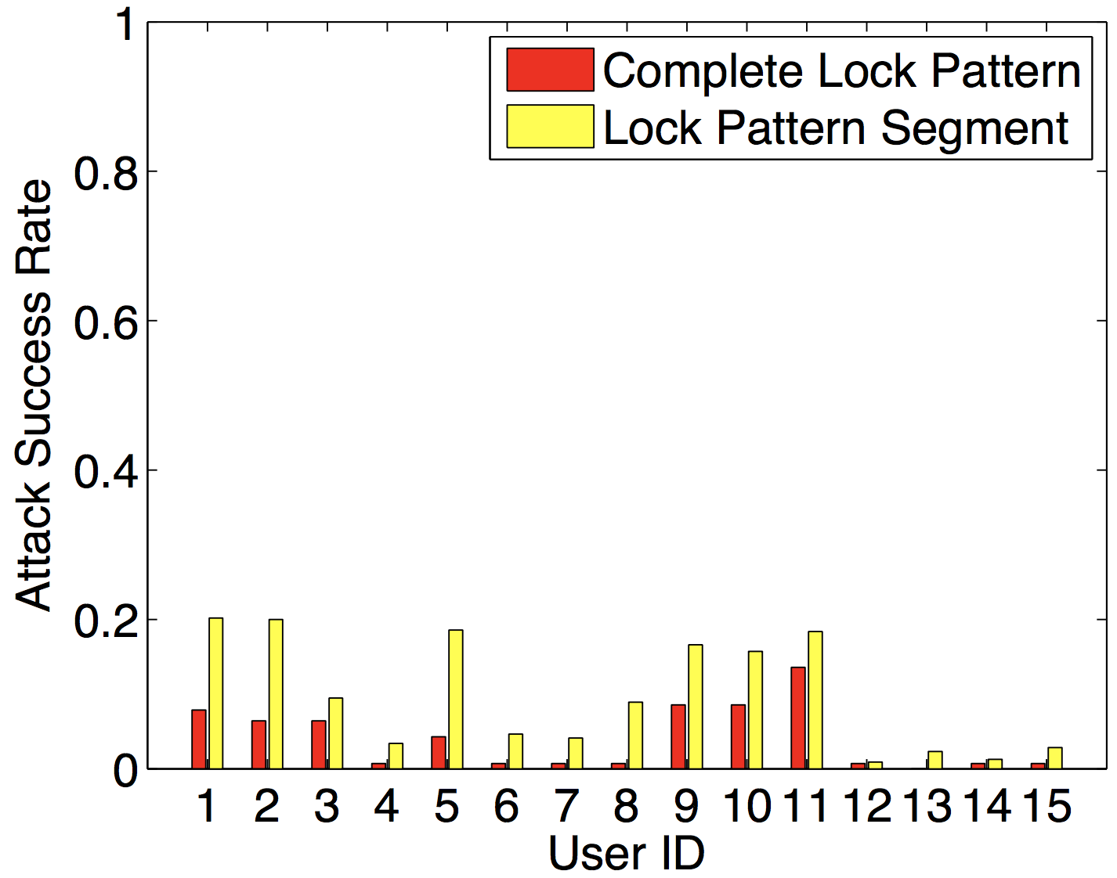
Knowledgeable Observer Attacks
Attackers can break PIN sequences with 2% and lock patterns with 5% success rates

Slide 23
Conclusion
Proposed VibWrite, the low-cost low-power tangible user authentication beyond touch screens on any solid surface
Demonstrated that vibration can capture unique human physiological and behavioral characteristics presenting through finger-input
Implemented a prototype using a single pair of vibration motor and receiver
Demonstrated the robustness of the system under various attacks on different surfaces

Slide 24
Limitations and Future Work
Accuracy, and Further Improvement
Deploying multiple sensor pairs
Refining the hardware
Improving the authentication algorithms
Coping with Additional Physical Attacks
Denial-of-service (DoS) attack
System Maintenance
Dealing with various environmental factors
Notes:
This is just an academic prototype

Slide 25
DAISY Data Analysis and Information SecuritY Lab
Jian Liu
jianliu@winlab.rutgers.edu http://www.winlab.rutgers.edu/~jianliu/

